Slide 1
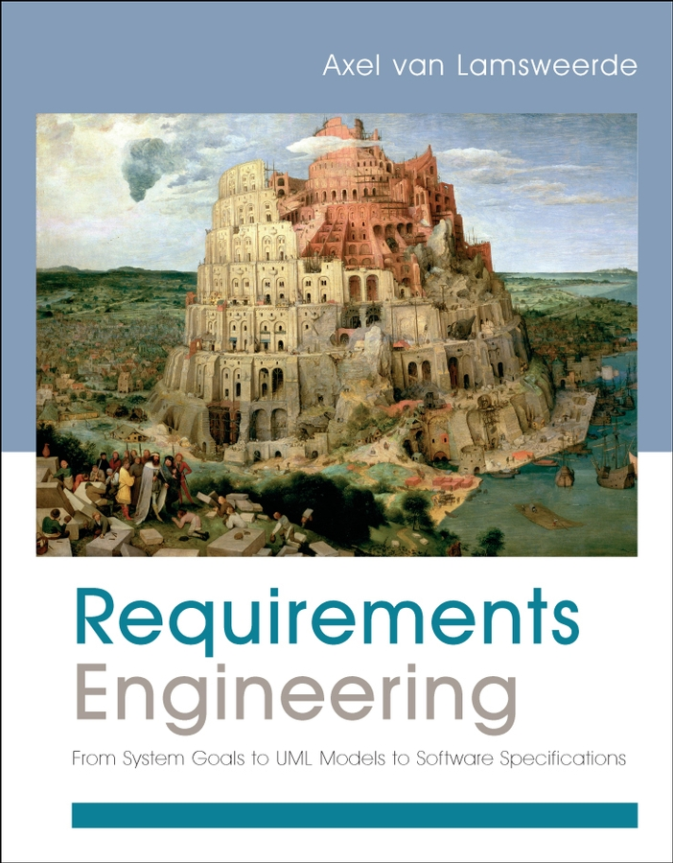
Requirements Engineering From System Goals to UML Models to Software Specifications
Axel Van Lamsweerde

Slide 2
Chapter 16
Semi-Formal Reasoning for Model Analysis and Exploitation

Slide 3
Query-based analysis of the model database
Meta-concepts (goal, refinement, requirement, expectation, obstacle, agent, etc.)
Meta-relationships (responsibility, monitoring/control, performance, input/output, coverage0
Meta-attributes (priority of Goal, fit criterion of SoftGoal, domPost of Operation, multiplicity of Link, etc.)

Slide 4
Checking the structural consistency and completeness of the model
Structural rules – Examples? (p. 538)
pre-cooked queries/rules
intra-view rules

Slide 5
Generation of other views for dedicated analyses
Load analysis (I.e. GET all Responsibility Assignment for Agent Y)

Slide 6
Traceability management
Derivation links:
OR-Ref, AND-Ref (between goals)
Resolution (between goals, obstacles or boundary conditions)
Operationalization (between goals and operations)
Coverage (between goals, scenarios, and state machines)

Slide 7
Traceability management
Use Links
Concern (between goals and objects)
Responsibility ( between goals and agents)
Dependency (among agents for goals)
Monitoring/Control (between agents and objects)
Input/Output (between operations and objects)

Slide 8
Analogical reuse
“mapping well-defined elements of the source model to partially-defined elements of the target model so additional specifications of the target model can be obtained by source-target transposition”

Slide 10
Semi-formal analysis of goal-oriented models
Conflict analysis:
Identification of overlapping assertions
Detection of conflicts among them
Generation of resolutions for the detected conflicts
Selection of the best resolution(s)

Slide 11
Semi-formal analysis of goal-oriented models
Conflict Types:
Potential conflict – a boundary condition could make a set of goals unsatisfiable.
Minimal conflict – potential conflicts that, when removed, no longer result in conflict.
Feasible conflict – a conflict that holds when a trivial boundary condition is met.
Non-trivial conflict – a strong conflict (where the boundary conflict always holds) or obstacle

Slide 12
Semi-formal analysis of goal-oriented models
Threat Analysis
Goals
Anti-goals – intentional obstacle; malicious

Slide 13
Semi-formal analysis of goal-oriented models
Security Threats
Unintentional threat – potential inadvertent violation of a security goal.
Intentional threat – possibility of proactive violation y exploitation of unprotected data, system knowledge through malicious behavior. Countermeasure: know attacker capabilities.

Slide 14
Semi-formal analysis of goal-oriented models
Analyzing Intentional Threats
1. Build threat graphs from anit-goals:
Get initial anti-goals to be refined or abstracted
Identify classes of attackers wishing these, together w/ capabilities
For each initial anti-goal and attacker class:
build an anti-goal refinement/abstraction graph as an argument showing how anti-goal can be satisfied; refinement terminates when leaf conditions are reached that meet attacker's capabilities
2. Derive new security goals as countermeasures to counter the leaf anti-goals from the threat graphs.

Slide 20
Reasoning about alternative options
Qualitative reasoning
assess positive or negative influence on each leaf goal in a model.
Propagate influences from bottom up.
Quantitative reasoning
Model-based score matrices
alternative refinements, assignments, resolutions are taken as options
leaf soft goals are taken as evaluation criteria

Slide 21
Determining option scores
quantity the soft goal prescribes to improve, increase, reduce, maximize or minmize
estimated cost of satisfying the goal
estimated time required to satisfy the goal

Slide 22
Chapters 5 & 17

Slide 23
Formal Methods Background
Three Components of Logic:
Syntax
Semantics
Proof Theory

Slide 24
Propositional Logic
Logical Connectors:
^ (and)
v (or)
¬ (not)
→ (implies)
↔ (equivalent to)

Slide 25
Syntax of Propositional Logic
<atomicProposition> ::= true | false | <propositionalSymbol>
<statement> ::= < atomicProposition> | (¬<statement>) | (<statement> ^ <statement> ) | (<statement> v <statement> ) | (<statement> → <statement> ) | (<statement> ↔ <statement> )

Slide 26
Rules of Inference
Modus Ponens:
P→Q,P
Q
Chaining:
P → Q, Q→ R
P→ R
Resolution:
PvQ, ¬PvR
Q v R

Slide 27
Propositional Logic Example
trainMoving v doorsClosed, trainStopped v trainMoving
What can be derived?

Slide 28
First-Order Predicate Logic
More expressive than propositional logic
Syntax:
<term> ::= <constant> | <variable> | <functionSymbol> (<term>*)
<atomicPredicate> ::= true | false | <predicateSymbol> (<term>*)
<statement> ::= <atomicPredicate> | (¬<statement>) | (<statement> ^ <statement> ) | (<statement> v <statement> ) | (<statement> → <statement> ) | (<statement> ↔ <statement> ) | ( A<variable>)(<statement>) | (Ǝ<variable>) (<statement> )

Slide 29
Formal Methods
… will be covered in greater detail with Chapters 17 and 18.

Slide 40
Exercises Chapter 16

Slide 42
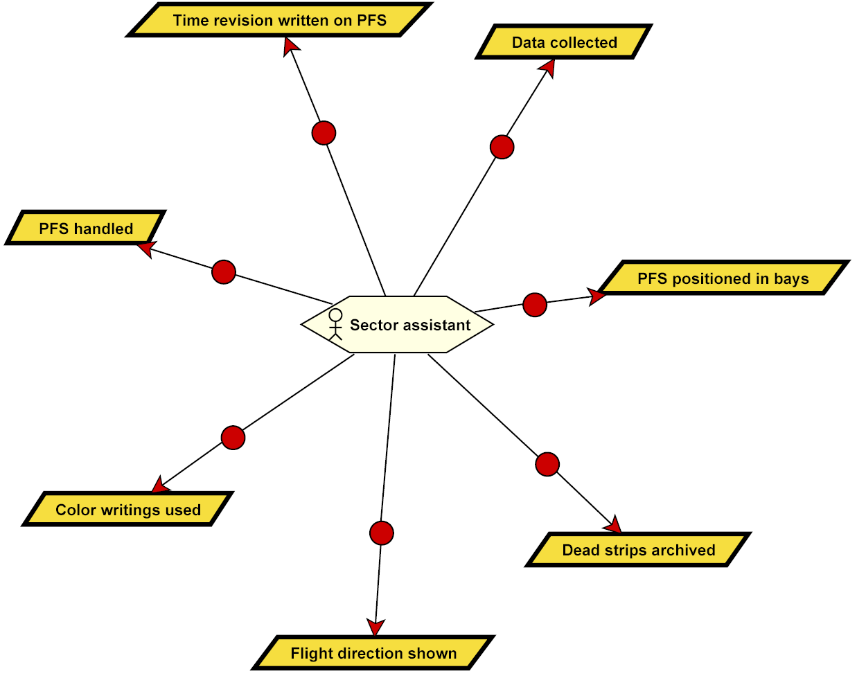
Chapter 16

