Slide 1
Requirements Engineering Basics
SEG3101 (Fall 2018)
Daniel Amyot, University of Ottawa
Based on Powerpoint slides prepared in collaboration with G. Mussbacher
with material from:
Sommerville & Kotonya 1998, Lethbridge & Laganière 2001-2005, Hooks &
Farry 2001, Bray 2002, Pressman 2005, Amyot 2005-2017, Somé 2008, Bochmann 2010

Slide 2
Table of Contents
Definition and Importance of Requirements
Types of Requirements
The Requirements Engineering Process
Requirements Engineering: Main Activities
The beginning is the most important part of the work.¹
[1] Plato, 4 B.C.

Slide 3
Mars Climate Orbiter
Failures Requirements Definition/Importance Requirements Types Development Process Requirements Activities
In 1999, the Mars Climate Orbiter disappears around Mars
Cost: about $125M US
Problem caused by a misunderstanding between a team in Colorado and one in California
One team used the metric system while the other used the English system for a key function…

Slide 4
Québec’s GIRES
Failures Requirements Definition/Importance Requirements Types Development Process Requirements Activities
GIRES¹ (Gestion intégrée des ressources)
  Integrated management of resources
  To replace >1000 existing systems
  In 140 organisations / departments
  Affecting 68000 employees!
8-year project of the Quebec government, started 1998
$80 million budget
Could not cope with changes to the requirements…
  Cost of $400 millions after 5 years, and very late
  Project cancelled in 2003
[1] http://radio-canada.ca/nouvelles/Index/nouvelles/200303/04/012-GIRES.shtml

Slide 5

Canadian Gun Registry^{1,2}
Failures Requirements Definition/Importance Requirements Types Development Process Requirements Activities
Law C-68 adopted in 1995
Was supposed to cost $119M, with revenues
of $117M (net cost of $2M)
30 types of permits, long questionnaires, 90%
of errors in requests
Rising costs ($327M in 2000, $688M in 2002, plus others…)
Many political and legal issues, and a few scandals…
Customer asked for 2000+ changes in the computer system!
~$1B in 2004, probably ~$2B by the time the system is fully functional…
General auditor finds requirements/evolution problems
Tons of unhappy customers and taxpayers…
Not required to register as of May 17, 2006!
Bill C-391 passed in April 2012…
[1] http://en.wikipedia.org/wiki/Canadian_gun_registry
[2] http://radio-canada.ca/actualite/zonelibre/04-02/registre_armes.asp

Slide 6
Canada’s Phoenix Payroll System
Failures Requirements Definition/Importance Requirements Types Development Process Requirements Activities
Centralization of payroll systems in Miramichi, N.-B.
Planned savings of $70M annually
156,035/313,734 (50%) public servants not paid properly for months (mainly supplementary/over-time pay, adjustments, parental leaves, long-term disability, health/dental benefits…)
Anger, credit cards maxed out, unpaid bills, bad reputation!
$25M in fixes as of August 24, 2016
Another $142M announced in May for hiring HR and for fixes
Projecting $2.2G costs by 2023 instead of $300M (31 July 2018)
“It’s like 101 companies, basically, coming together with like 27 collective bargaining agreements; it’s 80,000 different rules.”
Created by IBM, based on PeopleSoft
  PeopleSoft is the software used for the new Student Information System at uOttawa, deployed November 7, 2016...
Will be entirely replaced (23 August 2018)…
  Will we do better next time?

Slide 7
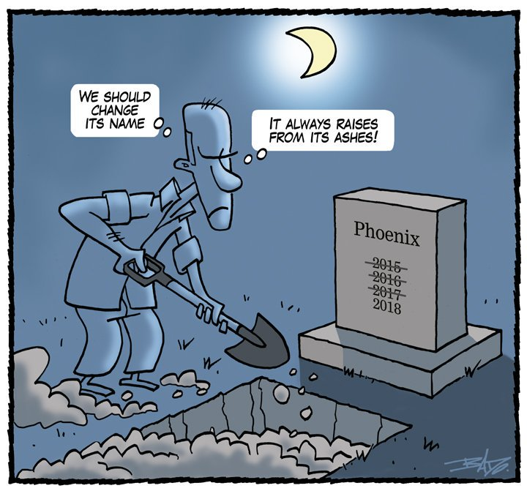

Slide 8
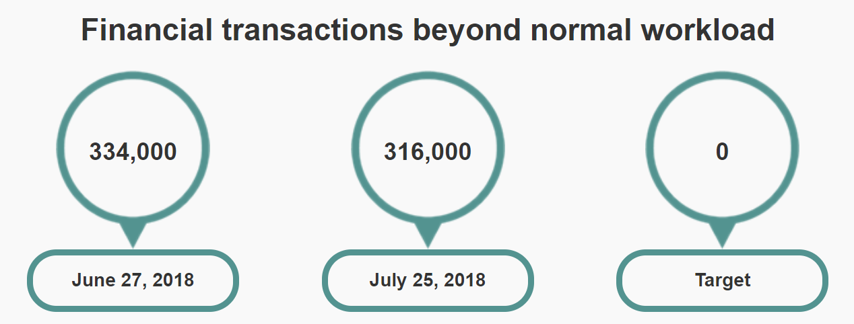
Team Discussion
Failures Requirements Definition/Importance Requirements Types Development Process Requirements Activities
Why isn’t Canada’s Phoenix system yet fixed?
Why isn’t uOttawa’s new Student Information System better?
https://www.tpsgc-pwgsc.gc.ca/remuneration-compensation/services-paye-pay-services/centre-presse-media-centre/mise-a-jour-update-eng.html

Slide 9
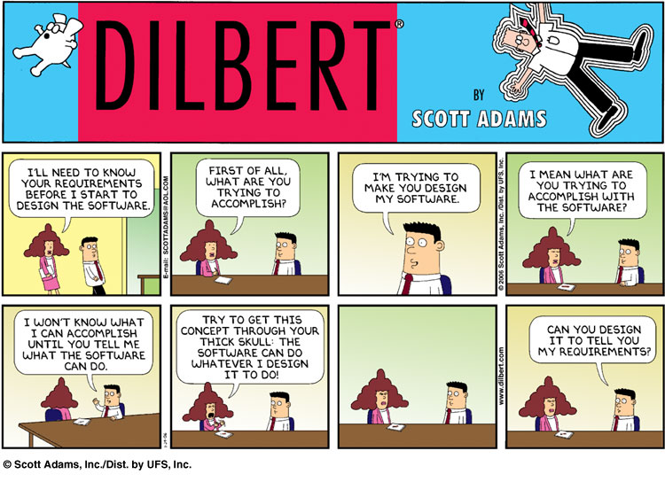
Lessons From a Decade of IT Failures
http://spectrum.ieee.org/static/lessons-from-a-decade-of-it-failures

Slide 10
Definition and Importance of Requirements

Slide 11
You said “Requirements”?
Failures Requirements Definition/Importance Requirements Types Development Process Requirements Activities
A requirement is:
  Capturing the purpose of a system
  An expression of the ideas to be embodied in the system or application under development
  A statement about the proposed system that all stakeholders agree must be made true in order for the customer’s problem to be adequately solved
    Short and concise piece of information
    Says something about the system
    All the stakeholders have agreed that it is valid
    It helps solve the customer’s problem
  A statement which translates or expresses a need and its associated constraints and conditions [IEEE 29148-2011].
  In French: exigence, requis, besoin

Slide 12
You said “Requirements Engineering”?
Failures Requirements Definition/Importance Requirements Types Development Process Requirements Activities
Requirements Engineering (RE) is:
  The activity of development, elicitation, specification, analysis, and management of the stakeholder requirements, which are to be met by a new or evolving system
Standard definition: RE is the interdisciplinary function that mediates between the domains of the acquirer and supplier to establish and maintain the requirements to be met by the system, software or service of interest. RE is concerned with discovering, eliciting, developing, analyzing, determining verification methods, validating, communicating, documenting, and managing requirements [IEEE 29148] .

Slide 13
You said “Requirements Engineering”?
Failures Requirements Definition/Importance Requirements Types Development Process Requirements Activities
Not a phase
or stage!
Requirements Engineering is a set of activities concerned with eliciting, analyzing and communicating the purpose of a (software-intensive) system, and the contexts in which it will be used. Hence, RE acts as the bridge between the real world needs of stakeholders, affected by the system-to-be, and the capabilities and opportunities afforded by (software-intensive) technologies
Communication
is as important
as the analysis
Designers need to
know how and where
the system will be used
Quality means
fitness-for-purpose.
Cannot say anything
about quality unless you understand the purpose
Requirements are
partly about what
is really needed…
…and partly about
what is possible
Need to identify all the stakeholders - not just customers and users
[J. Mylopoulos, 2016]

Slide 14
Requirements Engineering Activities
Failures Requirements Definition/Importance Requirements Types Development Process Requirements Activities
Requirements Engineering
Requirements Inception
Requirements Development
Requirements Management
Elicitation
Analysis
Specification
Verification
Source: Larry Boldt, Trends in Requirements Engineering People-Process-Technology, Technology Builders, Inc., 2001

Slide 15
About these RE Activities…
Failures Requirements Definition/Importance Requirements Types Development Process Requirements Activities
Inception
  Start the process (business need, market opportunity, great idea, ...), business case, feasibility study, system scope, risks, etc.
Requirements elicitation
  Requirements discovered through consultation with stakeholders
Requirements analysis and negotiation
  Requirements are analyzed and conflicts resolved through negotiation
Requirements specification
  A precise requirements document is produced
Requirements validation
  The requirements document is checked for consistency and completeness
Requirements management
  Needs and contexts evolve, and so do requirements… constantly!

Slide 16
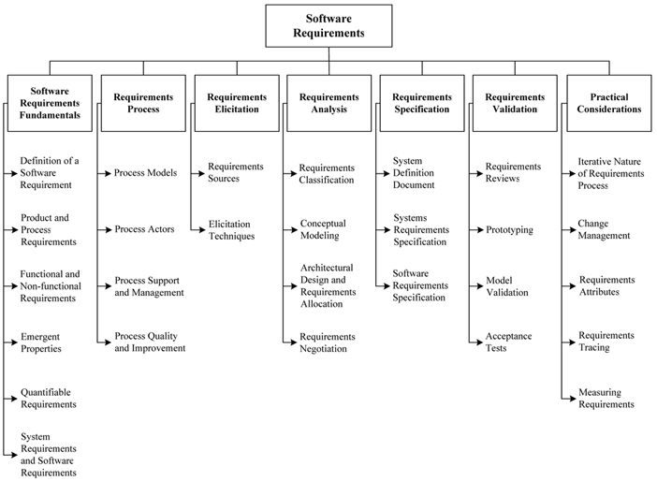
SWEBOK’s Perspective (2013)
Failures Requirements Definition/Importance Requirements Types Development Process Requirements Activities
http://www.computer.org/portal/web/swebok/html/ch2

Slide 17
General Problems with the Requirements Process
Failures Requirements Definition/Importance Requirements Types Development Process Requirements Activities
Lack of the right expertise (software engineers, domain experts, etc.)
Initial ideas are often incomplete, wildly optimistic, and firmly entrenched in the minds of the people leading the acquisition/design process
Difficulty of using complex tools and diverse methods associated with requirements gathering may negate the anticipated benefits of a complete and detailed approach
Change management

Slide 18
Why Focus on Requirements ?
Failures Requirements Definition/Importance Requirements Types Development Process Requirements Activities
Distribution of Defects
Distribution of Effort to Fix Defects
Code
7%
Code
1%
Other
4%
Design
13%
Requirements
56%
Other
10%
Requirements
82%
Design
27%
Source: J. Martin / D. Leffingwell

Slide 19
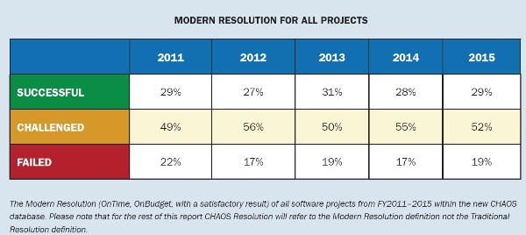
Chaos Report, 2015 (Standish Group)
Failures Requirements Definition/Importance Requirements Types Development Process Requirements Activities
https://www.infoq.com/articles/standish-chaos-2015

Slide 20
Evolution of Success Factors
Failures Requirements Definition/Importance Requirements Types Development Process Requirements Activities
Source: Standish Group Inc., 2000. See 2012 report at http://versionone.com/assets/img/files/CHAOSManifesto2012.pdf

Slide 21
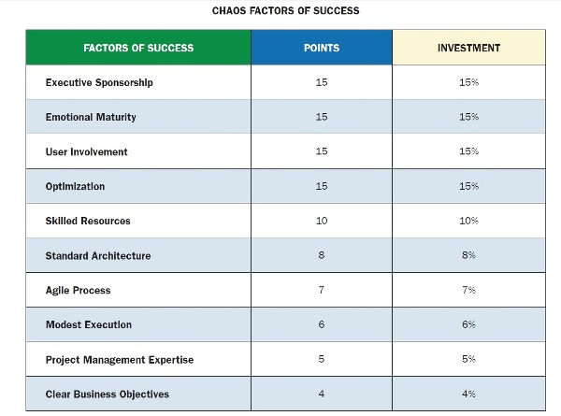
Success Factors, 2015
Failures Requirements Definition/Importance Requirements Types Development Process Requirements Activities
https://www.infoq.com/articles/standish-chaos-2015

Slide 22
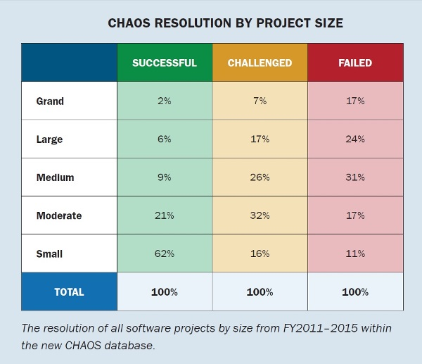
Project Size Matters!
Failures Requirements Definition/Importance Requirements Types Development Process Requirements Activities
https://www.infoq.com/articles/standish-chaos-2015

Slide 23
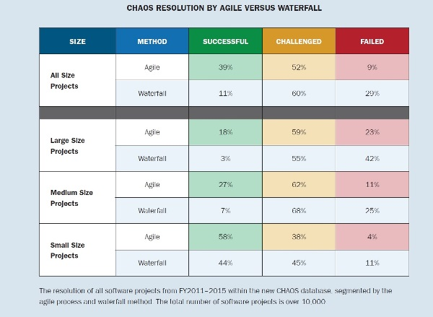
Agile vs Waterfall
Failures Requirements Definition/Importance Requirements Types Development Process Requirements Activities
Notes:
Not all “agile” projects actually follow agile practices
Agility also allows projects to fail (and restart) more quickly
https://www.infoq.com/articles/standish-chaos-2015

Slide 24
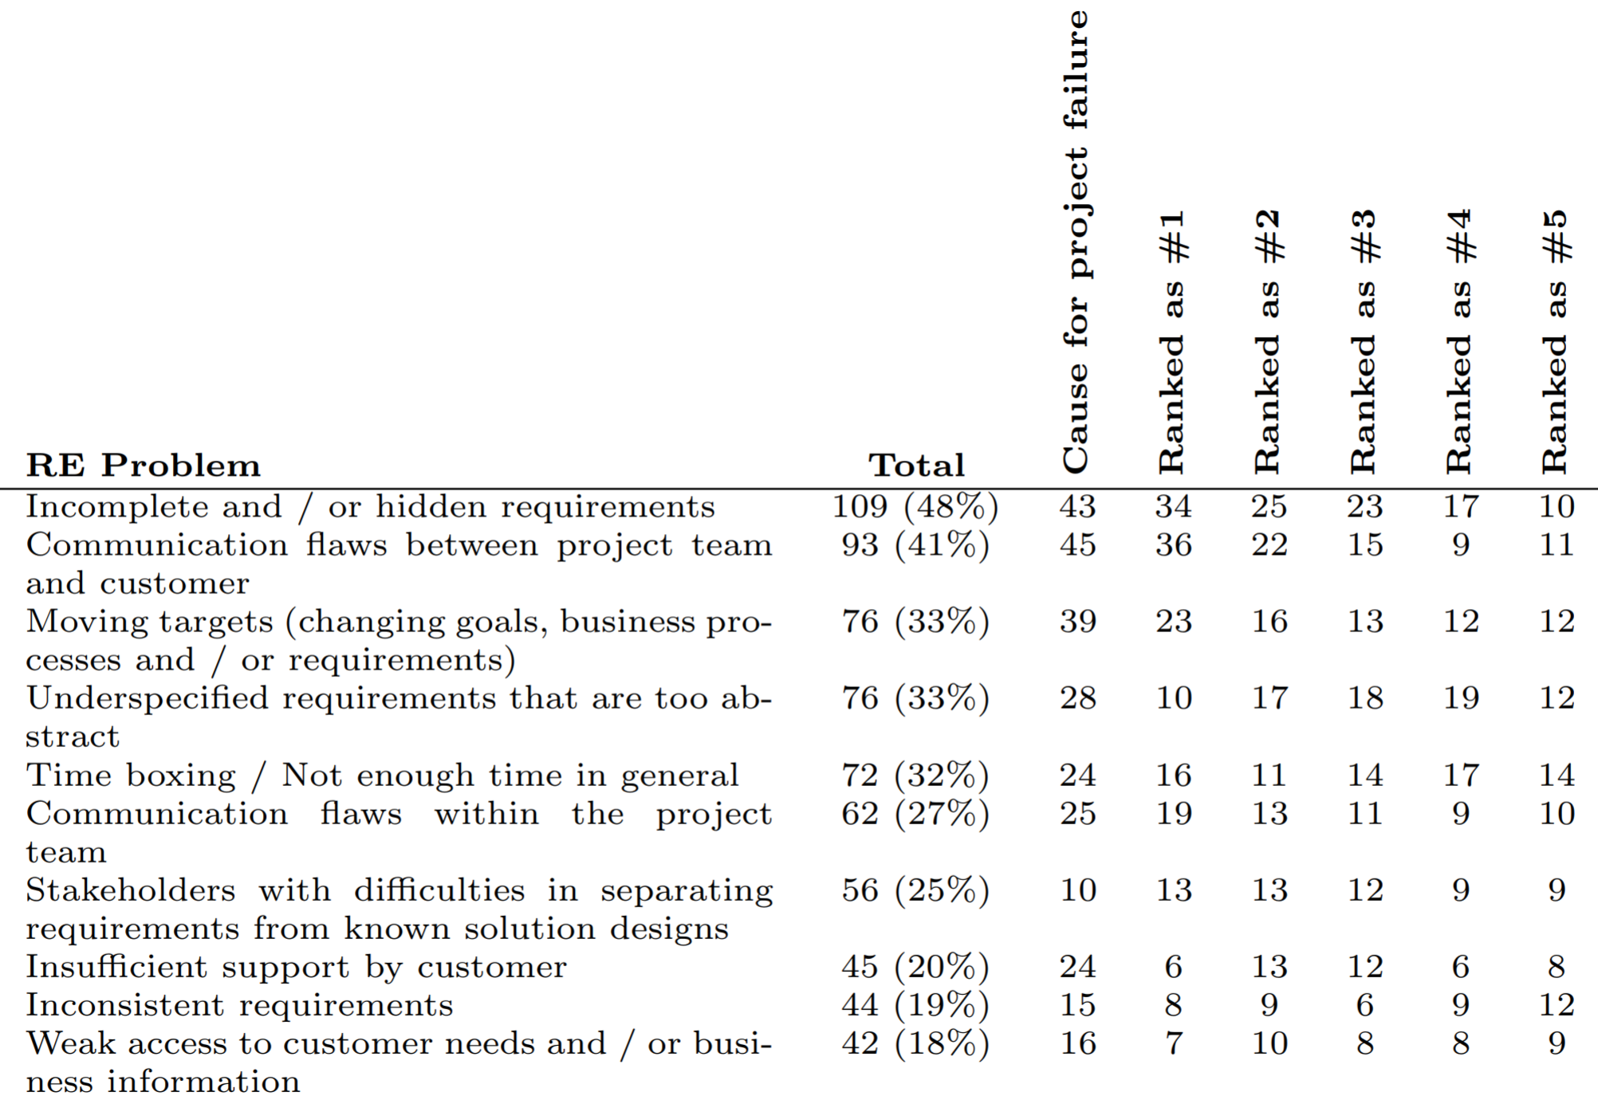
Top-10 RE Problems (NaPiRE 2016)
Failures Requirements Definition/Importance Requirements Types Development Process Requirements Activities
https://arxiv.org/pdf/1611.10288.pdf (2016)

Slide 25
This “Truth” is Contextual…
Failures Requirements Definition/Importance Requirements Types Development Process Requirements Activities
Tim Menzies, William Nichols, Forrest Shull, Lucas Layman: Are delayed issues harder to resolve? Revisiting cost-to-fix of defects throughout the lifecycle. Empirical Software Engineering 22(4): 1903-1935 (2017)
Many practitioners and academics believe in a delayed issue effect (DIE); i.e. the longer an issue lingers in the system, the more effort it requires to resolve.
Tested for DIE in 171 software projects (median duration = 61 days, based on the Team Software Process) from 2006–2014.
The effort to resolve issues in a later phase was not consistently or substantially greater than when issues were resolved soon after their introduction.
DIE is not a global truism; it might be a historical relic that occurs intermittently only in certain kinds of projects.
“Truth” may vary with system type (e.g., cloud vs embedded) | size.

Slide 26
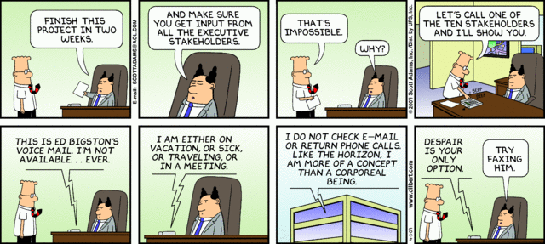
Keep Users and Other Stakeholders Involved?
Failures Requirements Definition/Importance Requirements Types Development Process Requirements Activities

Slide 27
Types of Requirements

Slide 28
So Many “Requirements”… (1)
Failures Requirements Definition/Importance Requirements Types Development Process Requirements Activities
A goal is an objective or concern that guides the RE process. It can be used to discover and evaluate functional and non-functional requirements
  A goal is not yet a requirement…
Note: All requirements must be verifiable (by some test, inspection, audit, etc.)
A functional requirement is a requirement defining functions of the system under development
  Describes what the system should do
A non-functional requirement (NFR) is a requirement characterized by a measurable property or quality such as system performance, robustness, usability, maintainability, etc.

Slide 29
So Many “Requirements”… (2)
Failures Requirements Definition/Importance Requirements Types Development Process Requirements Activities
A user requirement is a desired goal or function that a user and other stakeholders expect the system to achieve
  Does not necessarily become a system requirement
Application domain requirement (sometimes called business rules) are requirements derived from business practices within a given industrial sector, or in a given company, or defined by government regulations or standards.
  May lead to system requirements. Can be functional or non-functional
System requirements are the requirements for the system to be built, as a whole
  A system is a collection of interrelated components working together towards some common objective (may be software, mechanical, electrical and electronic hardware and be operated by people)
  Systems Engineering is a multidisciplinary approach to systems development – software is only a part (but often the problematic part)

Slide 30
So Many “Requirements”… (3)
Failures Requirements Definition/Importance Requirements Types Development Process Requirements Activities
Important note: Software Requirements Engineering is a special case of Requirements Engineering. Many topics discussed in this course are quite general and apply to requirements engineering, in general.
In a system containing software, software requirements are derived from the system requirements. The system then consists of hardware and software, and the hardware (and often the operating system and other existing software modules) are part of the environment in which the software is used.

Slide 31
Functional Requirements
Failures Requirements Definition/Importance Requirements Types Development Process Requirements Activities
What inputs the system should accept
What outputs the system should produce
What data the system should store other systems might use
What computations the system should perform
The timing and synchronization of the above
Depend on the type of software, expected users, and the type of system where the software is used
Functional user requirements may be high-level statements of what the system should do, but functional system requirements should describe the system services in detail

Slide 32
Examples of Functional Requirements
Failures Requirements Definition/Importance Requirements Types Development Process Requirements Activities
The system shall enable the user to search the database by product.
The system shall provide access to a Microsoft Word viewer for the user to read documents in the document store.

Slide 33
Non-Functional Requirements (NFR) (1)
Failures Requirements Definition/Importance Requirements Types Development Process Requirements Activities
Non-functional requirements are important
  If they are not met, the system is useless
  Non-functional requirements may be very difficult to state precisely (especially at the beginning) and imprecise requirements may be difficult to verify
They are sometimes called quality requirements, quality of service, or extra-functional requirements.
Three main categories ¹:
  Performance requirements reflecting: usability, efficiency, reliability, maintainability and reusability (note: also security requirements)
    Response time, throughput
    Resource usage
    Reliability, availability
    Recovery from failure
    Allowances for maintainability and enhancement
    Allowances for reusability
[1] Lethbridge and Laganière, Object Oriented Software Engineering: Practical Software Development using UML and Java, 2005

Slide 34
Non-Functional Requirements (NFR) (2)
Failures Requirements Definition/Importance Requirements Types Development Process Requirements Activities
  Design constraints: Categories constraining the environment and technology of the system.
    Platform (minimal requirements, OS, devices…)
    Technology to be used (language, DB, …)
  Commercial constaints: Categories constraining the project plan and development methods
    Development process (methodology) to be used
    Cost and delivery date
      Often put in contract or project plan instead

Slide 35
Various NFR Types
Failures Requirements Definition/Importance Requirements Types Development Process Requirements Activities
Other ontologies also exist
Source: Gerald Kotonya and Ian Sommerville, Requirements Engineering – Processes and Techniques, Wiley, 1998

Slide 36
Examples of Non-Functional Requirements
Failures Requirements Definition/Importance Requirements Types Development Process Requirements Activities
Security requirement
  The system shall not disclose any personal information about customers to users other than the operators of the system.
Technology requirement
  The system must support the ISO/CEI 10646 universal character set.
Process requirement
  The system development process and deliverable documents shall conform to the MIL-STD-498 standard.

Slide 37
Measurable Non-Functional Requirements
Failures Requirements Definition/Importance Requirements Types Development Process Requirements Activities
Property
Measure
Speed
Processed transactions/second
User/Event response time
Screen refresh time
Size
K Bytes
Number of RAM chips
Ease of use
Training time
Number of help frames
Reliability
Mean time to failure
Probability of unavailability
Rate of failure occurrence
Availability
Robustness
Time to restart after failure
Percentage of events causing failure
Probability of data corruption on failure
Portability
Percentage of target dependent statements
Number of target systems
Source: Gerald Kotonya and Ian Sommerville, Requirements Engineering – Processes and Techniques, Wiley, 1998

Slide 38
Goals
Failures Requirements Definition/Importance Requirements Types Development Process Requirements Activities
A Goal
  Conveys the intention or the objective of one or many stakeholders
  Can guide the discovery of verifiable non-functional requirements that can be tested objectively

Slide 39
Example of Goal and Related NFRs
Failures Requirements Definition/Importance Requirements Types Development Process Requirements Activities
A system goal
  The system must be easy to use by experienced controllers and should be organized in such a way that user errors are minimized.
Two verifiable usability requirements derived from this goal
  Assumption: An experienced controller has at least 2 years experience with the old system (as stated by the stakeholder)
  The system shall enable experienced controllers to use over 90% of the system functions after a total of three hours of training.
  The average number of errors using the system made by experienced controllers shall not exceed two per day.

Slide 40
Application-Domain Requirements
Failures Requirements Definition/Importance Requirements Types Development Process Requirements Activities
Derived from the application domain
Describe system characteristics and features that reflect the domain
May be new functional requirements, constraints on existing requirements, or define specific computations
If domain requirements are not satisfied, the system may be unworkable

Slide 41
Examples of Application-Domain Requirements
Failures Requirements Definition/Importance Requirements Types Development Process Requirements Activities
Library system
  The system interface to the database must comply with standard Z39.50.
Health Information System
  The system shall comply with Ontario’s Personal Health Information Protection Act

Slide 42
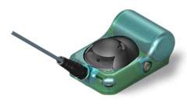

Other Example of Application-Domain Requirements
Failures Requirements Definition/Importance Requirements Types Development Process Requirements Activities
Surveillance of seal population in the North
  Transmitting tags attached to seals, to track their location
  Hard to attach a transmitter (and dangerous!)
  Project over several years
  Problem: batteries last several weeks, while the project spans many years
Options proposed for the tags:
  Transmit every 40 minutes for 9 months (4500$)
  Transmit every 60 minutes for 1 year (4500$)
  Transmit every 40 minutes for 2 years (5500$)
Domain constraints…
  Tags are attached to the fur of seals
  Seals lose their fur every 9 months!!!

Slide 43
Problems Concerning Application-Domain Requirements
Failures Requirements Definition/Importance Requirements Types Development Process Requirements Activities
Understandability
  Requirements are expressed in the language of the application domain
  This is often not understood by software engineers developing the system
Implicitness / Tacit Knowledge
  Domain specialists understand the area so well that they do not think of making the domain requirements explicit
  People are often unaware of the tacit knowledge they possess and therefore cannot express it to others
  “It’s obvious”
  “Assume”

Slide 44
Emergent Properties
Failures Requirements Definition/Importance Requirements Types Development Process Requirements Activities
Properties of the system as a whole
  Requirements that cannot be addressed by a single component, but that depend for their satisfaction on how all the software components interoperate
  Only emerge once all individual subsystems have been integrated
  Dependent on the system architecture
Examples of emergent properties
  Reliability
  Maintainability
  Performance
  Usability
  Security
  Safety

Slide 45
The Requirements Engineering Process

Slide 46
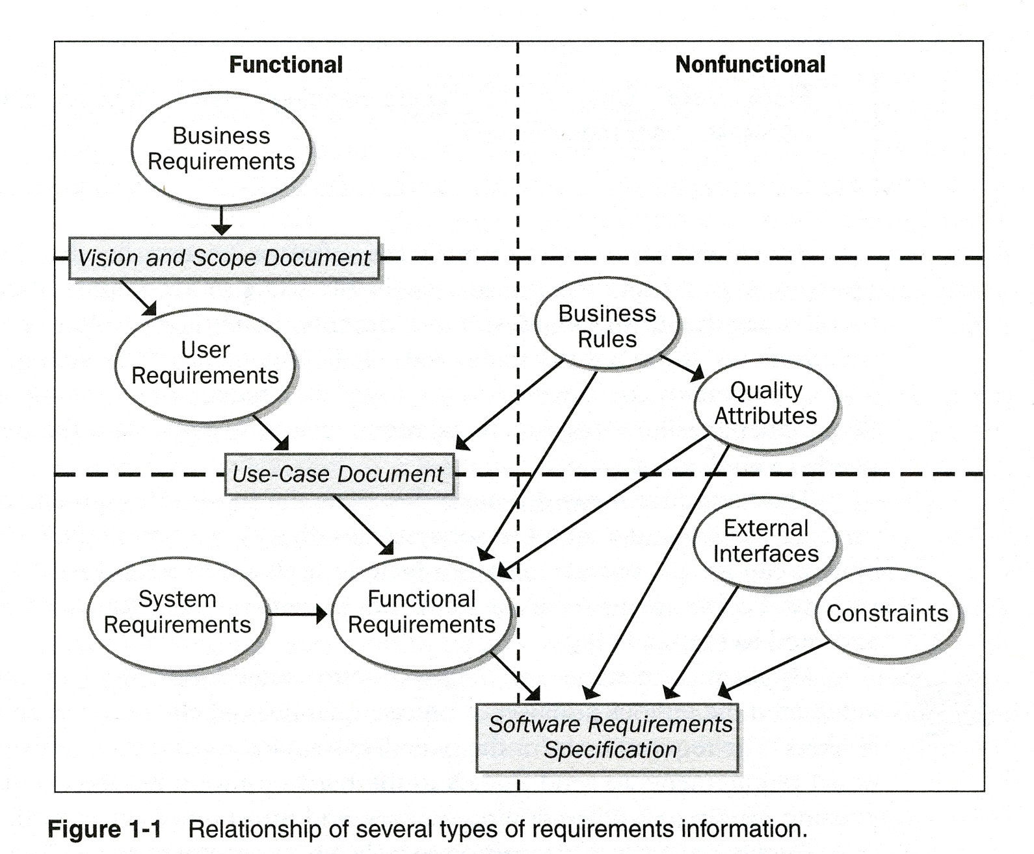
RE Activities and Documents (Wiegers)
Failures Requirements Definition/Importance Requirements Types Development Process Requirements Activities

Slide 47
Typical Layered Approach (V-shaped)
Failures Requirements Definition/Importance Requirements Types Development Process Requirements Activities
Source: Hull, Jackson, Dick: Requirements Engineering, 2004

Slide 48
Requirements and Modeling go together
Failures Requirements Definition/Importance Requirements Types Development Process Requirements Activities
The systems engineering sandwich!
Source: http://www.telelogic.com/download/paper/SystemsEngineeringSandwich.pdf

Slide 49
Back to the Sandwich – consider different levels of details
Failures Requirements Definition/Importance Requirements Types Development Process Requirements Activities
Source: Hull, Jackson, Dick: Requirements Engineering, 2004

Slide 50
RE Process and Related Activities
Failures Requirements Definition/Importance Requirements Types Development Process Requirements Activities
Why?
What?
How?
Who?
When?
If-Then
Does It?
Where?
Identify Business Needs and Goals
Derive User & Functional Requirements
Time
Design Solutions
TIME
Project Management Process
Risk Management Process
Quality Management Process
Component & Configuration Management Process

Slide 51
Main Requirements Activities

Slide 52
According to IEEE 29148
Failures Requirements Definition/Importance Requirements Types Development Process Requirements Activities
Requirements elicitation process through which the acquirer and the suppliers of a system discover, review, articulate, understand, and document the requirements on the system and the life cycle processes
Requirements validation: confirmation by examination that requirements (individually and as a set) define the right system as intended by the stakeholders.
Requirements verification: confirmation by examination that requirements (individually and as a set) are well formed
Requirements management: activities that ensure requirements are identified, documented, maintained, communicated and traced throughout the life cycle of a system, product, or service.
Software requirements specification: structured collection of the requirements (functions, performance, design constraints, and attributes) of the software and its external interfaces.

Slide 53
Requirements Inception
Failures Requirements Definition/Importance Requirements Types Development Process Requirements Activities
Start the process
  Identification of business need
  New market opportunity
  Great idea
Involves
  Building a business case
  Preliminary feasibility assessment
  Preliminary definition of project scope
Stakeholders
  Business managers, marketing people, product managers...

Slide 54
Requirements Elicitation (1)
Failures Requirements Definition/Importance Requirements Types Development Process Requirements Activities
Gathering of information
  About problem domain
  About problems requiring a solution
  About constraints related to the problem or solution
  More than just collecting… Need to evoke and provoke!
Questions that need to be answered
  What is the system?
  What are the goals of the system?
  How is the work done now?
  What are the problems?
  How will the system solve these problems?
  How will the system be used on a day-to-day basis?
  Will performance issues, legal issues, or other constraints affect the way the solution is approached?

Slide 55
Requirements Elicitation (2)
Failures Requirements Definition/Importance Requirements Types Development Process Requirements Activities
Overview of different sources
  Customers and other stakeholders
  Existing systems
  Documentation
  Domain experts
  More ...
Overview of different techniques
  Brainstorming and Design Thinking
  Interviews
  Task observations
  Questionnaires
  Use cases / scenarios
  Prototyping
  More ...

Slide 56
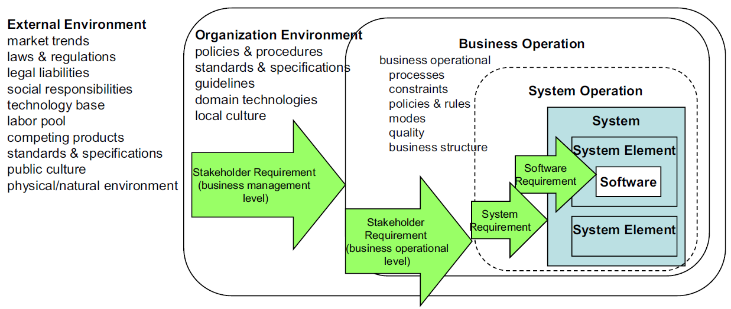
Requirements Elicitation (3)
Failures Requirements Definition/Importance Requirements Types Development Process Requirements Activities
[ISO/IEC/IEEE 29148:2011]

Slide 57
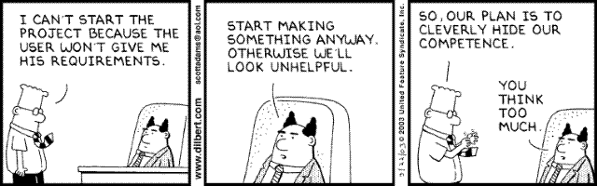
Dilbert on Requirements Elicitation
Failures Requirements Definition/Importance Requirements Types Development Process Requirements Activities

Slide 58
Requirements Analysis
Failures Requirements Definition/Importance Requirements Types Development Process Requirements Activities
The process of studying and analyzing the needs of stakeholders (e.g., customer, user) in view of coming up with a “solution”. Such a solution may involve:
  A new organization of the workflow in the company.
  A new system (system-to-be, also called solution domain) which will be used in the existing or modified workflow.
  A new software to be developed which is to run within the existing computer system or involving modified and/or additional hardware.
Objectives
  Detect and resolve conflicts between requirements (e.g., through negotiation)
  Discover the boundaries of the system / software and how it must interact with its environment
  Elaborate system requirements to derive software requirements
Requirements analysis is often linked to modeling

Slide 59
Requirements Specification
Failures Requirements Definition/Importance Requirements Types Development Process Requirements Activities
The invention and definition of the behavior of a new system (solution domain) such that it will produce the required effects in the problem domain
Requirements Analysis has defined the problem domain and the required effects
Specification Document
  A document that clearly and precisely describes, each of the essential requirements (functions, performance, design constraints, and quality attributes) of the software and the external interfaces
  Each requirement being defined in such a way that its achievement is capable of being objectively verified by a prescribed method (e.g., inspection, demonstration, analysis, or test)
  Different guidelines and templates exist for requirements specification

Slide 60
Requirements Verification and Validation
Failures Requirements Definition/Importance Requirements Types Development Process Requirements Activities
Validation and verification
  Both help ensure delivery of what the client wants
  Need to be performed at every stage during the process
Validation: checks that the right product is being built (refers back to stakeholders – main concern during RE)
Verification: checks that the product is being built right
  During design phase: refers back to the specification of the system or software requirements
  During RE: mainly checking consistency between different requirements, detecting conflicts
Techniques used during RE
  Simple checks
  Formal reviews
  Logical analysis
  Prototypes and enactments
  Design of functional tests

Slide 61
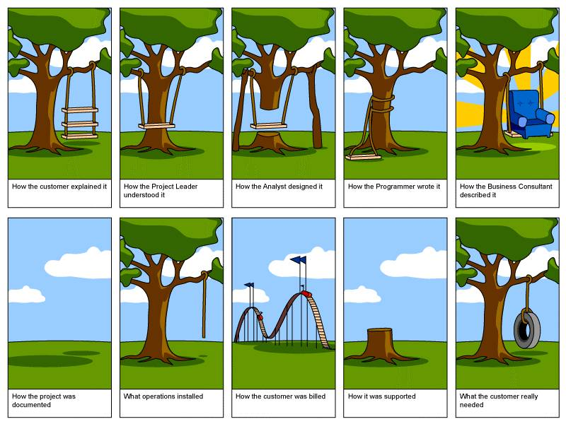
Validation vs Verification
Failures Requirements Definition/Importance Requirements Types Development Process Requirements Activities

Slide 62
Requirements Management
Failures Requirements Definition/Importance Requirements Types Development Process Requirements Activities
Necessary to cope with changes to requirements
Requirements change is caused by:
  Business process changes
  Technology changes
  Better understanding of the problem
Traceability is very important for effective requirements management
Elicitation notes
Goals

Slide 63
Requirements Documents
Failures Requirements Definition/Importance Requirements Types Development Process Requirements Activities
Vision and Scope Document
Elicitation notes
  (Raw) user requirements obtained through elicitation; often unstructured, incomplete, and inconsistent
Requirements document
System requirements document
Software requirements document
  The software is normally part of a system that includes hardware and software. Therefore the software requirements are normally part of the system requirements.

Slide 64
Types of Requirements Documents
Failures Requirements Definition/Importance Requirements Types Development Process Requirements Activities
Two extremes:
An informal outline of the requirements or stories using a few paragraphs or simple diagrams
A long list of specifications that contain
thousands of pages of intricate
requirements describing the
system in detail
Requirements documents for
large systems are normally
arranged in a hierarchy
Requirements
xxxx
xxxxxxx
xxx
xxxxxxxxxxx
xxxxx
xxxxxxxxxxxxx
xxxxxxx
xxx
xxxxxxxxxxxxxxx
subsystem 1
subsystem 2
Requirements
Requirements
xxxx
Definition
xxxxxxx
xxxx
xxx
xxxxxxx
Requirements
xxxxxxxxxxx
xxx
xxxxx
xxxxxxxxxxx
Specification
xxxxxxxxxxxxx
xxxxx
xxxxxxx
xxxx
xxx
xxxxxxxxxxxxx
xxxxxxxxxxxxxxx
xxxxxxx
xxxxxxx
xxx
xxx
xxxxxxxxxxx
xxxxxxxxxxxxxxx
xxxxx
xxxxxxxxxxxxx
sub-subsystems
xxxxxxx
xxx
Requirements
Requirements
Requirements
xxxxxxxxxxxxxxx
Requirements
Definition
Definition
Definition
Definition
xxxx
xxxx
xxxx
sub-subsystems
xxxx
xxxxxxx
xxxxxxx
xxxxxxx
Requirements
xxxxxxx
xxx
Requirements
xxx
Requirements
xxx
xxx
Requirements
xxxxxxxxxxx
xxxxxxxxxxx
xxxxxxxxxxx
Specification
xxxxxxxxxxx
Specification
xxxxx
Specification
xxxxx
Specification
xxxxx
xxxx
xxxxx
xxxxxxxxxxxxx
xxxxxxxxxxxxx
Requirements
xxxx
xxxx
xxxxxxx
Requirements
xxxxxxxxxxxxx
xxxxxxxxxxxxx
xxxxxxx
Requirements
xxxxxxx
xxxx
xxxxxxx
xxxxxxx
xxxxxxx
xxxxxxx
xxx
xxx
Requirements
Definition
Definition
xxxxxxx
xxx
xxx
xxx
xxx
xxxxxxxxxxx
Definition
xxx
xxx
xxxxxxxxxxxxxxx
xxxxxxxxxxxxxxx
Definition
xxxx
xxxxxxxxxxx
xxxxxxxxxxx
xxxxx
xxxx
xxxxxxxxxxxxxxx
xxxxxxxxxxxxxxx
xxxx
xxxxxxx
xxxxxxxxxxx
xxxxx
xxxxx
xxxxxxxxxxxxx
xxxx
xxxxxxx
xxxxxxx
xxx
Requirements
xxxxx
xxxxxxxxxxxxx
xxxxxxxxxxxxx
xxxxxxx
xxxxxxx
xxx
Requirements
xxx
Requirements
xxxxxxxxxxx
xxxxxxxxxxxxx
xxxxxxx
xxxxxxx
xxx
xxx
Requirements
xxxxxxxxxxx
xxxxxxxxxxx
Specification
xxxxx
Specification
xxxxxxx
xxx
xxx
xxxxxxxxxxxxxxx
xxxxxxxxxxx
xxxxx
Specification
xxxxx
xxxx
xxx
xxxxxxxxxxxxxxx
xxxxx
Specification
xxxxxxxxxxxxx
xxxxxxxxxxxxx
xxxxxxxxxxxxxxx
xxxx
xxxx
xxxxxxx
xxxxxxxxxxxxxxx
xxxxxxxxxxxxx
xxxxxxxxxxxxx
xxxxxxx
xxxxxxx
xxxx
xxxxxxx
xxxxxxx
xxxxxxx
xxxxxxx
xxx
xxx
xxxxxxx
xxx
xxx
xxx
xxx
xxxxxxxxxxx
xxx
xxx
xxxxxxxxxxxxxxx
xxxxxxxxxxxxxxx
xxxxxxxxxxx
xxxxxxxxxxx
xxxxx
xxxxxxxxxxxxxxx
xxxxxxxxxxxxxxx
xxxxxxxxxxx
xxxxx
xxxxx
xxxxxxxxxxxxx
xxxxx
xxxxxxxxxxxxx
xxxxxxxxxxxxx
xxxxxxx
xxxxxxxxxxxxx
xxxxxxx
xxxxxxx
xxx
xxxxxxx
xxx
xxx
xxxxxxxxxxxxxxx
xxx
xxxxxxxxxxxxxxx
xxxxxxxxxxxxxxx
xxxxxxxxxxxxxxx

Slide 65
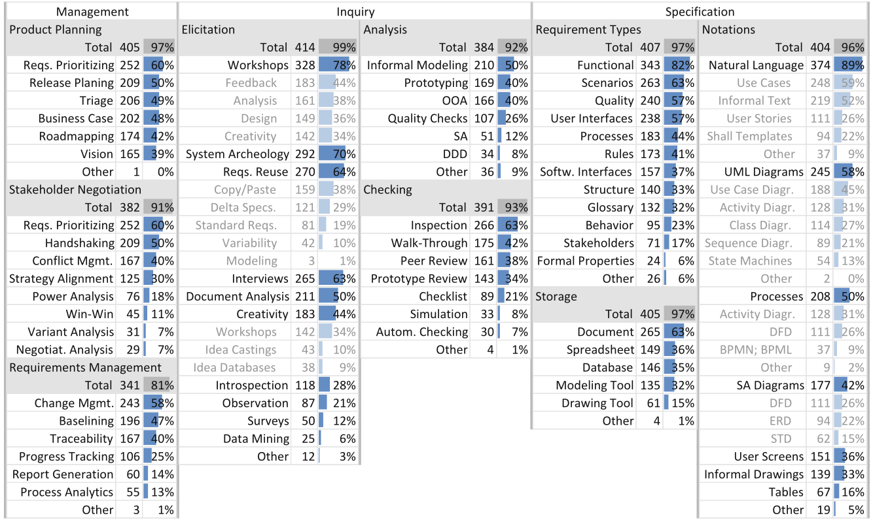
What is Actually Used (400+ Healthcare Projects)?
S. Fricker, R. Grau, A. Zwingli (2014). Requirements Engineering: Best Practice. Requirements Engineering for Digital Health. Springer.

Slide 66
The Requirements Analyst¹
Failures Requirements Definition/Importance Requirements Types Development Process Requirements Activities
Also called business analyst, system analyst, functional architect, requirements engineer…
Plays an essential communication role
  Talks to users: application domain
  Talks to developers: technical domain
  Translates user requirements into functional requirements and quality goals
Needs many capabilities
  Interviewing and listening skills
  Facilitation and interpersonal skills
  Writing and modeling skills
  Organizational ability
RE is more than just modeling…
This is a socio-technical discipline!
[1] Karl Wiegers, In Search of Excellent Requirements

Slide 67
Is RE a Software Engineering Discipline?
Failures Requirements Definition/Importance Requirements Types Development Process Requirements Activities
RE
Software Engineering
Systems Engineering
Procurement
Social Sciences
Governance and Politics
Management and Organizational Change

Slide 68
For More Information
B. A. Nuseibeh and S. M. Easterbrook, Requirements Engineering: A Roadmap. In A. C. W. Finkelstein (ed) The Future of Software Engineering, ACM Press, 2000
http://www.cs.toronto.edu/~sme/papers/2000/ICSE2000.pdf
Simson Garfinkel, History's Worst Software Bugs, Wired News, 2005
http://www.wired.com/news/technology/bugs/0,2924,69355,00.html
INCOSE Requirements Working Group
http://www.incose.org/ChaptersGroups/WorkingGroups/process/requirements
Tools Survey: Requirements Management (RM) Tools
http://makingofsoftware.com/resources/list-of-rm-tools
http://www.volere.co.uk/tools.htm
http://www.seilevel.com/business-analyst-resources/requirements-tools-reviews/
IEEE (1998) Recommended Practice for Software Requirements Specifications. IEEE Std 830-1998, NY, USA.
SWEBOK 2013







Slide 69
Main References
Jeremy Dick, Elizabeth Hull, Ken Jackson: Requirements Engineering, Springer-Verlag, 2004
Soren Lauesen: Software Requirements - Styles and Techniques, Addison Wesley, 2002
Ian K. Bray: An Introduction to Requirements Engineering, Addison Wesley,
2002
Karl E. Wiegers: Software Requirements, Microsoft Press,
2003
Gerald Kotonya, Ian Sommerville: Requirements Engineering – Processes and Techniques, Wiley, 1998
Roger S. Pressman: Software Engineering – A Practitioner's Approach, McGraw-Hill, 2005
Tim Lethbridge, Robert Laganière: Object Oriented Software Engineering: Practical Software Developement using UML and Java, 2nd edition, McGraw-Hill, 2005
Ivy F. Hooks, Kristin A. Farry: Customer-Centered Products – Creating Successful Products Through Smart Requirements Management, Amacom, 2001
CHAOS Report, Standish Group, 1994-2016










Slide 70


RE Professional Titles
https://www.ireb.org/
Certified Professional for Requirements Engineering (CPRE)
http://www.iiba.org/
Certification of Competency in Business Analysis™ (CCBA®)
Certified Business Analysis Professional™ (CBAP®)

Slide 71
RE Conferences
International Requirements Engineering Conference (RE; since 1993): http://www.requirements-engineering.org
Int. Working Conf. on Requirements Engineering Foundation for Software Quality (REFSQ; since 1995): http://refsq.org/
Workshop on Requirements Engineering (WER; since 1998): http://wer.inf.puc-rio.br/
Asia Pacific Requirements Engineering Symposium (APRES; since 2014): http://asiapacificre.org
ACM Symposium on Applied Computing (SAC), RE Track (since 2008): http://www.cin.ufpe.br/~sac18-re/
Dozens of satellite workshops and special tracks elsewhere.

Slide 72
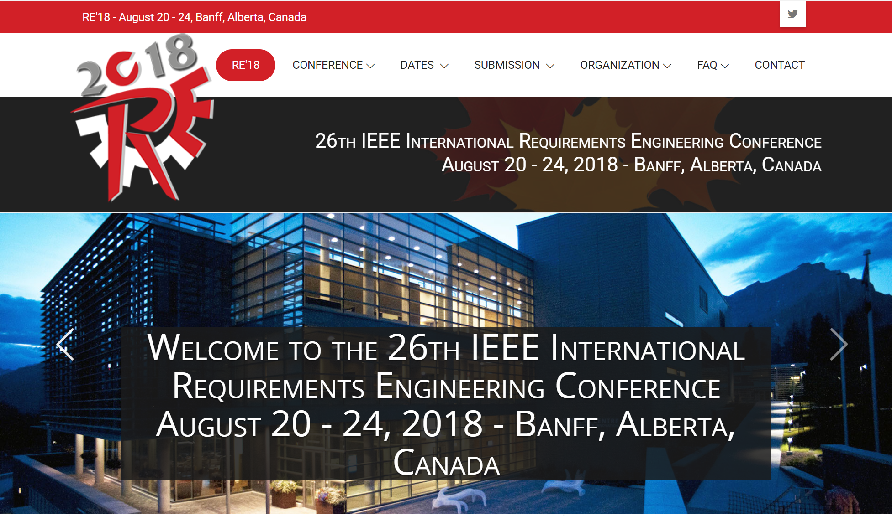
RE’18… Back to Canada! http://re18.org

Slide 73
Quiz
What is a requirement?
What are the differences between a goal and a non-functional requirement?
What are the main activities of requirements engineering?
How can we extract tacit knowledge from stakeholders?
What is the role of models in requirements engineering?
What is the role of the requirements analyst?
Is requirements engineering limited to software?

