Slide 1
Requirements Specification with the IEEE 29148 Standard
SEG3101 (Fall 2018)
Daniel Amyot, University of Ottawa
Based on slides by Gunter Mussbacher (2009) and Stéphane Somé (2008)
with material from these standards:
IEEE 830-1998, ISO/IEC 12207, ISE/IEC/IEEE 29148:2011

Slide 2
Table of Contents
Requirements Specification Document
Old IEEE 830-1998 Standard
Relationship between IEEE 830 and ISO/IEC 12207
ISO/IEC/IEEE 29148:2011 Standard

Slide 3
Requirements Specification Document (1)
Requirements Specifications IEEE 830-1998 Standard IEEE 830 and ISO/IEC 12207 ISO/IEC/IEEE 29148:2011
Clearly and accurately describes each of the essential requirements (functions, performance, design constraints, and quality attributes) of the system / software and its external interfaces
Defines the scope and boundaries of the system / software
Each requirement must be described in such a way that it is feasible and objectively verifiable by a prescribed method (e.g., by inspection, demonstration, analysis, or test)
Basis for contractual agreements between contractors or suppliers and customers
Elaborated from elicitation notes

Slide 4
Requirements Specification Document (2)
Requirements Specifications IEEE 830-1998 Standard IEEE 830 and ISO/IEC 12207 ISO/IEC/IEEE 29148:2011
Specifications are intended for a diverse audience
Customers and users for validation, RFPs, negotiation, contract, ...
Systems (requirements) analysts
Developers, programmers to implement the system
Testers to check that the requirements have been met
Project Managers to measure and control the project
Different levels of detail and formality is needed for each audience
Different template guidelines for requirements specifications
e.g., IEEE 830 and ISO/IEC/IEEE 29148

Slide 5
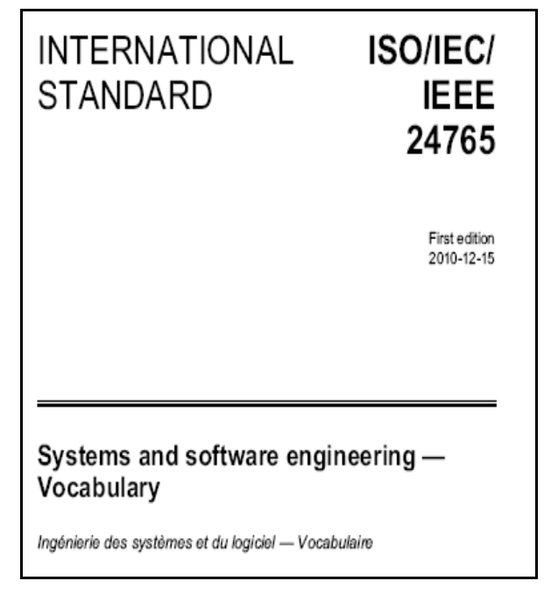
On Standards…
Requirements Specifications IEEE 830-1998 Standard IEEE 830 and ISO/IEC 12207 ISO/IEC/IEEE 29148:2011
A standard is a “Set of mandatory requirements established by consensus and maintained by a recognized body to prescribe a disciplined uniform approach or specify a product, that is, mandatory conventions and practices”
[ISO/IEC/IEEE 24765]

Slide 6
IEEE 830-1998 Standard
Requirements Specifications IEEE 830-1998 Standard IEEE 830 and ISO/IEC 12207 ISO/IEC/IEEE 29148:2011
Title of Standard
« IEEE Recommended Practice for Software Requirements Specifications »
Describes the content and qualities of a good software requirements specification (SRS)
Presents several sample SRS outlines

Slide 7
IEEE 830-1998 Standard – Objectives
Requirements Specifications IEEE 830-1998 Standard IEEE 830 and ISO/IEC 12207 ISO/IEC/IEEE 29148:2011
Help software customers to accurately describe what they wish to obtain
Help software suppliers to understand exactly what the customer wants
Help participants to:
Develop a template (format and content) for the software requirements specification (SRS) in their own organizations
Develop additional documents such as SRS quality checklists or an SRS writer’s handbook

Slide 8
IEEE 830-1998 Standard – Benefits
Requirements Specifications IEEE 830-1998 Standard IEEE 830 and ISO/IEC 12207 ISO/IEC/IEEE 29148:2011
Establish the basis for agreement between the customers and the suppliers on what the software product is to do
Reduce the development effort
Forced to consider requirements early → reduces later redesign, recoding, retesting
Provide a basis for realistic estimates of costs and schedules
Provide a basis for validation and verification
Facilitate transfer of the software product to new users or new machines
Serve as a basis for enhancement requests

Slide 9
IEEE 830-1998 Standard – Considerations
Requirements Specifications IEEE 830-1998 Standard IEEE 830 and ISO/IEC 12207 ISO/IEC/IEEE 29148:2011
Section 4 of IEEE 830 (how to produce a good SRS)
Nature (goals) of SRS
Functionality, interfaces, performance, qualities, design constraints
Environment of the SRS
Where does it fit in the overall project hierarchy
Characteristics of a good SRS
Generalization of the characteristics of good requirements to the document
Evolution of the SRS
Implies a change management process
Prototyping
Helps elicit software requirements and reach closure on the SRS
Including design and project requirements in the SRS
Focus on external behavior and the product, not the design and the production process (describe in a separate document)

Slide 10
IEEE 830-1998 Standard – Structure of the SRS
Requirements Specifications IEEE 830-1998 Standard IEEE 830 and ISO/IEC 12207 ISO/IEC/IEEE 29148:2011
Section 5 of IEEE 830
Contents of SRS
Introduction
General description of the software product
Specific requirements (detailed)
Additional information such as appendixes and index, if necessary

Slide 11
IEEE 830-1998 Standard – Section 1 of SRS
Requirements Specifications IEEE 830-1998 Standard IEEE 830 and ISO/IEC 12207 ISO/IEC/IEEE 29148:2011
Title
Table of Contents
1. Introduction
1.1 Purpose
1.2 Scope
1.3 Definitions. Acronyms, and Abbreviations
1.4 References
1.5 Overview
2. Overall Description
3. Specific Requirements
Appendices
Index
Describe purpose of this SRS
Describe intended audience
Identify the software product
Enumerate what the system will and will not do
Describe user classes and benefits for each
Define the vocabulary of the SRS (may reference appendix)
List all referenced documents including sources (e.g., Use Case Model and Problem Statement; Experts in the field)
Describe the content of the rest of the SRS
Describe how the SRS is organized

Slide 12
IEEE 830-1998 Standard – Section 2 of SRS
Requirements Specifications IEEE 830-1998 Standard IEEE 830 and ISO/IEC 12207 ISO/IEC/IEEE 29148:2011
Present the business case and operational concept of the system
Describe how the proposed system fits into the business context
Describe external interfaces: system, user, hardware, software, communication
Describe constraints: memory, operational, site adaptation
Title
Table of Contents
1. Introduction
2. Overall Description
2.1 Product Perspective
2.2 Product Functions
2.3 User Characteristics
2.4 Constraints
2.5 Assumptions and Dependencies
3. Specific Requirements
4. Appendices
5. Index
Summarize the major functional capabilities
Include the Use Case Diagram and supporting narrative (identify actors and use cases)
Include Data Flow Diagram if appropriate
Describe and justify technical skills and capabilities of each user class
States assumptions about availability of certain resources that, if not satisfied, will alter system requirements and/or effect the design.
Describe other constraints that will limit developer’s options; e.g., regulatory policies; target platform, database, network software and protocols, development standards requirements

Slide 13
IEEE 830-1998 Standard – Section 3 of SRS (1)
Requirements Specifications IEEE 830-1998 Standard IEEE 830 and ISO/IEC 12207 ISO/IEC/IEEE 29148:2011
…
1. Introduction
2. Overall Description
3. Specific Requirements
3.1 External Interfaces
3.2 Functions
3.3 Performance Requirements
3.4 Logical Database Requirements
3.5 Design Constraints
3.6 Software System Quality Attributes
3.7 Object Oriented Models
4. Appendices
5. Index
Specify software requirements in sufficient detail to enable designers to design a system to satisfy those requirements and testers to verify requirements
State requirements that are externally perceivable by users, operators, or externally connected systems
Requirements should include, at a minimum, a description of every input (stimulus) into the system, every output (response) from the system, and all functions performed by the system in response to an input or in support of an output
(a) Requirements should have characteristics of
high quality requirements (b) Requirements should be cross-referenced to
their source. (c) Requirements should be uniquely identifiable (d) Requirements should be organized to
maximize readability

Slide 14
IEEE 830-1998 Standard – Section 3 of SRS (2)
Requirements Specifications IEEE 830-1998 Standard IEEE 830 and ISO/IEC 12207 ISO/IEC/IEEE 29148:2011
…
1. Introduction
2. Overall Description
3. Specific Requirements
3.1 External Interfaces
3.2 Functions
3.3 Performance Requirements
3.4 Logical Database Requirements
3.5 Design Constraints
3.6 Software System Quality Attributes
3.7 Object Oriented Models
4. Appendices
5. Index
Detail all inputs and outputs (complement, not duplicate, information presented in section 2)
Examples: GUI screens, file formats
Include detailed specifications of each use case, including collaboration and other diagrams useful for this purpose
Include:
Types of information used
Data entities and their relationships
Should include:
Standards compliance
Accounting & Auditing procedures
The main body of requirements organized in a variety of possible ways:
Architecture Specification
Class Diagram
State and Collaboration Diagrams
Activity Diagram (concurrent/distributed)‏

Slide 15
IEEE 830-1998 Standard – Templates
Requirements Specifications IEEE 830-1998 Standard IEEE 830 and ISO/IEC 12207 ISO/IEC/IEEE 29148:2011
Annex A of IEEE 830
Section 3 (Specific Requirements) may be organized in many different ways based on
Modes
User classes
Concepts (object/class)
Features
Stimuli
Response
Functional hierarchy

Slide 16
ISO/IEC 12207:2008 Software Life Cycle Processes
Requirements Specifications IEEE 830-1998 Standard IEEE 830 and ISO/IEC 12207 ISO/IEC/IEEE 29148:2011

Slide 17
Relationship of IEEE 830 and ISO/IEC 12207 (1)
Requirements Specifications IEEE 830-1998 Standard IEEE 830 and ISO/IEC 12207 ISO/IEC/IEEE 29148:2011
12207
Common framework for « Software life cycle processes »
ISO/IEC 12207 = IEEE/EIA 12207
IEEE 830-1998 and IEEE/EIA 12207.1-1997 both place requirements on documents describing software requirements
Annex B of IEEE 830 explains the relationship between the two sets of requirements for those who want to produce documents that comply with both standards simultaneously
Such compliance may be required by customers when requesting proposals or issuing call for tenders

Slide 18
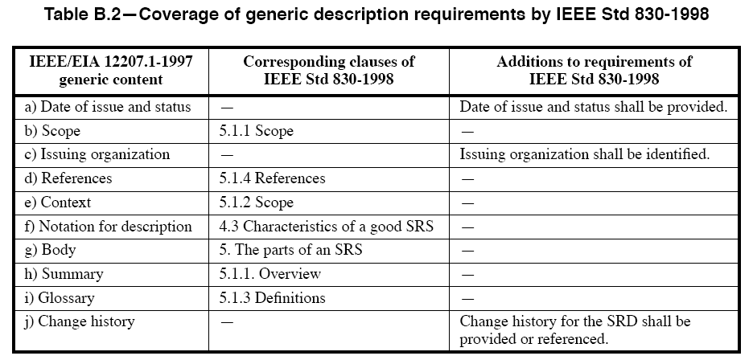
Relationship of IEEE 830 and ISO/IEC 12207 (2)
Requirements Specifications IEEE 830-1998 Standard IEEE 830 and ISO/IEC 12207 ISO/IEC/IEEE 29148:2011
Note: Table B.3 is more detailed and shows the correspondence between the two standards at the level of requirements types

Slide 19
ISO/IEC/IEEE 29148:2011
Requirements Specifications IEEE 830-1998 Standard IEEE 830 and ISO/IEC 12207 ISO/IEC/IEEE 29148:2011
ISO/IEC/IEEE 29148:2011: Systems and software engineering — Life cycle processes — Requirements engineering
http://ieeexplore.ieee.org/stamp/stamp.jsp?arnumber=6146379
This International Standard provides a unified treatment of the processes and products involved in engineering requirements throughout the life cycle of systems and software.
Harmonizes IEEE 830, SWEBOK, and 7 other standards.
More emphasis on characteristics of good requirements, RE activities and processes, operations (and operation context), and different information items (including their structures) such as specification of requirements for stakeholders, systems and software.
Complies with ISO/IEC 15288 and ISO/IEC 12207

Slide 20
Stakeholder Requirements Specification Outline
Requirements Specifications IEEE 830-1998 Standard IEEE 830 and ISO/IEC 12207 ISO/IEC/IEEE 29148:2011

Slide 21
System Requirements Specification Outline
Requirements Specifications IEEE 830-1998 Standard IEEE 830 and ISO/IEC 12207 ISO/IEC/IEEE 29148:2011

Slide 22
Software Requirements Specification Outline
Requirements Specifications IEEE 830-1998 Standard IEEE 830 and ISO/IEC 12207 ISO/IEC/IEEE 29148:2011
Verification: This section provides the verification approaches and methods planned to qualify the software. The information items for verification are recommended to be given in a parallel manner with the information items in section 3.

Slide 23
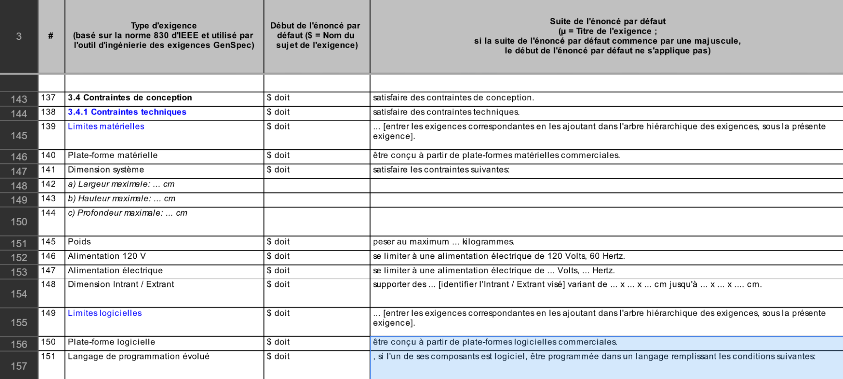
Relevant Patterns… in French!
From Hydro-Québec (with thanks to René Bujold)
Excel file with hundreds of illustrated patterns based on the structure of IEEE 830, including non-functional requirements

Slide 24
Some tools that can help you…
Requirements Authoring Tool (RAT)
Requirements Quality Analyzer (RQA)
QVscribe
Specification Analysis Tool (SAT)
RAVEN
Interesting article: A. Smit, R. Halligan: An evaluation of requirements writing templates and tools. 12th INCOSE SA Systems Engineering Conference, 2016.

Slide 25
Quiz
Does IEEE 29148 offer standard templates for requirements specifications?
Whom are requirements specification documents meant for?
Can you enumerate two types of requirements specifications?
Can you enumerate three benefits of using a standard such as ISO/IEC/IEEE 29148:2011?
Can you think of potential problems related to the use of such standards?

Slide 26
ISO JTC1-SC7 Standards and Technical Reports
http://www.iso.org/iso/iso_catalogue/catalogue_tc/catalogue_tc_browse.htm?commid=45086

Slide 27
Why Don’t VSEs Use Standards?
VSE = very small entities: enterprise, government, or not-for-profit organizations; departments; or projects with up to people who develop systems with hardware and software components and/or software products.
* Difficult, Bureaucratic, not enough guidance.
C.Y. Laporte and R.V. O'Connor: Software Engineering Standards for Very Small Entities: Accomplishments and Overview. IEEE Computer, August 2016, 84-87

