Slide 1
Writing Better Requirements
SEG3101
Daniel Amyot, University of Ottawa
Based on slides by Gunter Mussbacher
with material from:
Ian Zimmerman (Telelogic, 2001),
Ivy Hooks (Compliance Automation, 1998)

Slide 2
Table of Contents
Anatomy of a Good / Bad Requirement
Standard for Writing a Requirement
Writing Pitfalls to Avoid
A Few Simple Tests…
The greatest challenge to any thinker is stating the problem in a way that will allow a solution.¹
[1] Bertrand Russell, 1872-1970

Slide 3
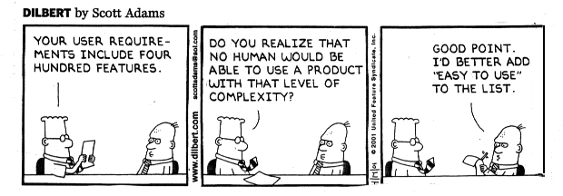

Slide 4
Anatomy of a Good Requirement
Martha can’t … Good & Bad Standard Pitfalls to Avoid A Few Simple Tests Summary & Tools
The challenge is to seek out the system under discussion, end result, and success measure in every requirement
Defines the system under discussion
Verb with correct identifier (shall or may)
The Online Banking System shall allow the Internet user to access her current account balance in less than 5 seconds.
Defines a positive end result
Quality criteria

Slide 5
Example of a Bad Requirement
Martha can’t … Good & Bad Standard Pitfalls to Avoid A Few Simple Tests Summary & Tools
Cannot write a requirement on the user
No identifier for the verb
X
The Internet User quickly sees her current account balance on the laptop screen.
Vague quality criteria
What versus how

Slide 6
Standard for Writing a Requirement
Martha can’t … Good & Bad Standard Pitfalls to Avoid A Few Simple Tests Summary & Tools
Each requirement must first form a complete sentence
Not a bullet list of buzzwords, list of acronyms, or sound bites on a slide
Each requirement contains a subject and predicate
Subject: a user type (watch out!) or the system under discussion
Predicate: a condition, action, or intended result
Verb in predicate: “shall” / “will” / “must” to show mandatory nature; “may” / “should” to show optionality
The whole requirement provides the specifics of a desired end goal or result
Contains a success criterion or other measurable indication of the quality

Slide 7
Standard for Writing a Requirement
Martha can’t … Good & Bad Standard Pitfalls to Avoid A Few Simple Tests Summary & Tools
Several standards define fairly precisely how to use key words (verbs and adjectives) in their documents.
Example: IETF RFC 2119: Key words for use in RFCs to Indicate Requirement Levels
MUST, REQUIRED or SHALL: mean that the definition is an absolute requirement of the spec.
MUST NOT or SHALL NOT: absolute prohibition
SHOULD or RECOMMENDED: think twice about not doing it!
SHOULD NOT or NOT RECOMMENDED: think twice about doing it!
MAY or OPTIONAL: truly optional

Slide 8
Standard for Writing a Requirement
Martha can’t … Good & Bad Standard Pitfalls to Avoid A Few Simple Tests Summary & Tools
Look for the following characteristics in each requirement
Feasible (not wishful thinking)
Needed (provides the specifics of a desired end goal or result)
Testable (contains a success criterion/other measurable indication of quality)
Clear, unambiguous, precise, one thought
Prioritized
ID
Note: several characteristics are mandatory (feasible, needed, testable) whereas others improve communication

Slide 9
Writing Pitfalls to Avoid
Martha can’t … Good & Bad Standard Pitfalls to Avoid A Few Simple Tests Summary & Tools
Never describe prematurely how the system is going to achieve something (over-specification), always describe what the system is supposed to do
Refrain from designing the system prematurely
Danger signs: using names of components, materials, software objects, fields & records in the user or system requirements
Designing the system too early may possibly increase system costs
Do no mix different kinds of requirements (e.g., requirements for users, system, and how the system should be designed, tested, or installed)
Do not mix different requirements levels (e.g., the system and subsystems)
Danger signs: high level requirements mixed in with database design, software terms, or very technical terms
Beware: may depend on the level of abstraction…
Your what is my how!

Slide 10
Writing Pitfalls to Avoid
Martha can’t … Good & Bad Standard Pitfalls to Avoid A Few Simple Tests Summary & Tools
“What versus how” test
X
The system shall use Microsoft Outlook to send an email to the customer with the purchase confirmation.
The system shall inform the customer that the purchase is confirmed.

Slide 11
Writing Pitfalls to Avoid
Martha can’t … Good & Bad Standard Pitfalls to Avoid A Few Simple Tests Summary & Tools
Never build in let-out or escape clauses
Requirements with let-outs or escapes are dangerous because of problems that arise in testing
Danger signs: if, but, when, except, unless, although
These terms may however be useful when the description of a general case with exceptions is much clearer and complete that an enumeration of specific cases
Avoid ambiguity
Write as clearly and explicitly as possible
Ambiguities can be caused by:
The word or to create a compound requirement
Poor definition (giving only examples or special cases)
The words etc., …and so on (imprecise definition)

Slide 12
Writing Pitfalls to Avoid
Martha can’t … Good & Bad Standard Pitfalls to Avoid A Few Simple Tests Summary & Tools
Do not use vague indefinable terms
Many words used informally to indicate quality are too vague to be verified
Danger signs: user-friendly, highly versatile, flexible, to the maximum extent, approximately, as much as possible, minimal impact
X
The EasyEntry System shall be easy to use and require a minimum of training except for the professional mode.

Slide 13
Writing Pitfalls to Avoid
Martha can’t … Good & Bad Standard Pitfalls to Avoid A Few Simple Tests Summary & Tools
Do not make multiple requirements
Keep each requirement as a single sentence
Conjunctions (words that join sentences together) are danger signs: and, or, with, also
Do not ramble
Long sentences with arcane language
References to unreachable documents
X
The Easy Entry Navigator module shall consist of order entry and communications, order processing, result processing, and reporting. The Order Entry module shall be integrated with the Organization Intranet System and results are stored in the group’s electronic customer record.

Slide 14
Writing Pitfalls to Avoid
Martha can’t … Good & Bad Standard Pitfalls to Avoid A Few Simple Tests Summary & Tools
Do not speculate
There is no room for “wish lists” – general terms about things that somebody probably wants
Danger signs: vague subject type and generalization words such as usually, generally, often, normally, typically
Do not express suggestions or possibilities
Suggestions that are not explicitly stated as requirements are invariably ignored by developers
Danger signs: may, might, should, ought, could, perhaps, probably
Avoid wishful thinking
Wishful thinking means asking for the impossible (e.g., 100% reliable, safe, handle all failures, fully upgradeable, run on all platforms)
X
The Easy Entry System may be fully adaptable to all situations and often require no reconfiguration by the user.

Slide 15
A Few Simple Tests…(1)
Martha can’t … Good & Bad Standard Pitfalls to Avoid A Few Simple Tests Summary & Tools
“What versus how” test discussed earlier
Example: a requirement may specify an ordinary differential equation that must be solved, but it should not mention that a fourth order Runge-Kutta method should be employed
“What is ruled out” test
Does the requirement actually make a decision (if no alternatives are ruled out, then no decision has really been made)
Example: a requirement may be already covered by a more general one
Source: Spencer Smith, McMaster U.

Slide 16
A Few Simple Tests…(2)
Martha can’t … Good & Bad Standard Pitfalls to Avoid A Few Simple Tests Summary & Tools
“Negation” test
If the negation of a requirement represents a position that someone might argue for, then the original decision is likely to be meaningful
Failing that test may indicate the presence of a goal that still needs to be refined into requirements
X
The software shall be reliable.
Source: Spencer Smith, McMaster U.

Slide 17
Towards Good Requirements Specifications (1)
Martha can’t … Good & Bad Standard Pitfalls to Avoid A Few Simple Tests Summary & Tools
Valid (or “correct”)
Expresses actual requirements
Complete
Specifies all the things the system must do (including contingencies)
...and all the things it must not do!
Conceptual Completeness (e.g., responses to all classes of input)
Structural Completeness (e.g., no TBDs!!!)
Consistent
Does not contradict itself (satisfiable)
Uses all terms consistently
Note: inconsistency can be hard to detect, especially in concurrency/timing aspects and condition logic
Formal modeling can help
Beneficial
Has benefits that outweigh the costs of development
Source: Adapted from Blum 1992, pp164-5 and the IEEE-STD-830-1993

Slide 18
Towards Good Requirements Specifications (2)
Martha can’t … Good & Bad Standard Pitfalls to Avoid A Few Simple Tests Summary & Tools
Necessary
Doesn’t contain anything that isn’t “required”
Unambiguous
Every statement can be read in exactly one way
Clearly defines confusing terms (e.g., in a glossary)
Uniquely identifiable
For traceability and version control
Verifiable
A process exists to test satisfaction of each requirement
“every requirement is specified behaviorally”
Understandable (clear)
E.g., by non-computer specialists
Modifiable
Must be kept up to date!
Source: Adapted from Blum 1992, pp164-5 and the IEEE-STD-830-1993

Slide 19
Typical Mistakes
Martha can’t … Good & Bad Standard Pitfalls to Avoid A Few Simple Tests Summary & Tools
Noise = the presence of text that carries no relevant information to any feature of the problem
Silence = a feature that is not covered by any text
Over-specification = text that describes a feature of the solution, rather than the problem
Contradiction = text that defines a single feature in a number of incompatible ways
Ambiguity = text that can be interpreted in >=2 different ways
Forward reference = text that refers to a feature yet to be defined
Wishful thinking = text that defines a feature that cannot possibly be validated
Jigsaw puzzles = e.g., distributing requirements across a document and then cross-referencing
Inconsistent terminology = inventing and then changing terminology
Putting the onus on the development staff = i.e. making the reader work hard to decipher the intent
Writing for the hostile reader (fewer of these exist than friendly ones)
Source: Steve Easterbrook, U. of Toronto

Slide 20
Patterns for Functional Requirements: Easy Approach to Requirements Syntax (EARS)
A Ubiquitous requirement is continually active and takes the form The <system name> shall <system response>
A State-driven requirement is active while some precondition remains true and takes the form WHILE <precondition> the <system name> shall <system response>
An Event-driven requirement is activated when a triggering event is detected at the system boundary and takes the form WHEN <trigger> the <system name> shall <system response>
An Option requirement is used for systems that include a particular feature and take the form WHERE <feature is included> the <system name> shall <system response>
An Unwanted Behavior requirement defines the required system response to an unwanted external event and takes the form IF <trigger> THEN the <system name> shall <system response>
The basic EARS patterns can be combined to build Complex requirements, for example WHILE <precondition> WHEN <trigger> the <system name> shall <system response>.
A. Mavin et al., Listens Learned (8 Lessons Learned Applying EARS). RE’16, 276-282, IEEE CS, 2016

Slide 21
Rate these Requirements
Martha can’t … Good & Bad Standard Pitfalls to Avoid A Few Simple Tests Summary & Tools
X
The Order Entry system provides for quick, user- friendly and efficient entry and processing of all orders.
X
Invoices, acknowledgments, and shipping notices shall be automatically faxed during the night, so customers can get them first thing in the morning.
X
Changing report layouts, invoices, labels, and form letters shall be accomplished.
X
The system shall be upgraded in one whack.
X
The system has a goal that as much of the IS data as possible be pulled directly from the T&M estimate.

Slide 22
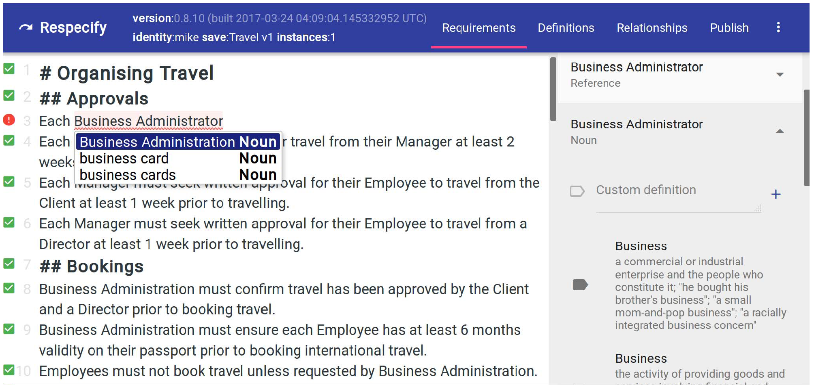
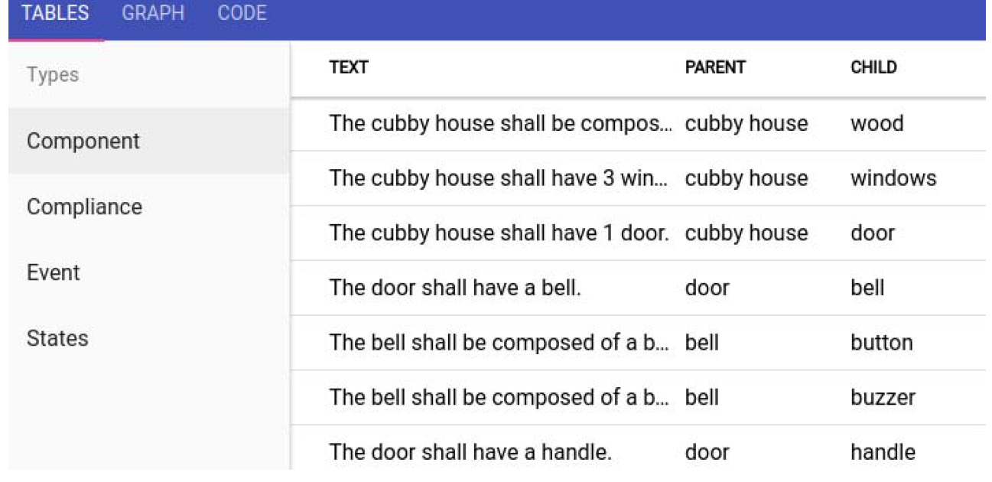
Sample Tool: Respecify
Martha can’t … Good & Bad Standard Pitfalls to Avoid A Few Simple Tests Summary & Tools
Respecify: Web-based requirements authoring tool
Uses constrained natural language (CNL) to guide the requirements and specification authoring process
Completions, glossary, Wordnet synonyms/semantics, relationships… Improved consistency!
M. Ledger: A demonstration of Respecify: a requirements authoring tool harnessing CNL. RE 2017. IEEE CS, 472-473

Slide 23
Other Commercial Tool: RAT
Martha can’t … Good & Bad Standard Pitfalls to Avoid A Few Simple Tests Summary & Tools
Requirements Authoring Tool (RAT)
https://www.reusecompany.com/authoring-tools
Claims:
Tools and plug-ins to assist you in the activity of writing requirements and other natural language texts.
Performs Correctness and Consistency analysis on the fly
Suggests controlled-vocabulary items based on a central knowledge base
Fully integrated into your Requirements Management Tool and Modelling Tool

Slide 24
Key Questions and Characteristics
Martha can’t … Good & Bad Standard Pitfalls to Avoid A Few Simple Tests Summary & Tools
Remember the key questions “Why?” or “What is the purpose of this?”
Feasible
Needed
Testable

