Slide 1
Requirements Elicitation
SEG3101 (Fall 2018)
Daniel Amyot, University of Ottawa
Based on PowerPoint slides by Gunter Mussbacher (2009)
with material from:
Jo Atlee, Nancy Day, Dan Berry (all University of Waterloo);
Lethbridge & Laganière; Bruegge & Dutoit;
I. Alexander; Amyot 2008-2017; Somé 2008, Bochmann 2010

Slide 2
Table of Contents
Goals, Risks, and Challenges
Sources of Requirements
Requirements Elicitation Tasks
Elicitation Problems
Elicitation Techniques
I know that you believe that you understood what you think I said, but I am not sure you realize that what you heard is not what I meant.¹
[1] Robert McCloskey, State Department spokesman

Slide 3
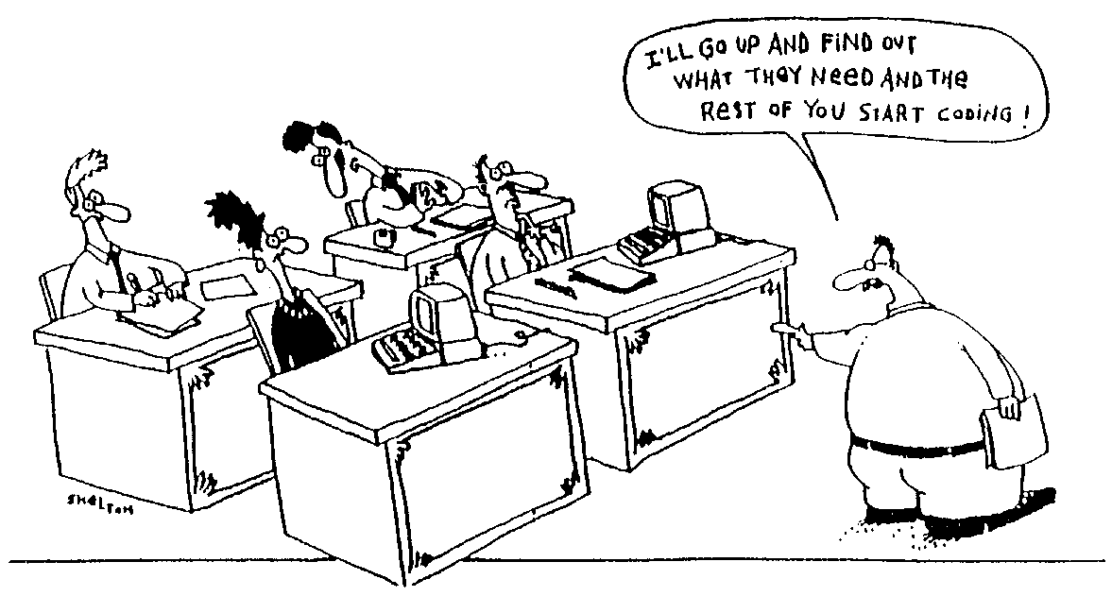

Slide 4
Goals, Risks, and Challenges

Slide 5
What is Requirements Elicitation?
Goals, Risks, and Challenges Sources of Requirements Requirements Elicitation Tasks Elicitation Problems
Requirements elicitation is “the process of discovering the requirements for a system by communicating with customers, system users and others who have a stake in the system development”¹
Elicitation means “to bring out, to evoke, to call forth”
Elicitation might even require one to provoke!
Human activity involving interaction between a diverse array of human beings
[1] Ian Sommerville and Pete Sawyer

Slide 6
Elicitation Goals
Goals, Risks, and Challenges Sources of Requirements Requirements Elicitation Tasks Elicitation Problems
Determine information needed, the sources of information & the appropriate techniques
Get information on domain, problem, constraints
Produce a first document
  Mainly user requirements and elicitation notes
  Potentially incomplete, disorganized, inconsistent
  But we must start somewhere!

Slide 7
Elicitation Risks and Challenges (1)
Goals, Risks, and Challenges Sources of Requirements Requirements Elicitation Tasks Elicitation Problems
Problems of scope
  System boundaries inadequately defined or defined too soon
  Unnecessary technical details
Problems of understanding
  Stakeholder not sure of what is needed
  Stakeholder has trouble communicating needs
  Stakeholder does not understand capabilities and limitation of computing environment
    Requirements limited by what stakeholders think is possible
  Stakeholder does not have full understanding of domain
  Stakeholders state conflicting requirements
    Hard to detect, negotiate, and prioritize
Problems of volatility
  Stakeholders will not commit to a set of written requirements

Slide 8
Elicitation Risks and Challenges (2)
Goals, Risks, and Challenges Sources of Requirements Requirements Elicitation Tasks Elicitation Problems
Other typical issues
  Experts seldom available
  Many stakeholders lack motivation or resist to change
  Finding an adequate level of precision/detail
  Mixing requirements with design
  Common vocabulary often missing
Requirements do not fall from the sky!
  Sometimes hidden
  Sometimes too obvious, implicit, ordinary…
  Assume == “a**” of “u” and “me”
Need for creative thinking in order to
produce innovative and adequate
requirements

Slide 9
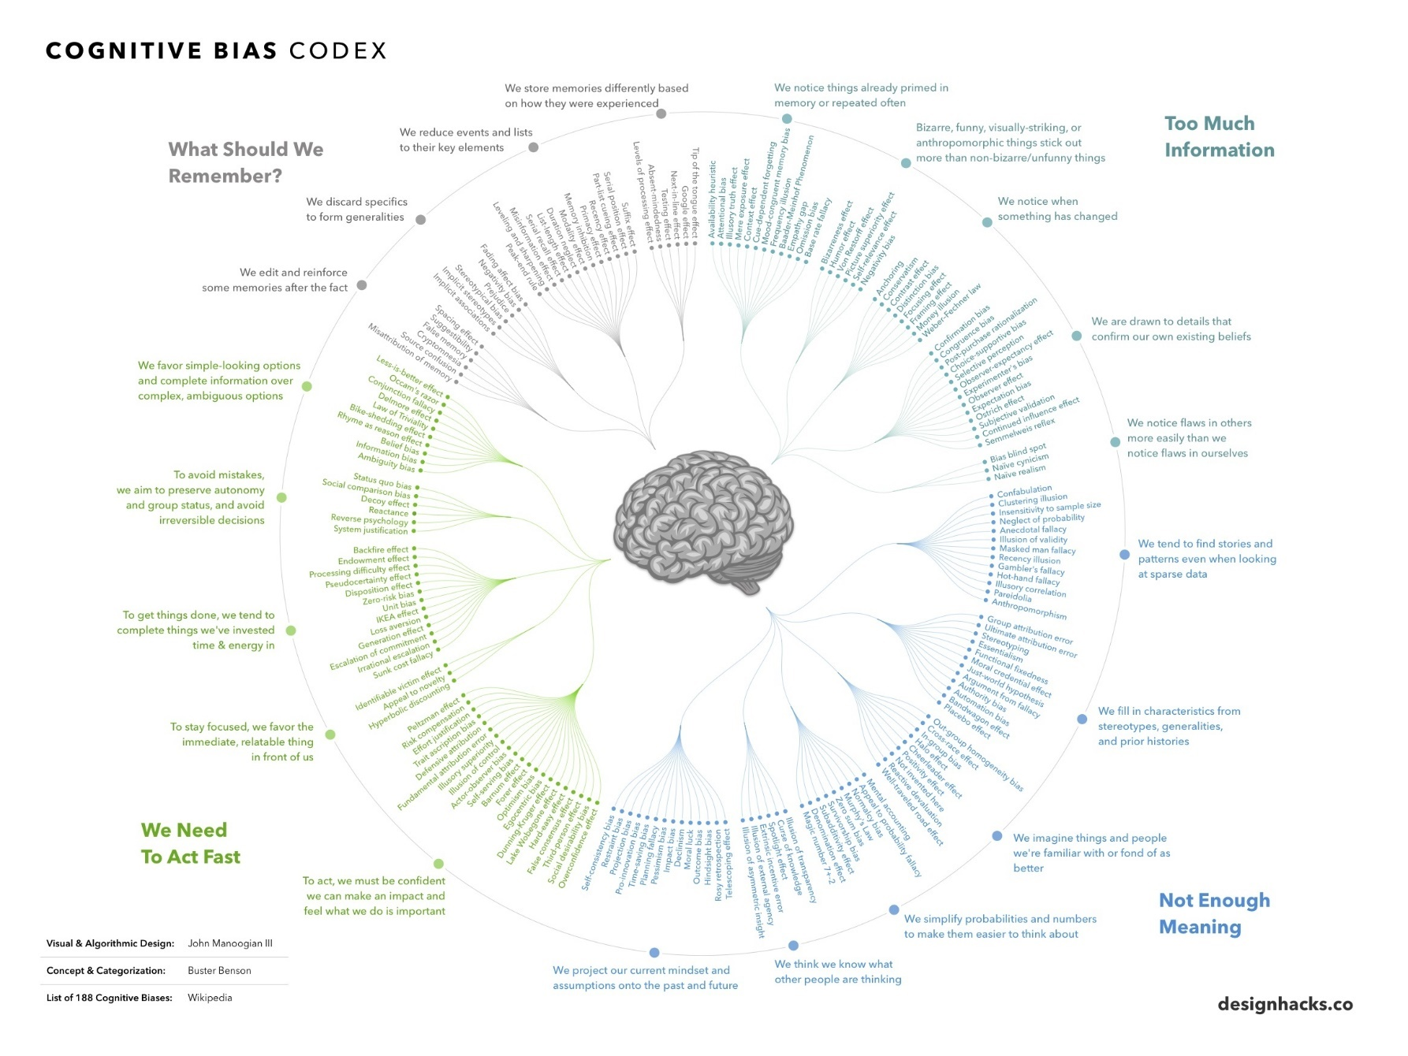
Risks of Bias?
Goals, Risks, and Challenges Sources of Requirements Requirements Elicitation Tasks Elicitation Problems

Slide 10
RE: More an Art than Science?
Goals, Risks, and Challenges Sources of Requirements Requirements Elicitation Tasks Elicitation Problems

Slide 11
Sources of Requirements and Stakeholders

Slide 12
Sources of Requirements
Goals, Risks, and Challenges Sources of Requirements Requirements Elicitation Tasks Elicitation Problems
Various stakeholders
  Clients, customers, users (past and future), buyers, managers, domain experts, developers, marketing and QA people, lawyers, people involved in related systems, anyone who can bring added value!
Pre-existing systems
  Not necessarily software systems
Pre-existing documentation
Competing systems
Documentation about interfacing systems
Standards, policies, collective agreements, legislation
…

Slide 13
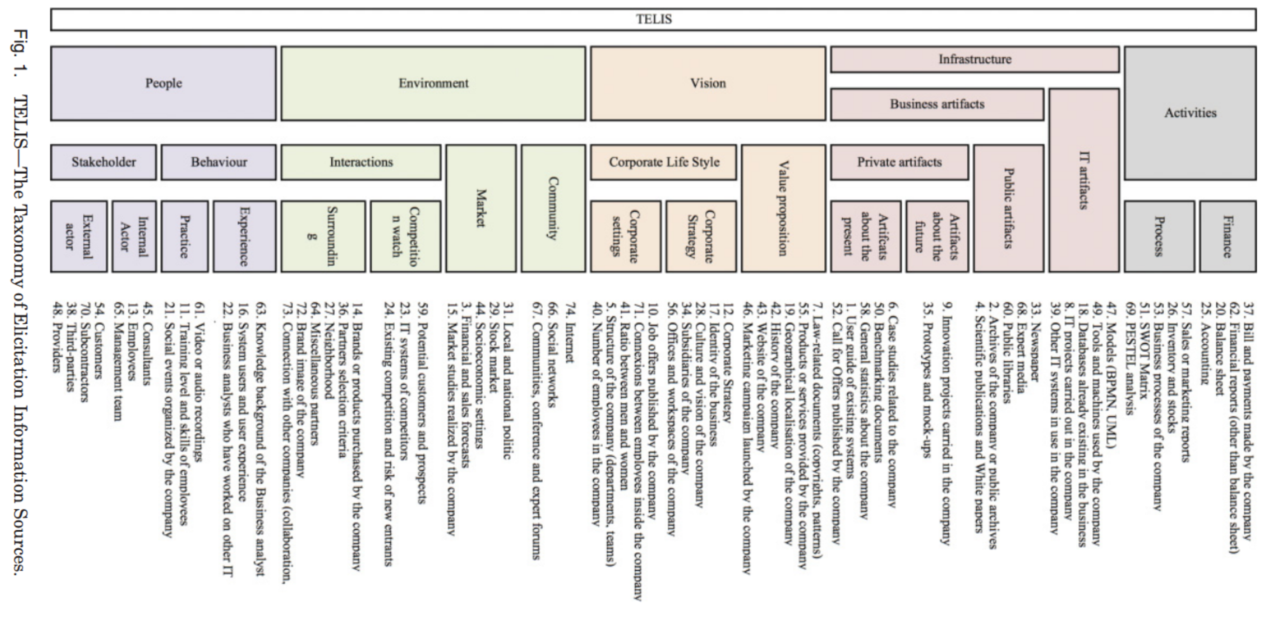
Sources of Requirements: TELIS
Goals, Risks, and Challenges Sources of Requirements Requirements Elicitation Tasks Elicitation Problems
Corentin Burnay. 2016. Are Stakeholders the Only Source of Information for Requirements Engineers? Toward a Taxonomy of Elicitation Information Sources. ACM Trans. Manage. Inf. Syst.7, 3, Article 8

Slide 14
Stakeholder – Customer/Client
Goals, Risks, and Challenges Sources of Requirements Requirements Elicitation Tasks Elicitation Problems
Person who pays for the software development
Ultimately, has the final word on what will be the product
For an internal product, the client is probably a product manager
For the consumer market, the customer may be the marketing department

Slide 15
Stakeholder – Buyer
Goals, Risks, and Challenges Sources of Requirements Requirements Elicitation Tasks Elicitation Problems
Person who pays for the software once it is developed
Possibly a user or a business owner buying a product for his employees
What features is he willing to pay for?
  Which are trivial or excessive?
Must participate actively in the project (or have a representative)

Slide 16
Stakeholder – User
Goals, Risks, and Challenges Sources of Requirements Requirements Elicitation Tasks Elicitation Problems
... of the current system or future system
Experts of the current system: indicate which functions to maintain or improve
Experts of competitors’ products: suggestions on designing a superior product
May have special needs or requirements
  Usability, training, online help ...
Do not neglect interest groups
  Expert users, or with disabilities or handicaps
Select users with care
  Different seniority
  Must speak with authority and be responsible and motivated

Slide 17
Stakeholder – Domain Expert
Goals, Risks, and Challenges Sources of Requirements Requirements Elicitation Tasks Elicitation Problems
Expert who knows the work involved
Familiar with the problem that the software must solve. For example:
  Financial expert for finance management software
  Aeronautical engineers for air navigation systems
  Meteorologist for weather forecasting system, etc…
Also knows the environment in which the product will be used

Slide 18
Stakeholder – Software Engineer
Goals, Risks, and Challenges Sources of Requirements Requirements Elicitation Tasks Elicitation Problems
Expert who knows the technology and process
Determines if the project is technically and economically feasible
Specifically estimates the cost and time of product development
Educates the buyer/client on the latest and innovative hardware or software, and recommends new features that will benefit from these technologies

Slide 19
Stakeholder – Others
Goals, Risks, and Challenges Sources of Requirements Requirements Elicitation Tasks Elicitation Problems
Inspector
  An expert in governmental rules and safety relevant to the project
  Examples: safety inspectors, auditors, technical inspectors, government inspectors
Market research specialist
  Can play the role of the customer if the software is developed for the general public
  Expert who has studied the market to determine trends and needs of potential customers

Slide 20
Stakeholder – Others
Goals, Risks, and Challenges Sources of Requirements Requirements Elicitation Tasks Elicitation Problems
Lawyer
  Familiar with laws and legal aspects
  Standards relevant to the project
Expert of systems that interact with the system to be built
  Knows the interfaces of the interacting systems
  May be interested in product features (if the product can help the interacting system to perform its tasks)
Managers and decision-makers
Others that bring added value
  People who will use your product as a basic building block
  User experience (UX) expert, negative stakeholders (competitor, hacker, …), regulators, unions, testers, interest groups, the “crowd”, etc.

Slide 21
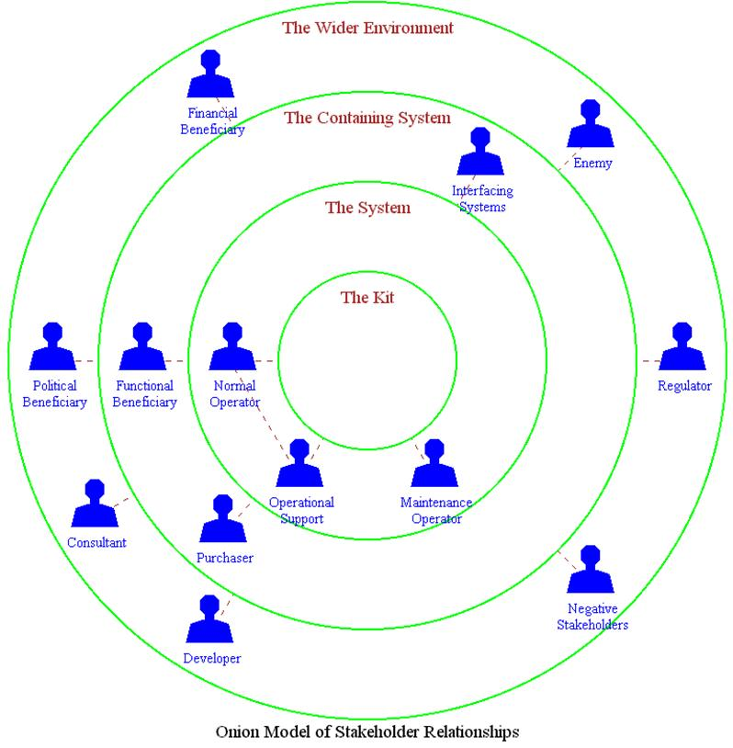
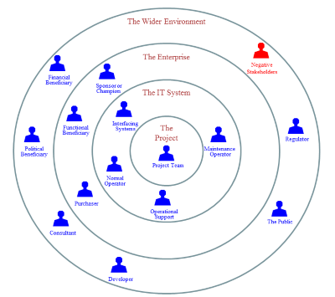
Onion Models: Spheres of Influence
Goals, Risks, and Challenges Sources of Requirements Requirements Elicitation Tasks Elicitation Problems
Ian Alexander: A Taxonomy of Stakeholders (2005), http://www.scenarioplus.
org.uk/papers/stakeholder_taxonomy/stakeholder_taxonomy.htm

Slide 22
On Stakeholders Availability…
Goals, Risks, and Challenges Sources of Requirements Requirements Elicitation Tasks Elicitation Problems
Stakeholders are generally busy!
  Have priorities other than you
  Are rarely entirely disconnected from their daily routine and tasks
  See their participation in the elicitation process as a supplementary task
Hence, you must have the support and commitment of managers (especially theirs!)
You must also avoid being perceived as a threat:
  Loss of jobs caused by the improved system
  Loss of autonomy, powers, or privileges
  To the recognition and visibility of their work

Slide 23
Persona
Goals, Risks, and Challenges Sources of Requirements Requirements Elicitation Tasks Elicitation Problems
Fictitious representation of a probable user
  Away from outlier and unlikely cases
Seeks to represent the needs and characteristics of different groups of users (often unavailable)
Ideally created from real data / encounters / observations
Can partially compensate for the physical absence of users
  Name and photo! Personalizes a particular user. Focus and empathy!
  No interactions however ...
Describes: behavior patterns, objectives, problems, abilities, attitudes, environment, culture, demographic info...
Different templates exist
  Several are generic
  Some focus on particular areas, for example, medical patients (http://russellfaust.com/patient-personas/)

Slide 24
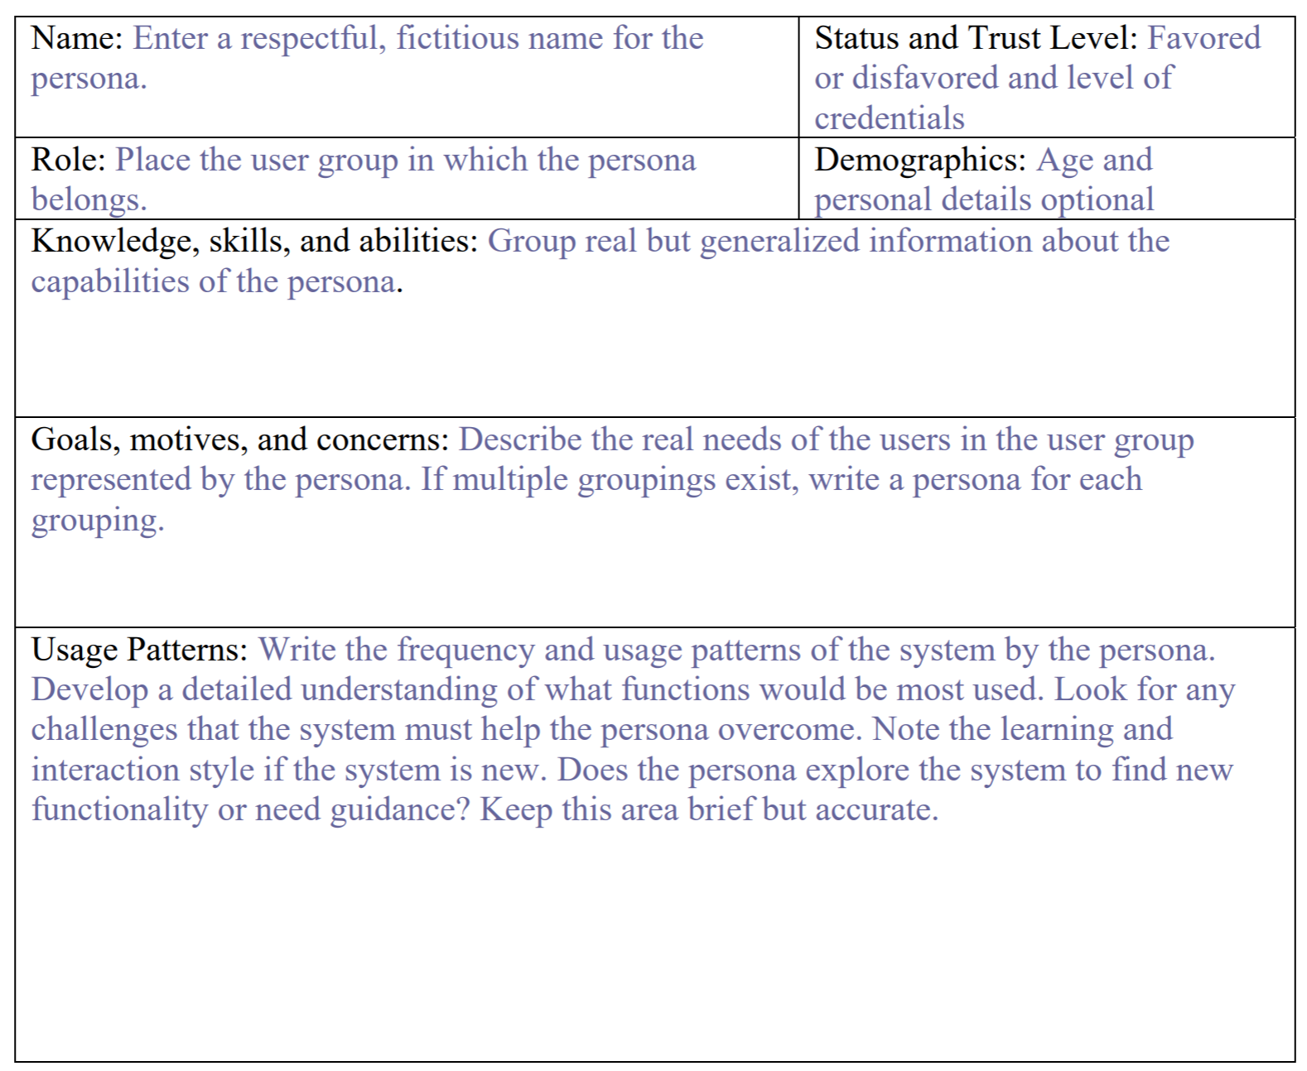
MSF Agile Persona Template
Goals, Risks, and Challenges Sources of Requirements Requirements Elicitation Tasks Elicitation Problems
http://agile.csc.ncsu.edu/SEMaterials/Personas.pdf

Slide 25
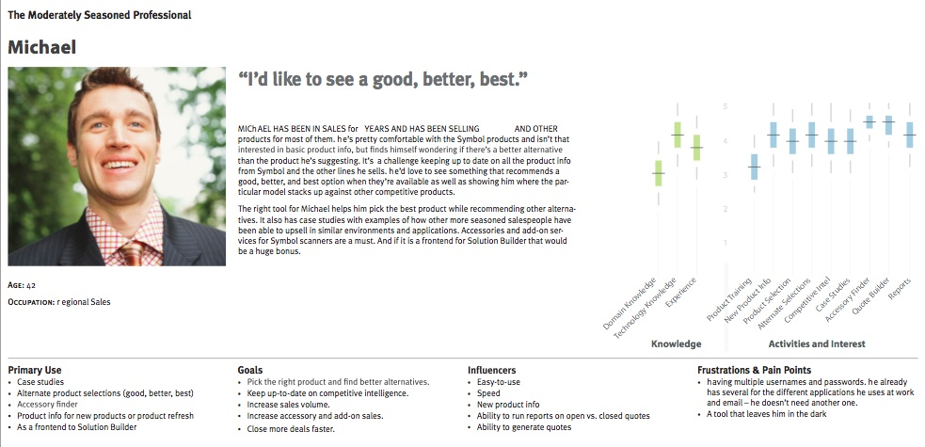
Michael the Moderately Seasoned Professional
Goals, Risks, and Challenges Sources of Requirements Requirements Elicitation Tasks Elicitation Problems
http://courses.ischool.berkeley.edu/i213/s09/lectures/Personas.ppt

Slide 26
Characteristics of personas: VARIED
Goals, Risks, and Challenges Sources of Requirements Requirements Elicitation Tasks Elicitation Problems
Vivid
  The persona should make anyone who reads it feel like they have actually met this person.
Actionable
  If the persona does not inform how you sell or build stuff, why bother?
Real
  Good personas are not created in cubicles. Go where the persona is and observe.
Identifiable
  Make sure you can identify and target these personas, or you will not be able to find a use for them.
Exact
  “Everyone” is not your customer. Make sure the personas are distinct so you can apply relevant focus.
Detailed
  People are complicated and so good personas are usually substantial
  [A. Cowan: A Day in the Life, 2014]

Slide 27
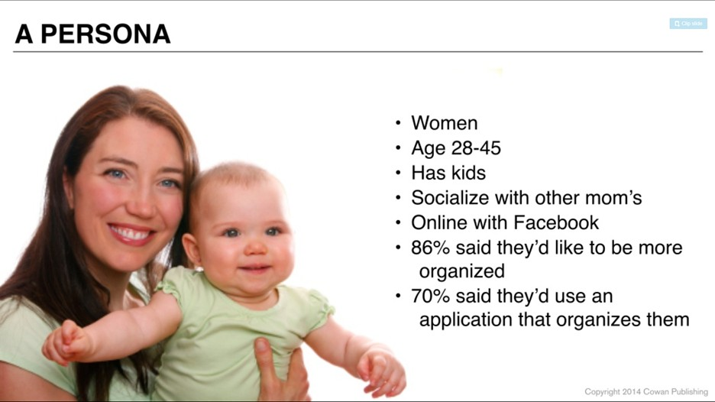
Example of Incorrect Persona
Goals, Risks, and Challenges Sources of Requirements Requirements Elicitation Tasks Elicitation Problems
  [A. Cowan: A Day in the Life, 2014]

Slide 28
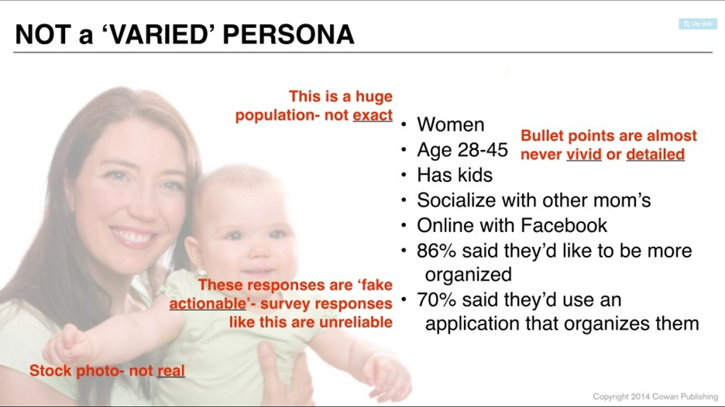
Example of Incorrect Persona
Goals, Risks, and Challenges Sources of Requirements Requirements Elicitation Tasks Elicitation Problems
  [A. Cowan: A Day in the Life, 2014]

Slide 29
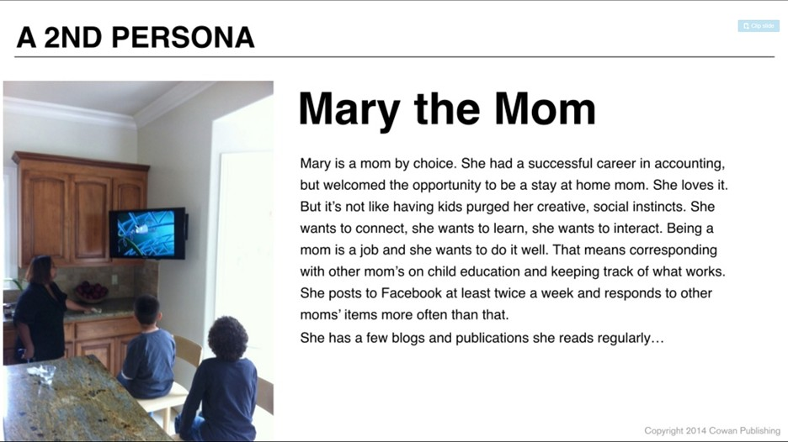
Example of Correct Persona
Goals, Risks, and Challenges Sources of Requirements Requirements Elicitation Tasks Elicitation Problems
  [A. Cowan: A Day in the Life, 2014]

Slide 30
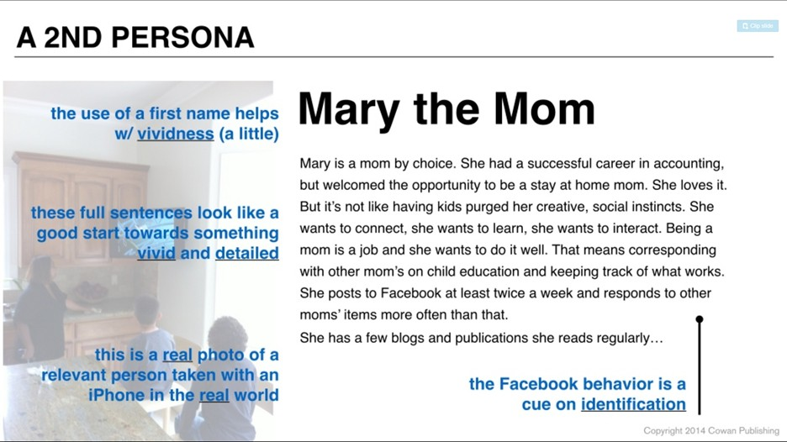
Example of Correct Persona
Goals, Risks, and Challenges Sources of Requirements Requirements Elicitation Tasks Elicitation Problems
  [A. Cowan: A Day in the Life, 2014]

Slide 31

Think / See / Feel / Do Approach
Goals, Risks, and Challenges Sources of Requirements Requirements Elicitation Tasks Elicitation Problems
Think
  Description of the tension between how things are now
  and how the persona would like them to be.
See
  Description of how your persona arrived at the point of view you described in Think
Feel
  This is the actual, emotional relevance of the personas thoughts and observations in your area of your interest.
Do
  You need to get at what they actually do in area and how often/how much/with how much money they engage in the activity question
See also this example: A. Cowan: Personas for Design, Development & Growth (2014)

Slide 32
Requirements Elicitation Tasks

Slide 33
Tasks Performed as Part of Elicitation (1)
Goals, Risks, and Challenges Sources of Requirements Requirements Elicitation Tasks Elicitation Problems
Planning for the elicitation
  Why? Who? When? How? Risks?
During the elicitation
  Confirm the viability of the project (is it worth it?)
  Understand the problem from the perspective of each stakeholder
  Extract the essence of stakeholders’ requirements
  Invent better ways to do the work of the user
Following the elicitation
  Analyse results to understand obtained information
  Negotiate a coherent set of requirements acceptable by all stakeholders and establish priorities
  Record results in the requirements specification

Slide 34
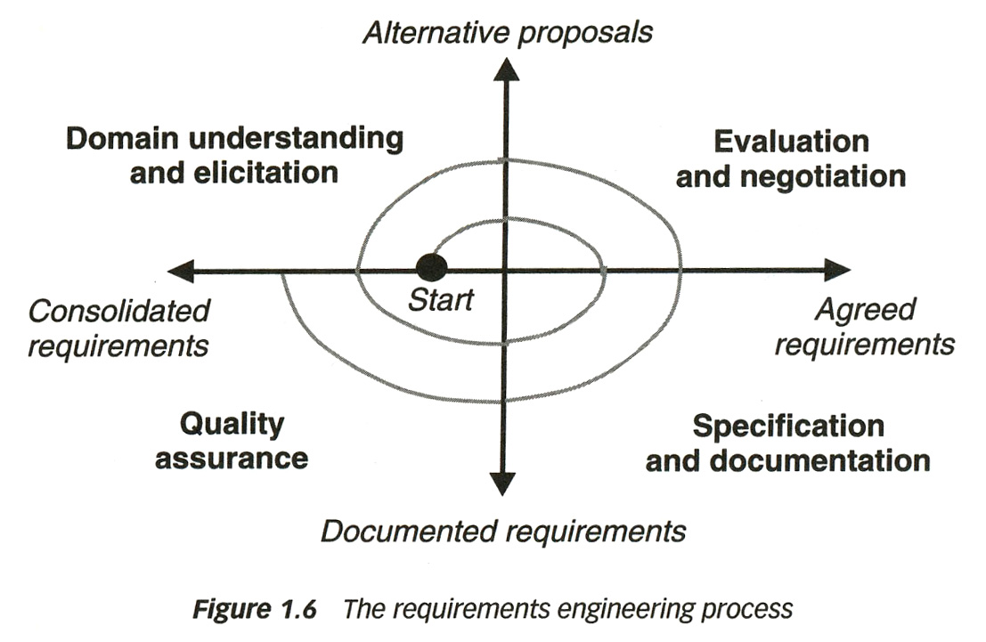
Tasks Performed as Part of Elicitation (2)
Goals, Risks, and Challenges Sources of Requirements Requirements Elicitation Tasks Elicitation Problems
Repeat as needed
Elicitation is incremental
  Driven by information obtained
  You always do a bit of elicitation – analysis – specification – verification at the same time

Slide 35
Elicitation Plan – Objectives / Strategies & Processes
Goals, Risks, and Challenges Sources of Requirements Requirements Elicitation Tasks Elicitation Problems
Objectives: Why this elicitation?
  Validate market data
  Explore usage scenarios
  Develop a set of requirements, etc..
Set elicitation strategies and processes
  Approaches used
  Often a combination of approaches depending on the types and number of stakeholders
  Examples: Surveys (questionnaires)‏, workshops, interviews…

Slide 36
Elicitation Plan – Products
Goals, Risks, and Challenges Sources of Requirements Requirements Elicitation Tasks Elicitation Problems
Usually set of rough requirements
  Written, audio, video notes
  Documentation
Deliverables depend on objective and technique
Generally: un-organized, redundant, incomplete

Slide 37
Extract Essence
Goals, Risks, and Challenges Sources of Requirements Requirements Elicitation Tasks Elicitation Problems
Extract the essence of the stakeholders' requirements
  Interpret stakeholders' descriptions of requirements
  Possibly build models (may be part of your documentation!)
  Gaps in the model behavior may indicate unknown or ambiguous situations
    Models help focus our efforts
    Should be resolved by asking the stakeholders (especially users)

Slide 38
Invent Better Ways
Goals, Risks, and Challenges Sources of Requirements Requirements Elicitation Tasks Elicitation Problems
Invent better ways to do the user's work
  Ask why documented requirements so far are desired
  The client/user’s view can be limited by past experiences...
  Brainstorm (or use another creativity technique) to invent and propose requirements the stakeholders have not yet thought of

Slide 39
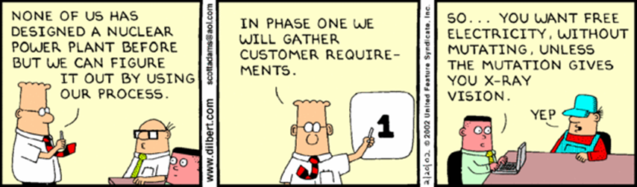
Dilbert on Requirements Elicitation
Goals, Risks, and Challenges Sources of Requirements Requirements Elicitation Tasks Elicitation Problems

Slide 40
Elicitation Techniques

Slide 41
Elicitation Techniques
Elicitation Techniques Existing Systems Interviews Questionnaires Brainstorming Prototyping Use Cases
Elicitation techniques
  Brainstorming and Design Thinking
  Analysis of existing systems
    Analysis of existing documentation
    Task observation, ethnography
  Discourse analysis
  Interviewing
  Questionnaires
  Workshops
  Prototyping
  Pilot system
  Use cases, scenarios, and user stories
  Usage data analysis
  …
Comparison
  See this paper (2015)

Slide 42
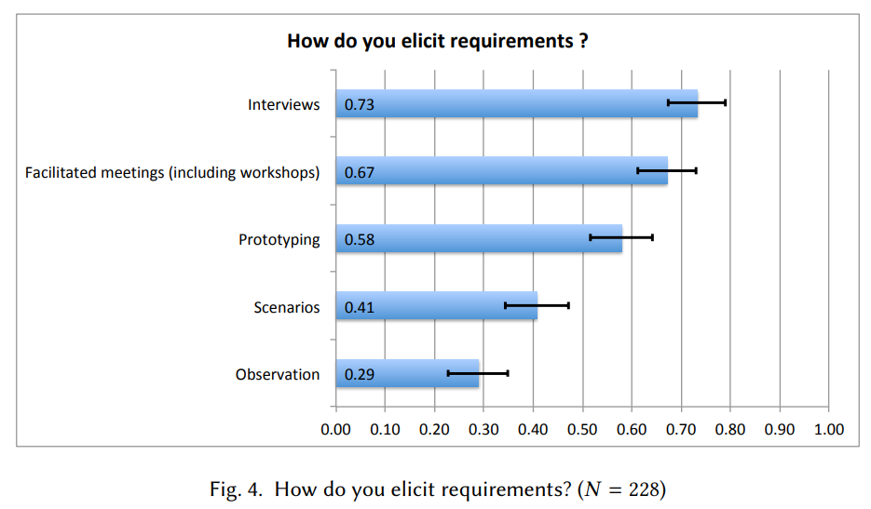
Popularity of Some Elicitation Technique
Elicitation Techniques Existing Systems Interviews Questionnaires Brainstorming Prototyping Use Cases
Status Quo in Requirements Engineering: A Theory and a Global Family of Surveys (2018)

Slide 43
Comparison of Data-Gathering Techniques¹
Elicitation Techniques Existing Systems Interviews Questionnaires Brainstorming Prototyping Use Cases
Technique | Good for | Kind of data | Plus | Minus
Questionnaires | Answering specific questions | Quantitative and qualitative data | Can reach many people with low resource | The design is crucial. Response rate may be low. Responses may not be what you want
Interviews | Exploring issues | Some quantitative but mostly qualitative data | Interviewer can guide interviewee. Encourages contact between developers and users | Time consuming. Artificial environment may intimidate interviewee
Focus groups and workshops | Collecting multiple viewpoints | Some quantitative but mostly qualitative data | Highlights areas of consensus and conflict. Encourages contact between developers and users | Possibility of dominant characters
Naturalistic observation | Understanding context of user activity | Qualitative | Observing actual work gives insight that other techniques cannot give | Very time consuming. Huge amounts of data
Studying documentation | Learning about procedures, regulations, and standards | Quantitative | No time commitment from users required | Day-to-day work will differ from documented procedures
[1] Preece, Rogers, and Sharp “Interaction Design: Beyond human-computer interaction”, p214

Slide 44
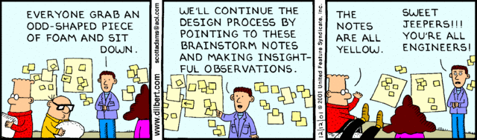
Brainstorming and Design Thinking

Slide 45
Brainstorming
Elicitation Techniques Existing Systems Interviews Questionnaires Brainstorming Prototyping Use Cases
To invent new way of doing things or when much is unknown
  When there are few or too many ideas
  Early on in a project particularly when:
    Terrain is uncertain
    There is little expertise for the type of applications
    Innovation is important (e.g., novel system)
Two main activities:
  The Storm: Generating as many ideas as possible (quantity, not quality) – wild is good!
  The Calm: Filtering out of ideas (combine, clarify,
  prioritize, improve…) to keep the best one(s) –
  may require some voting strategy
Roles: scribe, moderator (may also provoke),
participants

Slide 46
Brainstorming – Objectives
Elicitation Techniques Existing Systems Interviews Questionnaires Brainstorming Prototyping Use Cases
Hear ideas from everyone, especially unconventional ideas
  Keep the tone informal and non-judgemental
  Keep the number of participants “reasonable“ – if too many, consider a “playoff “-type filtering and invite back the most creative to multiple sessions
Encourage creativity
  Choose good, provocative project name
  Choose good, provocative problem statement
  Get a room without distractions, but with good acoustics, whiteboards, coloured pens, provide coffee/donuts/pizza/beer
  Provide appropriate props/mock-ups

Slide 47
Brainstorming – Roles
Elicitation Techniques Existing Systems Interviews Questionnaires Brainstorming Prototyping Use Cases
Scribe
  Write down all ideas (may also contribute)
  May ask clarifying questions during first phase but without criticizing
Moderator/Leader
  Cannot be the scribe
  Two schools of thought: traffic cop or agent provocateur
  Traffic cop – enforces "rules of order", but does not throw his/her weight around otherwise
  Agent provocateur – traffic cop plus more of a leadership role, comes prepared with wild ideas and throws them out as discussion wanes
    May also explicitly look for variations and combinations of other suggestions

Slide 48
Brainstorming – Participants
Elicitation Techniques Existing Systems Interviews Questionnaires Brainstorming Prototyping Use Cases
Virtually any stakeholder, e.g.
  Developers
  Domain experts
  End-users
  Clients
  ...
“Ideas-people” – a company may have a special team of people
  Chair or participate in brainstorming sessions
  Not necessarily further involved with the project

Slide 49
Brainstorming – The Storm
Elicitation Techniques Existing Systems Interviews Questionnaires Brainstorming Prototyping Use Cases
Goal is to generate as many ideas as possible
Quantity, not quality, is the goal at this stage
Look to combine or vary ideas already suggested
No criticism or debate is permitted – do not want to inhibit participants. No rambling (long stories) or distractions
Participants understand nothing they say will be held against them later on
Scribe writes down all ideas where everyone can see
  E.g., whiteboard, paper taped to wall
  Ideas do not leave the room
Wild is good!
  Feel free to be gloriously wrong
  Participants should NOT censor themselves or take too long to consider whether an idea is practical or not – let yourself go!

Slide 50
Brainstorming – The Calm
Elicitation Techniques Existing Systems Interviews Questionnaires Brainstorming Prototyping Use Cases
Go over the list of ideas and explain them more clearly
Categorize into "maybe" and "no" by pre-agreed consensus method
  Informal consensus
  50% + 1 vote vs. “clear majority”
  Does anyone have veto power?
  Dutch auction: http://en.wikipedia.org/wiki/Dutch_auction
Be careful about time and people
  Meetings (especially if creative or technical in nature) tend to lose focus after 90 to 120 minutes – take breaks or reconvene later
  Be careful not to offend participants
Review, consolidate, combine, clarify, improve
Rank the list by priority somehow
Choose the winning idea(s)

Slide 51

Brainstorming – Eliminating Ideas
Elicitation Techniques Existing Systems Interviews Questionnaires Brainstorming Prototyping Use Cases
There are some common ways to eliminate some ideas
Blending ideas
  Unify similar ideas but be aware not to force fit
  everything into one idea
Give each participant $100 to spend on the ideas
Apply acceptance criteria prepared prior to meeting
  Eliminate the ideas that do not meet the criteria
Various ranking or scoring methods
  Assign points for criteria met, possibly use a
  weighted formula
Vote with threshold…
  Possibly select top k for voting treatment

Slide 52
Brainstorming – Tool Support
Elicitation Techniques Existing Systems Interviews Questionnaires Brainstorming Prototyping Use Cases
With many good ideas, some outrageous and even farfetched, brainstorming can be really fun!
Creates a great environment that stimulates
people and motivates them to perform well!
Can be done by email (barely…), but a good moderator/leader is needed to
  Prevent flamers and trolls to come into play
  Prevent race conditions due to the asynchronous communication medium
  Be careful not to go into too much detail
Collaboration tools are also possible
  See 24 tools at http://mashable.com/2013/09/25/mind-mapping-tools/#9MfS8Icvt8qN

Slide 53
Variation: Joint Application Design (JAD)
Elicitation Techniques Existing Systems Interviews Questionnaires Brainstorming Prototyping Use Cases
A more structured and intensive brainstorming approach
  Developed at IBM in the 1970s
  Full of structure, defined roles, forms to be filled out...
Three phases
  Customization, Session, Synthesis
Six (human) roles to be played
  Session leader, Analyst, Executive sponsor, User representatives, Information system representatives, Technical expert on information systems, Specialists
JAD sessions may last a few days

Slide 54
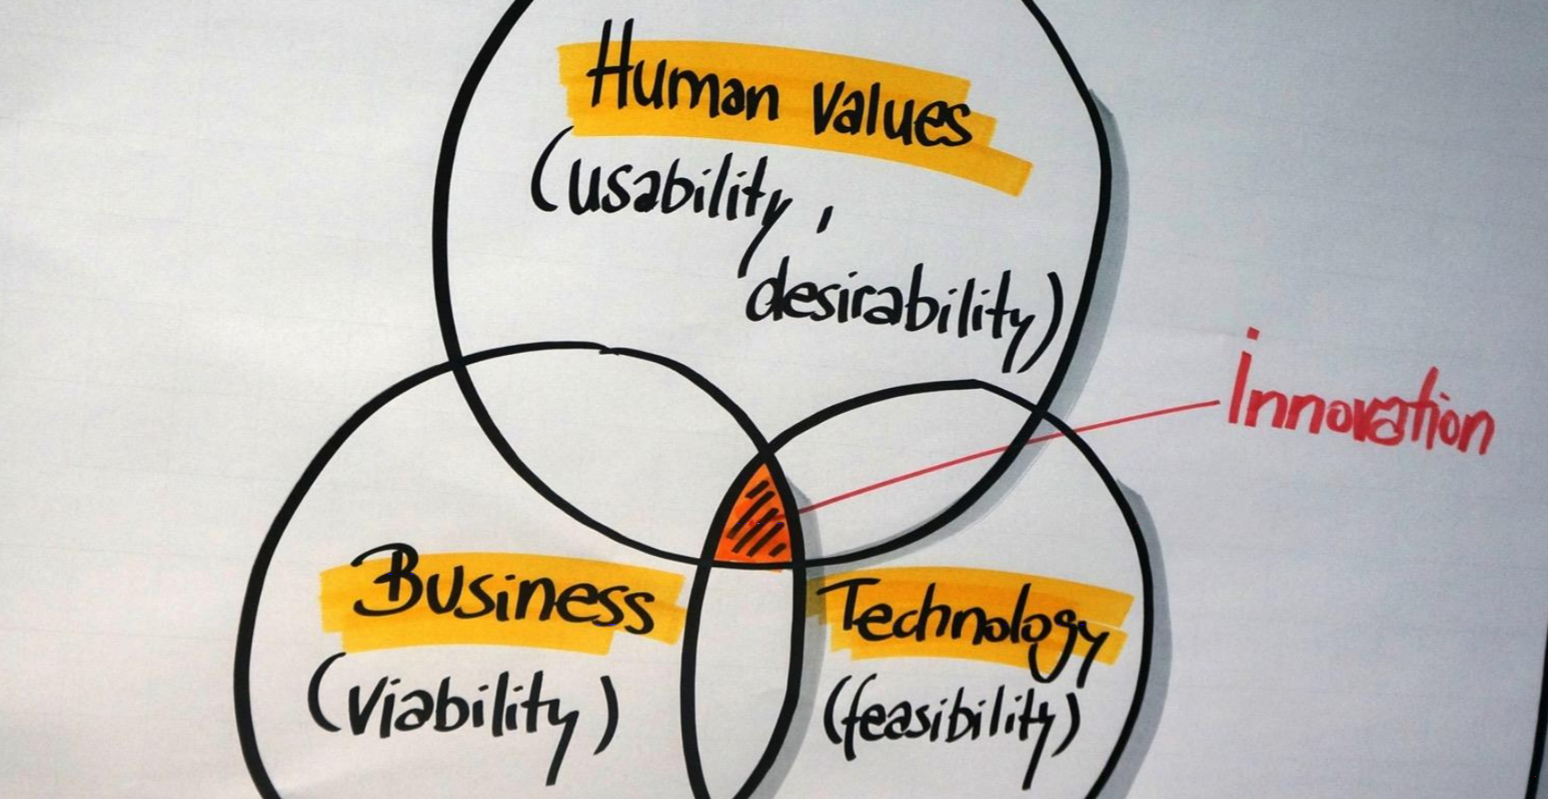
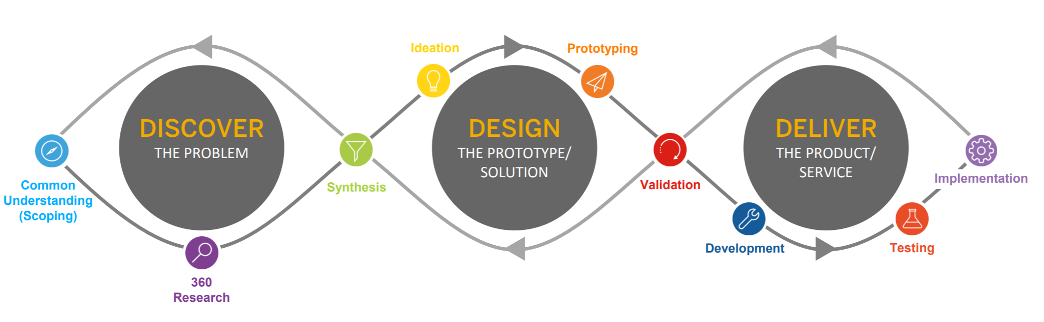
Variant: Design Thinking
Elicitation Techniques Existing Systems Interviews Questionnaires Brainstorming Prototyping Use Cases
Creative strategy for solving problems, user-centered
Divergent thinking, then convergent thinking
Romana Oehmig: How Design Thinking Works (@ SAP) (2017), http://ctp.di.fct.unl.pt/RE2017/slides/RE2017_Keynote_Romana.pdf

Slide 55
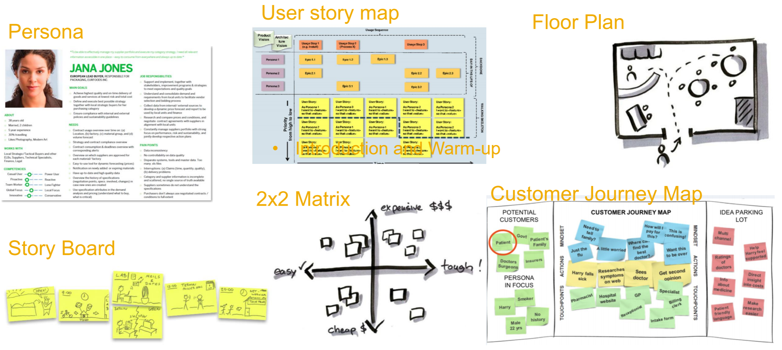
Design Thinking Tools
Elicitation Techniques Existing Systems Interviews Questionnaires Brainstorming Prototyping Use Cases
https://hpi.de/en/school-of-design-thinking.html

Slide 56
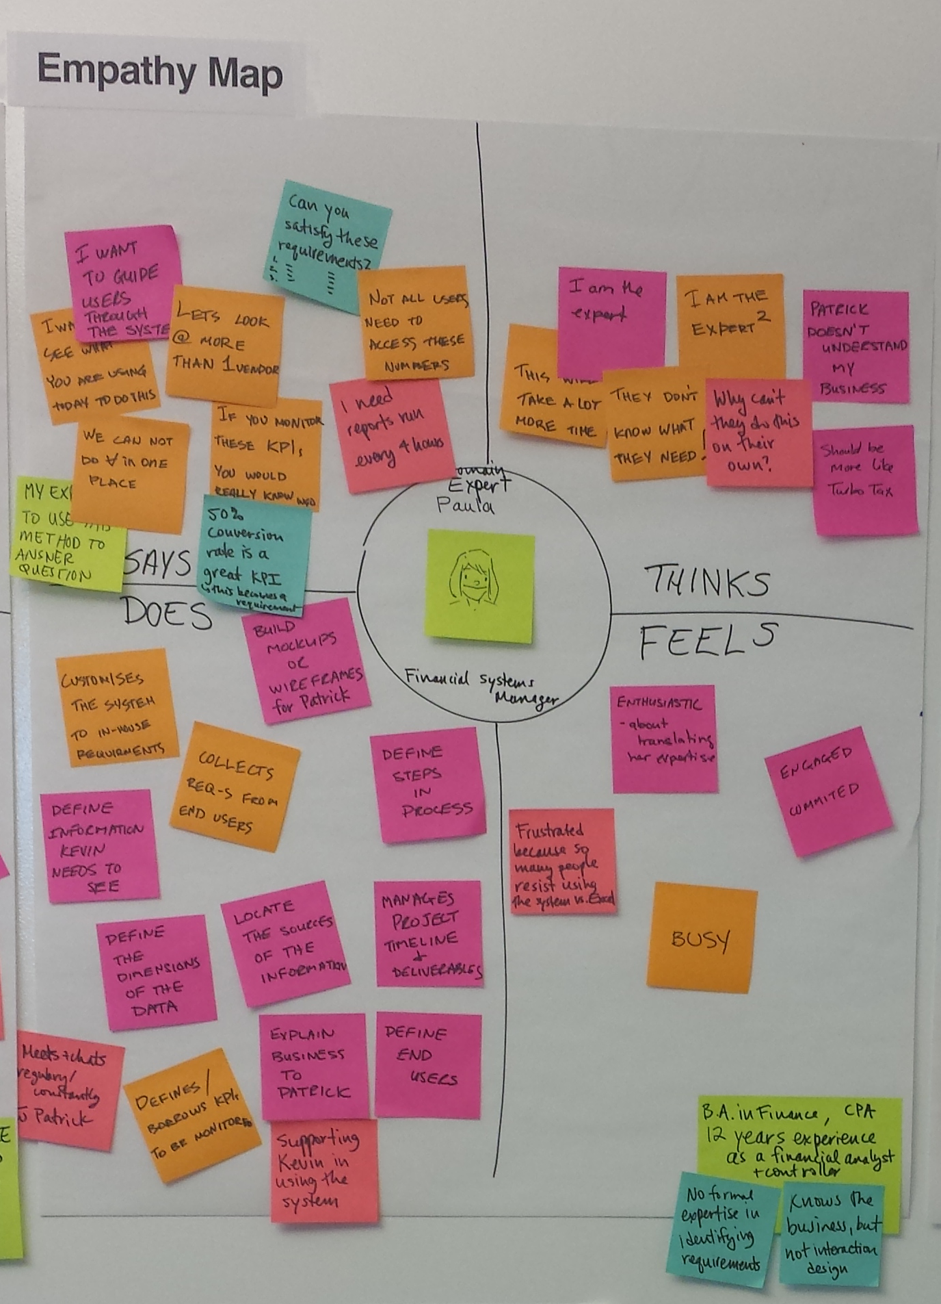
Design Thinking Empathy Map
Elicitation Techniques Existing Systems Interviews Questionnaires Brainstorming Prototyping Use Cases
Perspective of one stakeholder
  Says
  Thinks
  Does
  Feels
Related to personas

Slide 57
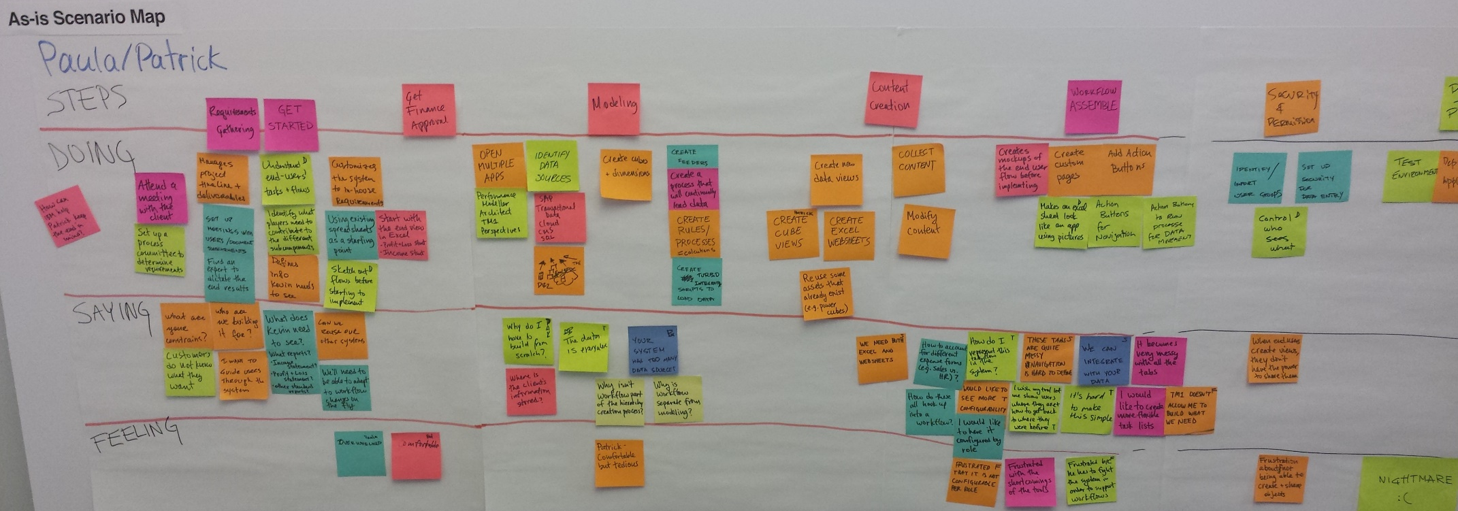
Design Thinking Scenario Maps
Elicitation Techniques Existing Systems Interviews Questionnaires Brainstorming Prototyping Use Cases
As-is and To-Be scenarios
  Steps, Doing, Saying, Feeling
https://www.ibm.com/design/thinking

Slide 58
Challenges of Brainstorming and its Variants
Elicitation Techniques Existing Systems Interviews Questionnaires Brainstorming Prototyping Use Cases
Unnatural clusters of (uncomfortable) participants
“Groupthink”
Superficial responses to technical issues
Bias and dominance

Slide 59
Analysis of Existing Systems

Slide 60
Analysis of Existing Systems (1)
Elicitation Techniques Existing Systems Interviews Questionnaires Brainstorming Prototyping Use Cases
Useful when building a new improved version of an existing system
Important to know:
  What is used, not used, or missing
  What works well, what does not work
  How the system is used (with frequency and importance) and it was supposed to be used, and how we would like to use it

Slide 61
Analysis of Existing Systems (2)
Elicitation Techniques Existing Systems Interviews Questionnaires Brainstorming Prototyping Use Cases
Why analyze an existing system?
  Users may become disillusioned with new system or do not like the new system if it is too different or does not do what they want (risk of nostalgia towards old systems)
  To appropriately take into account real usage patterns, human issues, common activities, relative importance of tasks/features
  To catch obvious possible improvements (features that are missing or do not currently work well)
  To find out which "legacy" features can/cannot be left out

Slide 62
Review Available Documentation
Elicitation Techniques Existing Systems Interviews Questionnaires Brainstorming Prototyping Use Cases
Start with reading available documentation
  User documents (manual, guides…)
  Development documents
  Requirements documents
  Internal memos
  Change histories
  …
Of course, often these are out of date, poorly written, wrong, etc., but it's a good starting point
Complement with observations, questionnaires, interviews…

Slide 63
Observation and Related Techniques
Elicitation Techniques Existing Systems Interviews Questionnaires Brainstorming Prototyping Use Cases
Observation
  Get into the trenches and observe specialists “in the wild”
  Shadow important potential users as they do their work
  Silent approach, or ask user to explain everything he or she is doing
  Session videotaping
Challenge
  Observed people can be conscious of the presence of external observers and change their behaviour accordingly (Hawthorne effect)
Ethnography also attempts to discover social, human, and political factors, which may also impact requirements

Slide 64
Ethnography – Overview
Elicitation Techniques Existing Systems Interviews Questionnaires Brainstorming Prototyping Use Cases
Comes from anthropology, literally means "writing the culture"
Essentially seeks to explore the human factors and social organization of activities → understand work
  Studies have shown that work is often richer and more complex than is suggested by simple models derived from interviews
Social scientists are trained in observation and work analysis
Discoveries are made by observation and analysis, workers are not asked to explain what they do
  Collect what is ordinary/what is it that people do (aim at making the implicit explicit)
  Study the context of work and watch work being done
Useful to discover for example
  What does a nuclear technician do during the day?
  What does his workspace look like?

Slide 65
Ethnography – Example
Elicitation Techniques Existing Systems Interviews Questionnaires Brainstorming Prototyping Use Cases
Sommerville et al. were involved in a project where they had to elicit the requirements of an air traffic control system
They observed the air traffic controllers in action with the existing system
Surprising observations
  Controllers often put aircrafts on potentially conflicting headings with the intention of fixing them later
  System generates an audible alarm when there is a possible conflict
  The controllers close the alarms because they are annoyed by the constant warnings
Incorrect conclusion
  The controllers do not like audible alarms because they close them
More accurate observation
  The controllers do not like being treated like idiots!
  Need to minimize false alarms (more generally: false positives)

Slide 66
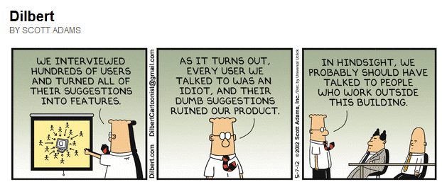
Interviews

Slide 67
Interviews (1)
Elicitation Techniques Existing Systems Interviews Questionnaires Brainstorming Prototyping Use Cases
Requires preparation and good communication management
  Achieve interview objectives without preventing the exploration of promising leads
Interview as many stakeholders as possible
  Not just clients and users… DIFFERENT TYPES!
Ask problem-oriented questions
  Ask about specific details, but…
  Detailed and solution-specific questions may miss the stakeholder’s real requirements. Example:
    Would you like Word 2016, Excel 2016 or both?
    vs.
    Would you like to do word processing, computations, or both?

Slide 68
Interviews – Objectives and Process (2)
Elicitation Techniques Existing Systems Interviews Questionnaires Brainstorming Prototyping Use Cases
Three main objectives:
  Record information to be used as input to requirements analysis and modeling
  Discover information from interviewee accurately and efficiently
  Reassure interviewee that his/her understanding of the topic has been explored, listened to, and valued
Process consists of four important steps:
  Planning and preparation
  Interview session
  Consolidation of information
  Follow-up
Many strategies for questioning

Slide 69
Interviews – Planning and Preparation
Elicitation Techniques Existing Systems Interviews Questionnaires Brainstorming Prototyping Use Cases
Important to plan and prepare interviews
  Set goals and objectives for the interview
  Acquire background knowledge of the subject matter to conduct an effective interview
    About the domain (vocabulary, problems...) but also about the interviewee (work tasks, attitude...)
  Prepare questions in advance, by subject
  Organize the environment for conducting an effective interview
    Determine how the elicitation notes will be taken (manually, audio, video, by whom…)

Slide 70
Interviews – Session
Elicitation Techniques Existing Systems Interviews Questionnaires Brainstorming Prototyping Use Cases
Make the interviewee comfortable and confident
Be polite and respectful!
Adjust to the interviewee
  You have your goals – be persistent but flexible
Interview several people at once to create synergy
Try to detect political aspects as they may influence the said and the unsaid

Slide 71
Interviews – Elicitation Notes
Elicitation Techniques Existing Systems Interviews Questionnaires Brainstorming Prototyping Use Cases
Revise and complete the elicitation notes after the interview
  Needs to be done soon after because one forgets the details (and everything else)
Identify inconsistencies and address them in a follow-up interview or by email
Keep all diagrams, charts, models created during the discussions
You are learning, so be precise
  Pay attention to terminology
  Use the interviewee’s terminology
  Identify synonyms
  Create a glossary if necessary
Thank the participants (e.g., by email), and keep the door open to future interactions. Take the opportunity to ask 2-3 short clarification questions if appropriate.

Slide 72
Common Interviewing Mistakes (1)
Elicitation Techniques Existing Systems Interviews Questionnaires Brainstorming Prototyping Use Cases
Not interviewing all of the necessary people
  Different points of view of stakeholders
Asking direct questions too early
  E.g., design of a transportation system:
    How much horsepower do you need? (direct)
    How many passengers? How far? How fast? (indirect)
  E.g., camera design for novice photographer:
    How important is control over shutter speed and aperture? (direct)
    Will you be taking action shots, still shots, or both? (indirect)

Slide 73
Common Interviewing Mistakes (2)
Elicitation Techniques Existing Systems Interviews Questionnaires Brainstorming Prototyping Use Cases
Interviewing one-at-a-time instead of in small groups
  More people might help get juices flowing as in brainstorming
  Users cannot think of everything they need when asked individually, but will recall more requirements when they hear others' needs
  Reduces spotlight on individuals (may produce more interesting answers)
  This interaction is called synergy, the effect by which group responses outperform the sum of the individuals' responses
    Exercise: Tell me 10 jokes each…
  Do not let one participant dominate the discussion
Assuming that stated needs are exactly correct
  Often users do not know exactly what they want and order "what he is eating"
  Need to narrow what is asked for down to what is needed

Slide 74
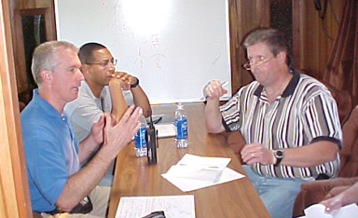
Common Interviewing Mistakes (3)
Elicitation Techniques Existing Systems Interviews Questionnaires Brainstorming Prototyping Use Cases
Trying to convince stakeholders that YOU are smart – wrong place to do that!
  Instead take every opportunity to show you think the stakeholder is smart
  Contrast these two cases¹
My Elevators Are
Too Slow!
I See.
Tell Me Why
You Feel They
Are Too Slow.
I Don’t Think So.
I Think You Have an
Elevator Throughput
Problem, not a Speed Problem
[1] Alan M. Davis “Just enough requirements management”

Slide 75
Common Interview Mistakes Student Make
Recent study by Ferrari et al., RE 2017 (have a look!)
Wrong opening
Ambiguity not leveraged
Implicit goals
Implicit stakeholders
Limitations in terms of resources not considered
NFRs not elicited
Interrogatory-like interviews
Problems in phrasing questions
Wrong closing

Slide 76
Interviews – Start Up Questions (1)
Elicitation Techniques Existing Systems Interviews Questionnaires Brainstorming Prototyping Use Cases
Context-free questions to narrow the scope a bit (Weinberg)
Identify customers, goals, and benefits
  Who is (really) behind the request for the system?
  Who will use the system? Willingly?
  Are there several types of users?
  What is the potential economic benefit from a successful solution?
  Is a (pre-existing) solution available from another source?

Slide 77
Interviews – Start Up Questions (2)
Elicitation Techniques Existing Systems Interviews Questionnaires Brainstorming Prototyping Use Cases
When do you need it by?
  Can you prioritize your needs?
  What are your constraints?
    Time
    Budget
    Resources (human or otherwise)
  Expected milestones (deliverables and dates)?

Slide 78
Interviews – Start Up Questions (3)
Elicitation Techniques Existing Systems Interviews Questionnaires Brainstorming Prototyping Use Cases
Try to characterize the problem and its solution
  What problems is the system trying to address?
  What would be a "good" solution to the problem?
  In what environment will the system be used?
  Any special performance issues?
  Other special constraints?
  What is (un)likely to change?
  Future evolution?
  What needs to be flexible (vs. quick & dirty)?

Slide 79
Interviews – Start Up Questions (4)
Elicitation Techniques Existing Systems Interviews Questionnaires Brainstorming Prototyping Use Cases
Calibration and tracking questions
  Are you the right person to answer these questions?
  Are your answers "official"? If not, whose are?
  Are these questions relevant to the problem as you see it?
  Are there too many questions? Is this the correct level of detail?
  Is there anyone else I should talk to?
  Is there anything else I should be asking you? Have you told me everything you know about the problem?
  Do you have any questions?

Slide 80
Interviews – Start Up Questions (5)
Elicitation Techniques Existing Systems Interviews Questionnaires Brainstorming Prototyping Use Cases
Questions that cannot be asked directly (ask indirectly)
  Are you opposed to the system?
  Are you trying to obstruct/delay the system?
  Are you trying to create a more important role for yourself?
  Do you feel threatened by the proposed system?
  Are you trying to protect your job?
  Is your job threatened by the new system?
  Is anyone else's?

Slide 81
Interviews – Specific Questions (1)
Elicitation Techniques Existing Systems Interviews Questionnaires Brainstorming Prototyping Use Cases
Functional requirements
  What will the system do?
  When will the system do it?
  Are there several modes of operations?
  What kinds of computations or data transformations must be performed?
  What are the appropriate reactions to possible stimuli?
  For both input and output, what should be the format of the data?
  Must any data be retained for any period of time?

Slide 82
Interviews – Specific Questions (2)
Elicitation Techniques Existing Systems Interviews Questionnaires Brainstorming Prototyping Use Cases
Design Constraints
  Physical environment
    Where is the equipment to be located?
    Is there one location or several?
    Are there any environmental restrictions, such as temperature, humidity, or magnetic interference?
    Are there any constraints on the size of the system?
    Are there any constraints on power, heating, or air conditioning?
    Are there constraints on the programming language because of existing software components?

Slide 83
Interviews – Specific Questions (3)
Elicitation Techniques Existing Systems Interviews Questionnaires Brainstorming Prototyping Use Cases
Design Constraints
  Interfaces
    Is input coming from one or more other systems?
    Is output going to one or more other systems?
    Is there a prescribed way in which input/output need to be formatted?
    Is there a prescribed way for storing data?
    Is there a prescribed medium that the data must use?
  Standards
    Are there any standards relevant to the system?
  Laws, policies, and regulations
    Are there any laws, policies, or regulations applicable here?

Slide 84
Interviews – Specific Questions (4)
Elicitation Techniques Existing Systems Interviews Questionnaires Brainstorming Prototyping Use Cases
Performance
  Are there constraints on execution speed, response time, or throughput?
  What efficiency measure will apply to resource usage and response time?
  How much data will flow through the system?
  How often will data be received or sent?

Slide 85
Interviews – Specific Questions (5)
Elicitation Techniques Existing Systems Interviews Questionnaires Brainstorming Prototyping Use Cases
Usability and Human Factors
  What kind of training will be required for each type of user?
  How easy should it be for a user to understand and use the system?
  How difficult should it be for a user to misuse the system?

Slide 86
Interviews – Specific Questions (6)
Elicitation Techniques Existing Systems Interviews Questionnaires Brainstorming Prototyping Use Cases
Security
  Must access to the system or information be controlled?
  Should each user's data be isolated from data of other users?
  Should user programs be isolated from other programs and from the operating system?
  Should precautions be taken against theft or vandalism?

Slide 87
Interviews – Specific Questions (7)
Elicitation Techniques Existing Systems Interviews Questionnaires Brainstorming Prototyping Use Cases
Reliability and Availability
  Must the system detect and isolate faults?
  What is the prescribed mean time between failures?
  Is there a maximum time allowed for restarting the system after failure?
  How often will the system be backed up?
  Must backup copies be stored at a different location?
  Should precautions be taken against fire or water damage?

Slide 88
Interviews – Specific Questions (8)
Elicitation Techniques Existing Systems Interviews Questionnaires Brainstorming Prototyping Use Cases
Maintainability
  Will maintenance merely correct errors, or will it also include improving the system?
  When and in what ways might the system be changed in the future?
  How easy should it be to add features to the system?
  How easy should it be to port the system from one platform (computer, operating system) to another?

Slide 89
Interviews – Specific Questions (9)
Elicitation Techniques Existing Systems Interviews Questionnaires Brainstorming Prototyping Use Cases
Precision and Accuracy
  How accurate must data calculations be?
  To what degree of precision must calculations be made?

Slide 90
More on Interviews
Elicitation Techniques Existing Systems Interviews Questionnaires Brainstorming Prototyping Use Cases
Watch for unanswerable questions…
  How do you tie your shoelaces?
See interesting video:
  http://www.youtube.com/watch?v=2WBef84bodc
Also:
  https://www.lynda.com/

Slide 91
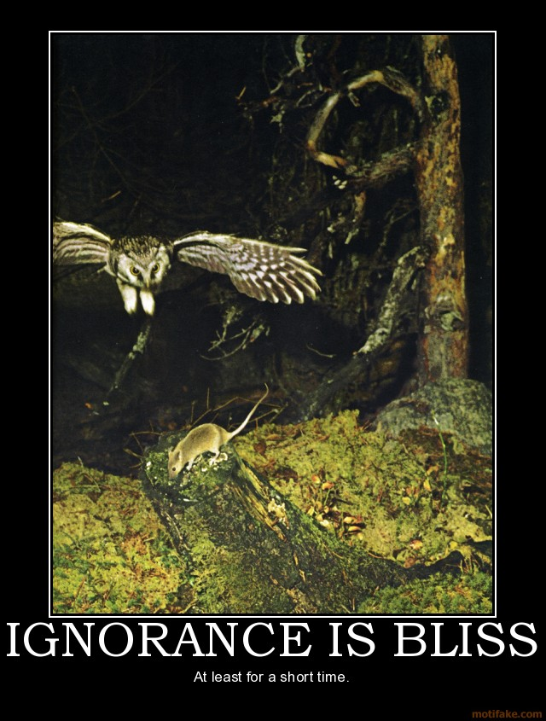
“Ignorance is bliss”¹
Elicitation Techniques Existing Systems Interviews Questionnaires Brainstorming Prototyping Use Cases
According to Dan Berry, ignorance of a domain is a good thing!
Ignorance (not stupidity !) allows one to expose hypotheses and some implicit facts
Berry even suggests that one day, requirements engineers may advertise their domains of ignorance (rather than their domains of expertise) to find a job!
Actually, a mix of domain experts and domain ignorants on a team is a good thing²
[1] The Matrix, 1999
[2] Ali Niknafs, Daniel M. Berry: The impact of domain knowledge on the effectiveness of requirements engineering activities. Empirical Software Engineering, 22(1), 80-133, February 2017.

Slide 92
Beware of Participant Answers!
Elicitation Techniques Existing Systems Interviews Questionnaires Brainstorming Prototyping Use Cases
“If I’d asked my customers what they wanted, they’d have said a faster horse.”
  Henry T. Ford
“The critical failing of user interviews is that you’re asking people to either remember past use or speculate on future use of a system.”
  Jakob Nielsen
“You can't just ask customers what they want and then try to give that to them. By the time you get it built, they'll want something new.”
  Steve Jobs

Slide 93
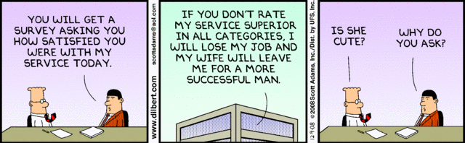
Questionnaires

Slide 94
Questionnaires and Surveys
Elicitation Techniques Existing Systems Interviews Questionnaires Brainstorming Prototyping Use Cases
Some benefits:
  Can reach multiple people, maybe in an anonymous way
  Asynchronous, distributed, and can be quick to answer
  Cheap
Challenges:
  Preparation time!
  Choice of questions: open-ended and close (lack of flexibility)
  Choice of answers and scales (nominal, intervals, Likert…); avoid centralist tendencies!
  Statistical significance during analysis
  Validity of questions (bias, ambiguities)
  Repetition and order of questions
  Determining suitable participants to invite (risk of bias, of fraud)
  Getting people to answer everything (exhaustion, unattractive…)!

Slide 95
Types of Questions to Consider
Elicitation Techniques Existing Systems Interviews Questionnaires Brainstorming Prototyping Use Cases
Demography questions (for classification)
  Age, country, occupation… For analysis from many angles
  Beware of re-identification risks if supposed to be anonymous
Attitudinal questions
  What do you think of…? Do you agree with…?
  Scale with 4-6 values (no center) or 5-7 values (with neutral value)
    Strongly agree
    Agree somewhat
    Neither agree nor disagree (Undecided)
    Disagree somewhat
    Strongly disagree
Supplementary open questions (instructive, but qualitative)
Optional/alternative questions, by population
Redundant questions, for robustness…

Slide 96
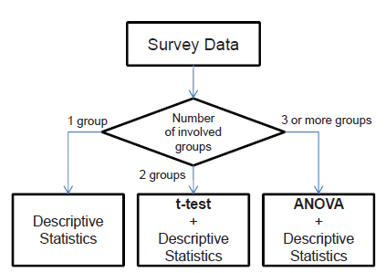
Analysis to Consider… In Advance!
Elicitation Techniques Existing Systems Interviews Questionnaires Brainstorming Prototyping Use Cases
Will the survey be repeated (before/after, for comparison)?
Determine the type of (statistical) analysis, e.g.:
Statistical significance? http://en.wikipedia.org/wiki/Statistical_significance
Test your questionnaire and your analysis on a small group!
See also this important video on surveys and questionnaires:
  http://www.youtube.com/watch?v=rSwVZJT9j1c

Slide 97
Typical Errors in Survey Questions (1/3)
Elicitation Techniques Existing Systems Interviews Questionnaires Brainstorming Prototyping Use Cases
How dumb is Donald Trump when it comes to foreign policy?
  Leading question, which sways the reader to a particular side.
  Better: Please describe Donald Trump’s position on foreign policy.
Where do you like to drink beer?
  Loaded question: what if one does not drink beer or alcohol? That person cannot answer this question truthfully.
  Better: use skip logic
    Do you drink beer? If not, please skip the next question
    Where do you like to drink beer?
How happy or unhappy are you with the tuition fees and with your course curriculum?
  Double-barreled question: these are two different things...
  Better: How happy or unhappy are you with the tuition fees?
  Also: How happy or unhappy are you with your course curriculum?

Slide 98
Typical Errors in Survey Questions (2/3)
Elicitation Techniques Existing Systems Interviews Questionnaires Brainstorming Prototyping Use Cases
Do you always shower before bed?
  Absolute question: participant is cornered and the answer will always be no…
  Better: How many nights a week do you shower before bed?
How many nights a week do you shower before bed:
Every day, 5-6 days, 3-4 days, 1-3 days, 0-1 days?
  Overlapping answers: keep the multiple choice answers mutually exclusive
  Better: 6-7 days, 4-5 days, 2-3 days, 0-1 day?
  Also, as this might be a sensitive topic, one option could be “prefer not to answer”

Slide 99
Typical Errors in Survey Questions (3/3)
Elicitation Techniques Existing Systems Interviews Questionnaires Brainstorming Prototyping Use Cases
What was the quality of the service you received:
Fair, Good, Very Good, or Excellent?
  Unbalanced scale: No option related to Poor service
What type of vehicle do you own: Van, Sedan, or SUV?
  Incomplete scale: there exist many other options. Minimally, the options should include Other. One may not own a vehicle either…
Other examples:
  10 Examples Of Biased Survey Questions
  5 Common Survey Question Mistakes That’ll Ruin Your Data
  Survey Questions 101: Do You Make any of These 7 Question Writing Mistakes?
Try also this simple exercise

Slide 100
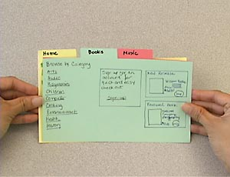
Prototyping
“Customers don’t know what they want. It’s very hard to envision the solution you want without actually seeing it.”
Marty Cagan

Slide 101
Prototyping
Elicitation Techniques Existing Systems Interviews Questionnaires Brainstorming Prototyping Use Cases
A software requirements prototype is a mock-up or partial implementation of a software system
  Helps developers, users, and customers better understand system requirements
  Helps clarify and complete requirements
  Provides early response to “I'll know it when I’ll see (or won’t see) it” attitude
  Helps find new functionalities, discuss usability, and establish priorities
Prototyping is effective in resolving uncertainties early in the development process
  Focus prototype development on these uncertain parts
  Encourages user participation and mutual understanding

Slide 102
Prototyping – Types
Elicitation Techniques Existing Systems Interviews Questionnaires Brainstorming Prototyping Use Cases
Evolutive: turned into a product incrementally, gives users a working system more quickly (begins with requirements that are more understood)
Throw-away: less precise, thrown away, focusing on the less well-understood aspects of the system to design, designed to elicit or validate requirements
  “Your prototype needs to be so rough that the customer feels sorry for you and wants to help you!” [Ian Sommerville, RE’17]

Slide 103
Prototyping – Realizations
Elicitation Techniques Existing Systems Interviews Questionnaires Brainstorming Prototyping Use Cases
Prototypes can take many forms:
  Paper prototypes (see https://en.wikipedia.org/wiki/Paper_prototyping)
  Screen mock-ups
  Interactive prototypes
    Using animation tools (e.g., Flash/Shockwave, PowerPoint with hyperlinks, https://app.moqups.com, …)‏
  Models (executables)
  Pilot systems
  …

Slide 104
Prototyping – Fidelity (1)
Elicitation Techniques Existing Systems Interviews Questionnaires Brainstorming Prototyping Use Cases
Fidelity is the extent to which the prototype is real and (especially) reactive
Fidelity may vary for throw-away prototypes
High-fidelity
  Applications that "work" – you press a button and something happens
  Often involves programming or executable modeling languages
  Advantages:
  provides an understanding of functionality, reduce design risk, more precise verdicts about requirements
  Disadvantages:
  takes time to build, more costly to build, sometimes difficult to change, false sense of security, often focuses on details rather than on the goals and important issues

Slide 105
Prototyping – Fidelity (2)
Elicitation Techniques Existing Systems Interviews Questionnaires Brainstorming Prototyping Use Cases
Low-fidelity
  It is not operated – it is static
  Advantages:
  easy and quick to build, cheaper to develop, excellent for interfaces, offers the opportunity to engage users before coding begins, encourage creativity
  Disadvantages:
  may not cover all aspects of interfaces, are not interactive, may seem non-professional in the eyes of some stakeholders (sigh!)

Slide 106
Use Cases, Scenarios, and User Stories

Slide 107
Developing Use Case Models of Systems
Elicitation Techniques Existing Systems Interviews Questionnaires Brainstorming Prototyping Use Cases
Description of a sequence of interactions between a system and external actors
Developed by Ivar Jacobson
  Not exclusively for object-oriented analysis
Actors – any agent that interact with the system to achieve a useful goal (e.g., people, other software systems, hardware)
Use case describes a typical sequence of actions that an actor performs in order to complete a given task
  The objective of use case analysis is to model the system
    … from the point of view of how actors interact with this system
    … when trying to achieve their objectives
  A use case model consists of
    A set of use cases
    An optional description or diagram indicating how they are related

Slide 108
Use Cases
Elicitation Techniques Existing Systems Interviews Questionnaires Brainstorming Prototyping Use Cases
A use case should describe the user’s interaction with the system ...
  Not the computations the system performs
In general, a use case should cover the full sequence of steps from the beginning of a task until the end
A use case should only include actions in which the actor interacts with the computer
  Some views differ on this one!!!

Slide 109
Use Cases – Abstraction Level
Elicitation Techniques Existing Systems Interviews Questionnaires Brainstorming Prototyping Use Cases
A use case should be written so as to be as independent as possible from any particular implementation / user interface design
Essential use cases (Constantine & Lockwood)
  Abstract, technology free, implementation independent
  Defined at earlier stages
  E.g., customer identifies herself
Concrete use cases
  Technology/user interface dependent
  E.g., customer inserts a card, customer types a PIN

Slide 110
Scenarios (1)
Elicitation Techniques Existing Systems Interviews Questionnaires Brainstorming Prototyping Use Cases
A scenario (according to the UML/UC community) is an instance of a use case
  It expresses a specific occurrence of the use case (a specific path through the use case)
    A specific actor ...
    At a specific time ...
    With specific data …
  Many scenarios may be generated from a single use case description
  Each scenario may require many test cases
Rather used in a generic way in this course (as is often the case in requirements engineering)

Slide 111
Scenarios (2)
Elicitation Techniques Existing Systems Interviews Questionnaires Brainstorming Prototyping Use Cases
A use case includes primary and secondary scenarios
1 primary scenario
  Normal course of events
0 or more secondary scenarios
  Alternative/exceptional course of events, variations of primary scenario
  An alternative scenario meets the intent of the use case but with a different sequence of steps
  An exceptional scenario addresses the conditions of main case and alternative cases that differ from the norm and cases already covered
  Example with consensus as a goal
    Primary scenario: vote in a session
    Alternative scenario: voting in several sessions
    Exceptional scenario: what to do with a non-registrant who wishes to vote

Slide 112
Types of Scenarios
Elicitation Techniques Existing Systems Interviews Questionnaires Brainstorming Prototyping Use Cases
As-is scenario
  Used in describing a current situation, usually used in re-engineering projects, the user describes the system
Visionary scenario (To-be)
  Used to describe a future system, usually used in greenfield engineering and reengineering projects
  Can often not be done by the user or developer alone
Evaluation scenario
  User tasks against which the system is to be evaluated
Training scenario
  Step by step instructions that guide a novice user through a system

Slide 113
Use Case-Driven Software Lifecycle Activities (1)
Elicitation Techniques Existing Systems Interviews Questionnaires Brainstorming Prototyping Use Cases
Requirements
Elicitation
Requirements
Analysis
System
Design
Object
Design
Implemen-
tation
Testing
Implemented
By
Expressed in Terms Of
Structured By
Realized By
Verified
By
class...
class...
class...
?
class....
?
Use Case
Model
Application
Domain
Objects
Solution Domain
Objects
Subsystems
Source
Code
Test
Cases

Slide 114
Use Case-Driven Software Lifecycle Activities (2)
Elicitation Techniques Existing Systems Interviews Questionnaires Brainstorming Prototyping Use Cases
Scenarios guide elicitation, analysis, design, and testing
  There are many scenario-based approaches
  E.g., XP and other agile methods employ user stories (scenarios) to directly generate tests that will guide software design and verification
Developers are often unable to speak directly to users
Scenarios provide a good enough approximation of the “voice of the user”

Slide 115
Representation of Scenarios (1)
Elicitation Techniques Existing Systems Interviews Questionnaires Brainstorming Prototyping Use Cases
Various approaches…
Text (informal, structured), diagrams (state, sequence ...), video, animation, comics, storyboard, collaborative workshops (pass the microphone)…
There are specialized notation such as UML (sequence, activity, use case, interaction, and collaboration diagrams), Message Sequence Charts (MSC), Live Sequence Charts, and Use Case Maps (UCM)

Slide 116
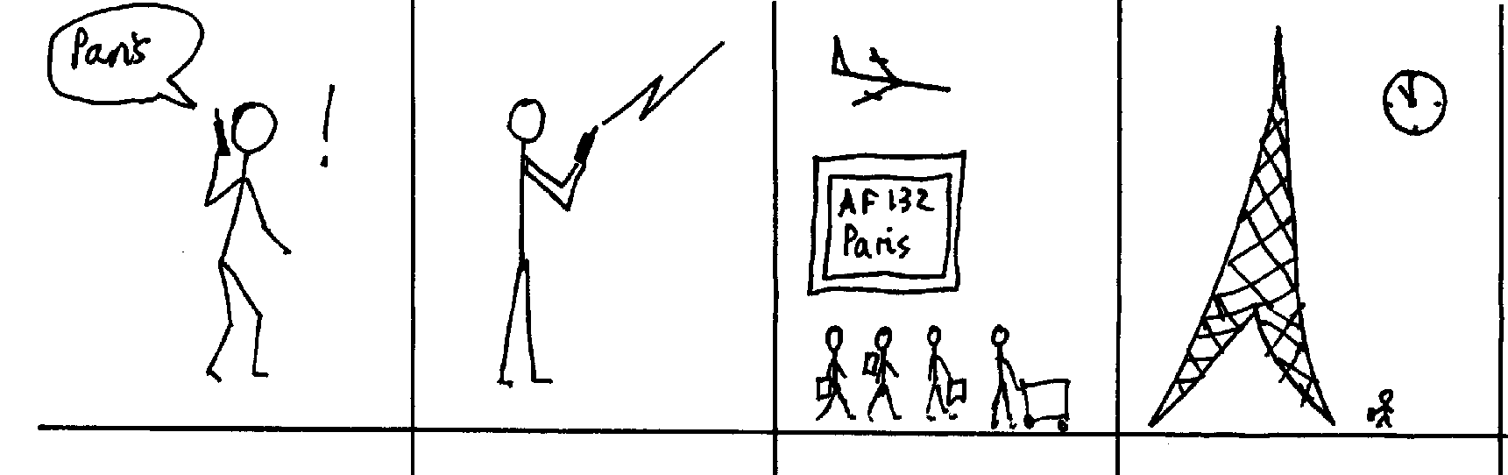
Representation of Scenarios (2)
Elicitation Techniques Existing Systems Interviews Questionnaires Brainstorming Prototyping Use Cases
Different representations may be useful in specific situations
  For example, storyboards, often used in the film industry, can describe situations, roles, and sequences of tasks in a fast, compact, and polyglot way¹
Some scenario-based approaches are very ideological or dogmatic
[1] I. Alexander

Slide 117
Use Case Modeling with UML
Elicitation Techniques Existing Systems Interviews Questionnaires Brainstorming Prototyping Use Cases
But: Where are the use cases?
use case
<<extend>>
Reserve Facility
Handle Waiting List
Register Member
generalization
<<include>>
<<include>>
Hotel Counter Staff
Customer
Reserve Room
Check In Customer
Check Room
Details
<<include>>
actor
extension
point
<<extend>>
Member
Earn and Redeem Credits
Check Out Customer

Slide 118
Use Case Templates (1)
Elicitation Techniques Existing Systems Interviews Questionnaires Brainstorming Prototyping Use Cases
There are many different templates for use cases but they often consist of a subset of the following items:
Identifier: unique label for use case used to reference it elsewhere
Name: succinctly state user task independently of the structure or implementation
  Suggested form “verb object” (e.g., Order a product)
Authors: people who discovered use case
Goal: short description of expected outcome from actors’ point of view
Preconditions: what needs to be satisfied before use case can begin
Postconditions: state of system after completion of use case
  Minimal guarantee: state of system after completion regardless of outcome

Slide 119
Use Case Templates (2)
Elicitation Techniques Existing Systems Interviews Questionnaires Brainstorming Prototyping Use Cases
Primary actor: initiates the use case
Participants (secondary actors): other actors involved in use case, provide services to the system and interact with the system after the use case was initiated
Related requirements: identifiers of functional and non-functional requirements linked to the use case
Related use cases: identifiers of related use cases
  Specify relationship: e.g.
      Supposes use case UC2 has been successfully completed
      Alternative to use case UC3
      ...
Description of events (scenarios)
  Different use case description formats
  Narrative, Simple column, Multiple columns

Slide 120
Use Case Templates – Narrative Form
Elicitation Techniques Existing Systems Interviews Questionnaires Brainstorming Prototyping Use Cases
Paragraph focusing on the primary scenario and some secondary ones
Very useful when the stakeholders first meet
A User inserts a card in the Card reader slot. The System
asks for a personal identification number (PIN). The User
enters a PIN. After checking that the user identification is
valid, the System asks the user to chose an operation...

Slide 121
Use Case Templates – Simple Column Form
Elicitation Techniques Existing Systems Interviews Questionnaires Brainstorming Prototyping Use Cases
Linear sequences (main and alternatives)
1. A User inserts a card in the Card reader slot.
2. The system asks for a personal identification number (PIN).
3. The User enters a PIN.
4. The System checks that the user identification is valid.
5. The System asks the user to chose an operation
1.a The Card is not valid.
1.a.1. The System ejects the Card.
4.a The User identification is not valid.
4.a.1 The System ejects the Card.

Slide 122
Use Case Templates – Multiple Column Form
Elicitation Techniques Existing Systems Interviews Questionnaires Brainstorming Prototyping Use Cases
One column per actor
Allows for a more detailed view

Slide 123
Use Case Diagrams
Elicitation Techniques Existing Systems Interviews Questionnaires Brainstorming Prototyping Use Cases
To define system boundary (subject), actors, and use cases
  Subject could be: a physical system, a component, a subsystem, a class
To structure and relate use cases
  Associate actors with use cases
  Include relation
  Extend relation
  Generalization (of actors and use cases)

Slide 124
Use Case Diagrams – <<include>> (Inclusions)
Elicitation Techniques Existing Systems Interviews Questionnaires Brainstorming Prototyping Use Cases
Inclusions allow one to express commonality between several different use cases
Inclusions are included in other use cases
  Even very different use cases can share a sequence of actions (reuse)
  Enable you to avoid repeating details in many use cases (consistency)
An inclusion represents the execution of a lower-level task with a lower-level goal (→ decomposition of complex tasks)
Base use case references the included use case as needed
Base use case cannot exist without the included use case
When included use case is done, control returns to base use case
Disadvantage: have to look in multiple places to understand use case

Slide 125
Use Case Diagrams – <<extend>> (Extensions)
Elicitation Techniques Existing Systems Interviews Questionnaires Brainstorming Prototyping Use Cases
Used to make optional interactions explicit or to handle exceptional cases
By creating separate use case extensions, the description of the basic use case remains simple
  Note: the base use case can still be executed without the use case extension
Extension points must be created explicitly in the base use case
Use sparingly: there is disagreement over the semantics

Slide 126
Use Case Diagrams – Generalizations
Elicitation Techniques Existing Systems Interviews Questionnaires Brainstorming Prototyping Use Cases
Much like super-classes in a class diagram
  Need to satisfy “is-a” relation
Applies to use cases and to actors
  A generalized use case represents several similar use cases
  One or more specializations provide details of the similar use cases
  Inheriting use case can replace steps of inherited use case
  Particularly useful for actors (clearer here, unlike use case generalization where the semantics are unclear – use generalization of use cases with caution)

Slide 127
Use Case Development – Actors
Elicitation Techniques Existing Systems Interviews Questionnaires Brainstorming Prototyping Use Cases
Choose actors’ names carefully
Should reflect roles rather than actual people
  An actor specifies a role an external entity adopts when it interacts directly with your system
  People / things may play multiple roles simultaneously or over time
Use right level of abstraction

Slide 128
Use Cases Development
Elicitation Techniques Existing Systems Interviews Questionnaires Brainstorming Prototyping Use Cases
Often one use case (or a very small number) can be identified as central to the system
There are other reasons for focusing on particular use cases:
  Some use cases will represent a high risk because for some reason their implementation is problematic
  Some use cases will have high political or commercial value
Do not loose your time detailing simple or known us cases
  For example: login and logout!
Approach is iterative
  System scope and boundaries may change as more information is known about actors, their goals, and use cases
Beware of over-specification and under-specification
Stay abstract; avoid functional decomposition of systems
Align the UC diagram with the use cases

Slide 129
Example: University Registration System (1)
Elicitation Techniques Existing Systems Interviews Questionnaires Brainstorming Prototyping Use Cases
Enroll in
University
<<include>>
Enroll in
Course
Registrar
<<extend>>
Applicant
Enroll Family
Member of Staff
Perform
Security Check
International Applicant
RCMP Security System

Slide 130
Example: University Registration System (2)
Elicitation Techniques Existing Systems Interviews Questionnaires Brainstorming Prototyping Use Cases
Name: Enroll in University
Identifier: UC 19
Goal: Enroll applicant in the university
Preconditions:
  The Registrar is logged into the system.
  The Applicant has already undergone initial checks to verify that they are eligible to enroll.
Postconditions:
  The Applicant will be enrolled in the university as a student if they are eligible.

Slide 131
Example: University Registration System (3)
Elicitation Techniques Existing Systems Interviews Questionnaires Brainstorming Prototyping Use Cases
Main Flow:
1. An applicant wants to enroll in the university.
2. The applicant hands a filled out copy of form UI13 University Application Form to the registrar.
3. The registrar visually inspects the forms.
4. The registrar determines that the forms have been filled out properly.
5. The registrar selects to Create New Student.
6. The system displays the Create Student Screen.
7. The registrar inputs the name, address, and phone number of the applicant.
[Extension Point: XPCheck]
8. The system determines that the applicant does not already exist within the system.
9. The system determines that the applicant is on the eligible applicants list.
10. The system adds the applicant to its records.
11. The registrar enrolls the student in courses via use case UC 17 Enroll in Course.
12. The system prepares a bill for the applicant enrollment fees.
Alternate Flows:
4.a The forms have not been adequately filled…

Slide 132
Example: University Registration System (4)
Elicitation Techniques Existing Systems Interviews Questionnaires Brainstorming Prototyping Use Cases
Name: Perform Security Check
Identifier: UC 34
At Extension Point XPCheck:
1. The registrar asks for security check results about applicant.
2. The system asks RCMP Security System for applicant security check results.
3. The RCMP Security System responds that applicant has been cleared.
3.a The Security System responds that applicant has not been cleared

Slide 133
Example: University Registration System (5)
Elicitation Techniques Existing Systems Interviews Questionnaires Brainstorming Prototyping Use Cases
Name: Enroll Family Member of Staff
Identifier: UC 20
Inherits From: UC 19
Main Flow:
1. An applicant family member wants to enroll in the university.
2. The applicant hands a filled out copy of form UI15 University Application Form for Family Members to the registrar.
…
12. The system prepares a bill for the applicant enrollment fees based on staff family members rate.
Alternate Flows: …

Slide 134
Tools
Elicitation Techniques Existing Systems Interviews Questionnaires Brainstorming Prototyping Use Cases
Many UML tools support use case diagrams, without really supporting use cases well
UCEd tool (Prof. Somé), to help capture/validate use cases
  Use Case edition (structured English), domain model edition (and automatic extraction), state models generation/simulation…
  http://www.site.uottawa.ca/~ssome/Use_Case_Editor_UCEd.html
Zen-RUCM (T. Yue et S. Ali) also allows the description and validation of use cases based on a restricted natural language syntax.
  Transformations also supported.
  http://zen-tools.com/rucm/index.html

Slide 135
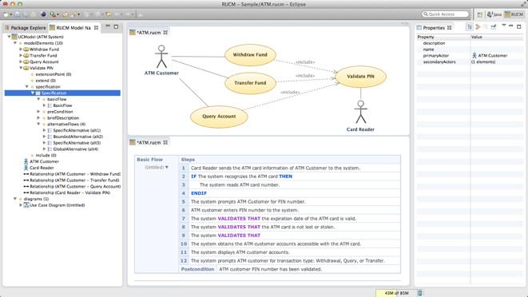
Zen-RUCM Basic Editor (Yue and Ali)
Elicitation Techniques Existing Systems Interviews Questionnaires Brainstorming Prototyping Use Cases
http://zen-tools.com/rucm/Editors.html
Video: http://zen-tools.com/rucm/metamodels/resources/Tool%20Teaser%20Video.mp4

Slide 136
User Stories
Elicitation Techniques Existing Systems Interviews Questionnaires Brainstorming Prototyping Use Cases
In French: histoires utilisateur, or récits utilisateur
Sentence, in a simple business language, that describes a functionality to support (Who? What? Why?)
Often from the viewpoint of the user or client
Popular in agile development approaches
Generic pattern (https://en.wikipedia.org/wiki/User_story):
As a <who/role>, I want <what/desire>
[so that <why/benefit>]
Examples:
  As a user, I can indicate folders not to backup so that my backup drive isn't filled up with things I don't need saved.
  As a manager, I want to browse my existing quizzes so I can recall what I have in place and figure out if I can just reuse or update an existing quiz for the position I need now.

Slide 137
User Stories: The Three « C »
Elicitation Techniques Existing Systems Interviews Questionnaires Brainstorming Prototyping Use Cases
“Card, Conversation, Confirmation”, from Ron Jeffries, 2001
  More social than just use case documentation.
Card: (or often a Post-It note) a physical token giving tangible and durable form to what would otherwise only be an abstraction.
  Uses a template
Conversation: taking place at different time and places during a project between the various people concerned by a given feature of a software product: customers, users, developers, testers; this conversation is largely verbal but most often supplemented by documentation
  Acceptance criteria or tests
Confirmation: finally, the more formal the better, that the objectives the conversation revolved around have been reached
  Criteria met or test passed… done!

Slide 138
User Stories: Various Templates
Elicitation Techniques Existing Systems Interviews Questionnaires Brainstorming Prototyping Use Cases
As a <role>, I want <goal/desire> so that <benefit>
  Connextra, 2001
  Mike Cohn claims that the last part is optional.
In order to <receive benefit> as a <role>, I want <goal/desire>
  Chris Matts
As <who> <when> <where>, I <what> because <why>
As a <role>, I can <action with system> so that <external benefit>
  Capital One, 2004
As an <actor>, I want to <task> in order to <contribution> achieve <goal>
  Easily transferrable to a goal-oriented model
See https://en.wikipedia.org/wiki/User_story

Slide 139
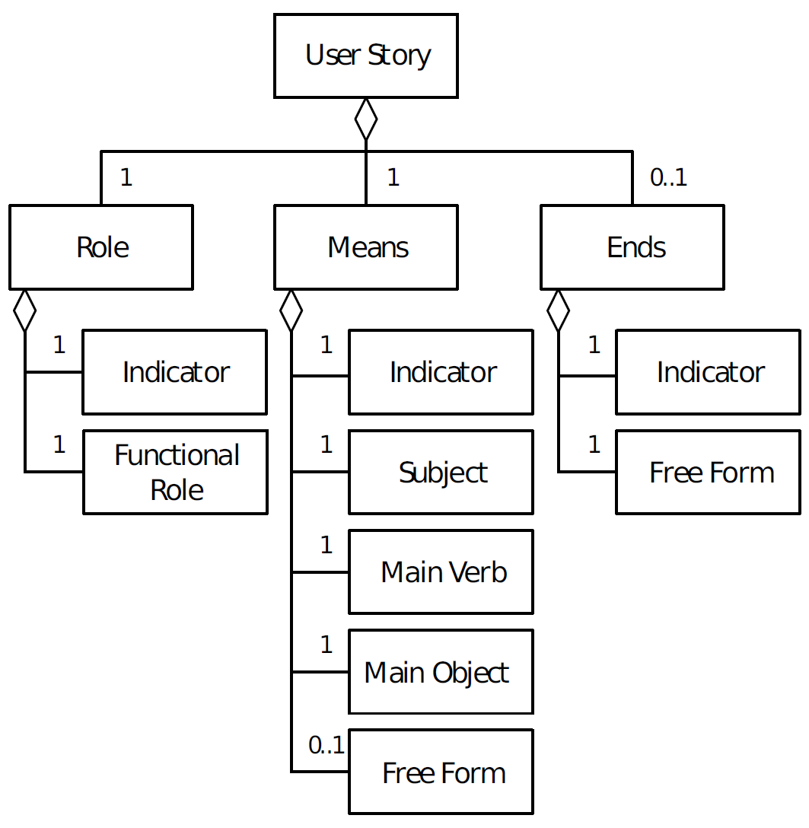
User Stories: Conceptual Model
Elicitation Techniques Existing Systems Interviews Questionnaires Brainstorming Prototyping Use Cases
M. Robeer et al.: Automated Extraction of Conceptual Models from User Stories via NLP. RE 2016, IEEE CS, pp. 196-205

Slide 140
User Stories: INVEST Characteristics
Elicitation Techniques Existing Systems Interviews Questionnaires Brainstorming Prototyping Use Cases
I – Independent. We want to be able to move stories around, taking into account their relative priority. This means stories are easiest to work with when they are independent.
N – Negotiable. Stories are not an explicit commitment to produce certain features, but a framework for ultimately defining what to produce for the end user.
V – Valuable. A story needs to be valuable to the end user. Development issues should be framed in a way that illustrate why the end user would perceive them as important.
E – Estimable. We want stories to be estimable, otherwise they're never likely to be tasked for development. Whether a story is estimable is a function of being negotiated (you can't estimate what you don't understand), a function of size (bigger stories are harder to estimate), and a function of team experience.
S – Small. Stories should be small -- no more than a few person-days of work. Above this size it's almost impossible to know a story's full scope.
T – Testable. Finally, we want stories to be testable. If a story isn't testable, you can't really determine when it's done. Test Driven Development has shown us how actually writing the tests early helps us know whether the business goal is met.
[Bill Wake, 2003. See also https://en.wikipedia.org/wiki/INVEST_(mnemonic) ]

Slide 141
User Stories: Appropriate Level of Detail
Elicitation Techniques Existing Systems Interviews Questionnaires Brainstorming Prototyping Use Cases
Too Broad
  A team member can view iteration status.
Too Detailed
  A team member can view a table of stories with rank, name, size, package, owner, and status.
  A team member can click a red button to expand the table to include detail, which lists all the tasks, with rank, name, estimate, owner, status.
Correct
  A team member can view the iteration's stories and their status with main fields.
  A team member can view the current burndown chart on the status page, and can click it for a larger view.
  A team member can view or hide the tasks under the stories.
  A team member can edit a task from the iteration status page.
Source: https://help.rallydev.com/writing-great-user-story

Slide 142
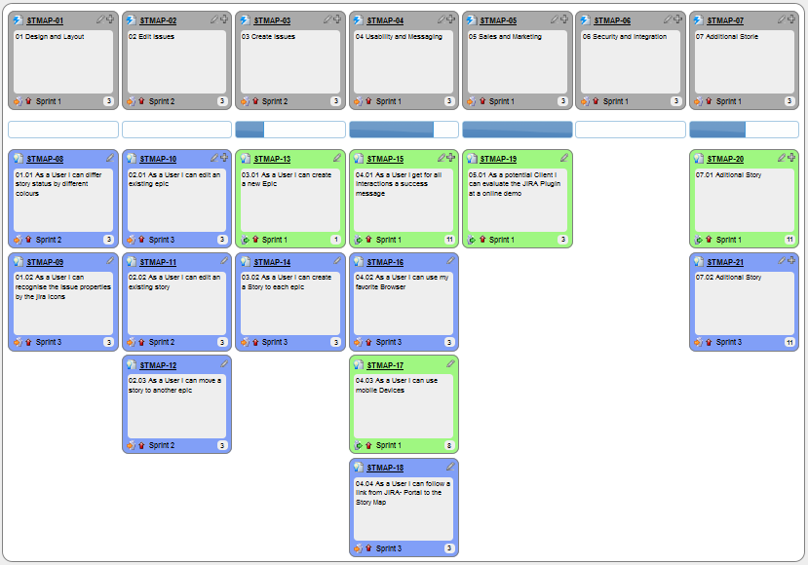
User Story Map (with Epic Stories at the Top)
Elicitation Techniques Existing Systems Interviews Questionnaires Brainstorming Prototyping Use Cases

Slide 143
User Stories with Acceptance Criteria
Elicitation Techniques Existing Systems Interviews Questionnaires Brainstorming Prototyping Use Cases
Example user story:
As an internet banking customer
I want to see a rolling balance for my everyday accounts
so that I know the balance of my account after each transaction is applied
Example acceptance criteria:
  The rolling balance is displayed
  The rolling balance is calculated for each transaction
  The balance is displayed for every transaction for the full period of time transactions are available
  The balance is not displayed if a filter has been applied
[ http://nomad8.com/acceptance_criteria/ ]

Slide 144
Quality User Story Framework (1)
Elicitation Techniques Existing Systems Interviews Questionnaires Brainstorming Prototyping Use Cases
Criteria | Description | Individual/set
Syntactic
Well-formed | A user story includes at least a role and a means | Individual
Atomic | A user story expresses a requirement for exactly one feature | Individual
Minimal | A user story contains nothing more than role, means, and ends | Individual
Semantic
Conceptually sound | The means expresses a feature and the ends expresses a rationale | Individual
Problem-oriented | A user story only specifies the problem, not the solution to it | Individual
Unambiguous | A user story avoids terms or abstractions that lead to multiple interpretations | Individual
Conflict-free | A user story should not be inconsistent with any other user story | Set

Slide 145
Quality User Story Framework (2)
Elicitation Techniques Existing Systems Interviews Questionnaires Brainstorming Prototyping Use Cases
Criteria | Description | Individual/set
Pragmatic
Full sentence | A user story is a well-formed full sentence | Individual
Estimatable | A story does not denote a coarse-grained requirement that is difficult to plan and prioritize | Individual
Unique | Every user story is unique, duplicates are avoided | Set
Uniform | All user stories in a specification employ the same template | Set
Independent | The user story is self-contained and has no inherent dependencies on other stories | Set
Complete | Implementing a set of user stories creates a feature-complete application, no steps are missing | Set
Lucassen, G., Dalpiaz, F., van der Werf, J.M.E.M. et al. Improving agile requirements: the Quality User Story framework and tool. Requirements Eng (2016) 21: 383. https://doi.org/10.1007/s00766-016-0250-x
See counter examples in section 3.

Slide 146
User Stories: Other Remarks
Elicitation Techniques Existing Systems Interviews Questionnaires Brainstorming Prototyping Use Cases
User stories promote face-to-face communication (à la Agile) with brief descriptions amenable to change, effort estimation, and prioritization.
Acceptance criteria can go beyond functional criteria; can also include performance and other non-functional criteria.
Effort evaluation is done using story points
  Used for planning and prioritization
  Acceptance criteria could be defined before assigning story points, for a more accurate effort estimate
Risks: too abstract, informal or vague (hard to test); too incomplete; no support for system-wide non-functional requirements…
Should developers write user stories?
  Some do so their management/refactoring tasks are considered by agile management tools!
http://www.mountaingoatsoftware.com/agile/user-stories

Slide 147
Don’t be Negative, But…
Elicitation Techniques Existing Systems Interviews Questionnaires Brainstorming Prototyping Use Cases
Be ready to face the music!
  In business, some people might wish to see you fail…
  There are unforeseen events in any project
  Open systems are subject to various threats
  Software contains various kinds of bugs
Remember Murphy’s Law…
  “Anything that can go wrong will go wrong.”

Slide 148
Think about Negative Scenarios?
Elicitation Techniques Existing Systems Interviews Questionnaires Brainstorming Prototyping Use Cases
A negative scenario is a scenario whose goal is
  Undesirable from the business organization’s viewpoint
  Desirable from a hostile agent’s viewpoint (not necessarily human)
Consider them beforehand
  As well as potential solutions
Or…
  Wait until it is too late to react…

Slide 149
Misuse Case
Elicitation Techniques Existing Systems Interviews Questionnaires Brainstorming Prototyping Use Cases
Proposed by Sindre et Opdahl (2000)
  Capture use cases that a system must be protected against
  Goal is to threaten the system
  Obvious applications for security and risk analysis
Also called abuse cases
The misuse case’s misactor is a hostile agent
The colors of the ellipse are inverted
threatens
Drive Car
Steal Car
Thief

Slide 150
A MiniMax¹ for Security
Elicitation Techniques Existing Systems Interviews Questionnaires Brainstorming Prototyping Use Cases
Similar to a chess match…
  White’s best move is to find Black’s best move and to counter it
New relations:
  threatens (from misuse case to use case)
  mitigates (from use case to misuse case)
[1] Minimax: minimizing the maximum possible loss

Slide 151
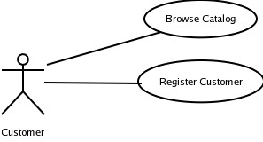
Finding Misuse Cases – Step 1
Elicitation Techniques Existing Systems Interviews Questionnaires Brainstorming Prototyping Use Cases
Start from a normal use case diagram
Find misactors (hostile roles)
  Who are the misactors, who want:
  To harm the system, its stakeholders, or their resources intentionally
  or
  To achieve goals that are incompatible with the system's goals
Competitor
Crook
…

Slide 152
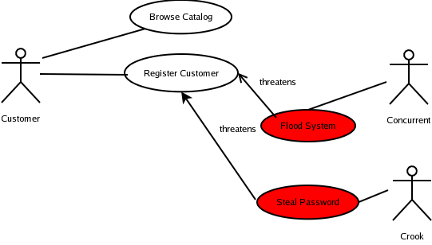
Finding Misuse Cases – Step 2
Elicitation Techniques Existing Systems Interviews Questionnaires Brainstorming Prototyping Use Cases
Find misuse cases
  Ask what would a misactor do to harm system
  Express goals of misactors (if needed elaborate with scenarios)
  Add relationships (threaten)
Competitor

Slide 153
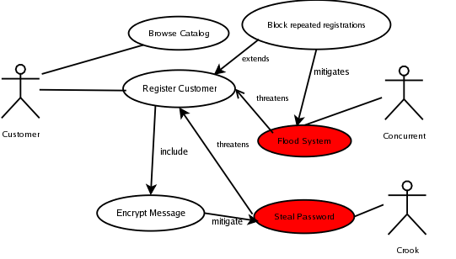
Finding Misuse Cases – Step 3
Elicitation Techniques Existing Systems Interviews Questionnaires Brainstorming Prototyping Use Cases
Mitigate misuse cases
  Ask what would neutralize the threats
  New included use case, new extension use case, or new secondary scenario to existing use case might be added
Competitor

Slide 154
Negative User Stories
Elicitation Techniques Existing Systems Interviews Questionnaires Brainstorming Prototyping Use Cases
Same idea applied to user stories
As a [MisActor] I want to [Task] in order to [Contribution] achieve [Goal] while [Contribution] prevent [Goal] of [Actor]

Slide 155
Benefits and Risks of Misuse Cases
Elicitation Techniques Existing Systems Interviews Questionnaires Brainstorming Prototyping Use Cases
Benefits
  Elicitation of security and safety requirements
  Early identification of threats, mitigations, and exceptions that could cause system failure
  Documentation of rationales
Risks
  Get into premature design solutions in step 3 (mitigation)
    Goal should be to find requirements (safety, security…)
  Missing misactors and threats in a partial view

Slide 156
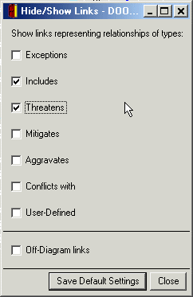
Conflict and Trade-off Analysis
Elicitation Techniques Existing Systems Interviews Questionnaires Brainstorming Prototyping Use Cases
New relations: aggravates and conflicts with
threatens
Sabotage
Rogue Employee
Access the Services
threatens
aggravates
includes
threatens
Frustrated by Controls
mitigates
Service User
mitigates
Service User
includes
Control Loosely
threatens
conflicts with
aggravates
Denial-of-Service Attack
Security Officer
aggravates
Control Strictly
mitigates
includes
Intrude into System
Hacker
Hacker
Hacker
Hacker
Hacker
includes
Log Access Attempts
includes
mitigates
includes
includes
Brute-Force Password Attack
Operate Firewall
includes
mitigates
Attack Unblocked Ports
Recognize Users
mitigates
Impersonate Users
Use Cases for 'Web Portal Security'

Slide 157
Benefits of Scenario-Based Software Development
Elicitation Techniques Existing Systems Interviews Questionnaires Brainstorming Prototyping Use Cases
Scenarios can help to define the scope of the system
They are often used to plan the development process
They are used to both develop and validate the requirements
  Simple, easy to create
  All stakeholders understand them
  Often reflect user's essential requirements
  Separates normal behavior from exceptional behavior
They can form the basis for the definition of test cases

Slide 158
Use Cases are Not a Panacea…
Elicitation Techniques Existing Systems Interviews Questionnaires Brainstorming Prototyping Use Cases
The use cases themselves must be validated
There are some aspects of software that are not covered by use case analysis
  How to integrate non-functional requirements?
Scalability and maintainability
Others discussed by Stephen Ferg in “What's Wrong with Use Cases”

Slide 159
Usage Data Analysis

Slide 160
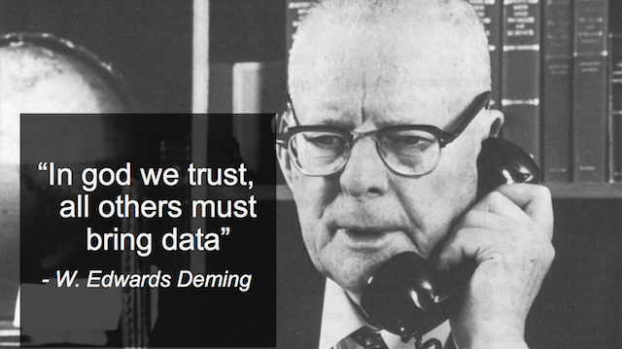
Using Data as Requirements?

Slide 161
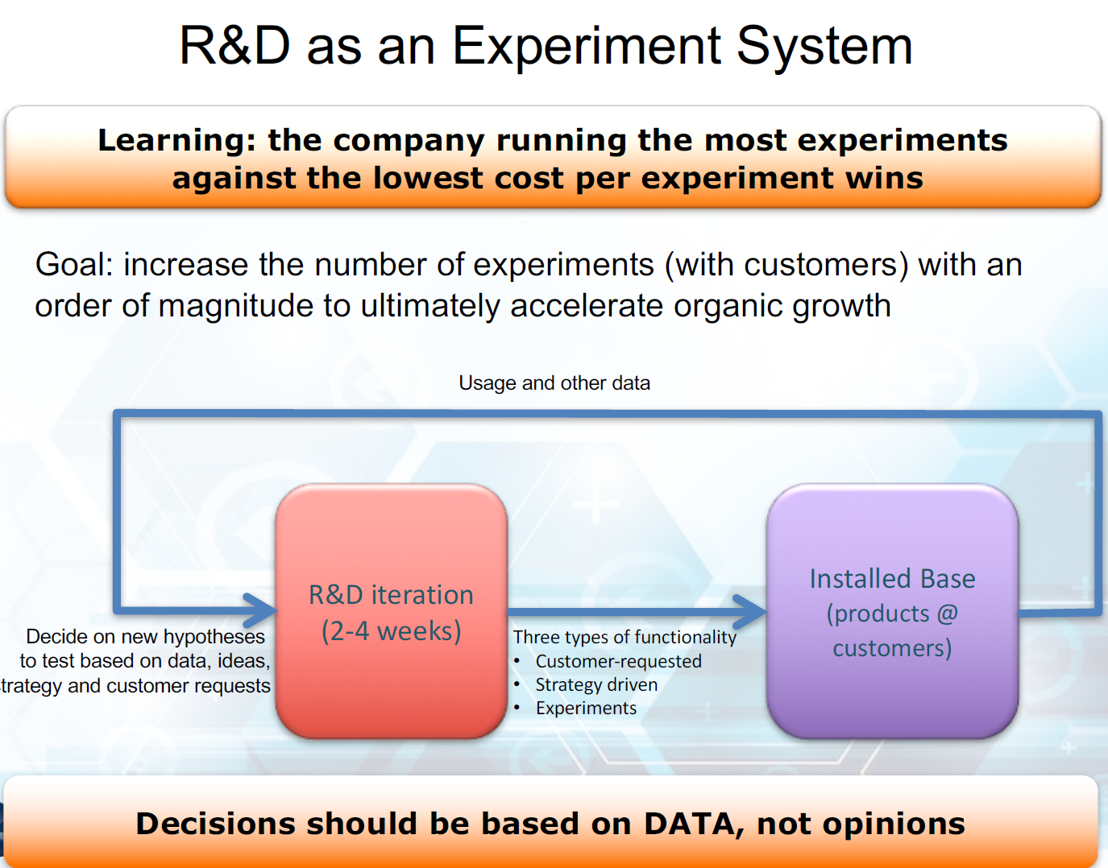
Data and Continuous Delivery instead of Opinions
[J. Bosch, RE’16 Keynote Talk, 2016]

Slide 162
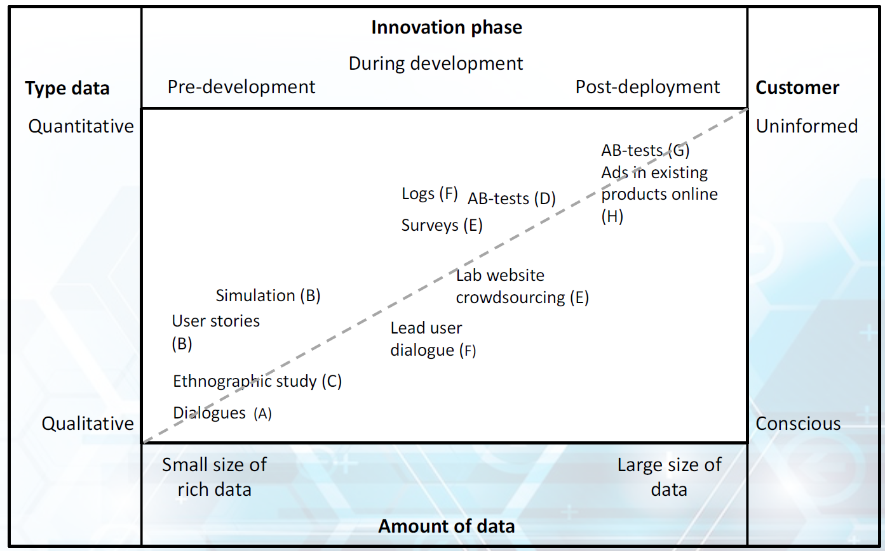
Data Types and Amounts
[Bosch-Sijtsema & Bosch, 2015]

Slide 163
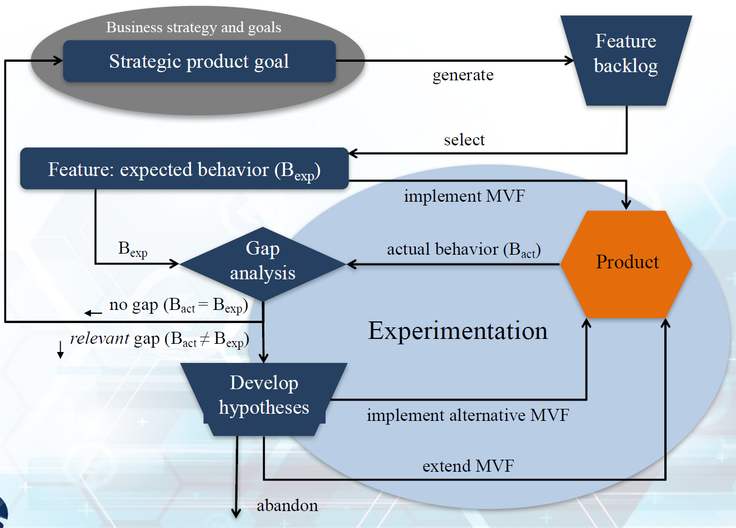
HYPEX Model

Slide 164
Implications for Requirements Engineering
Elicit as few requirements as you can before building the Minimally Viable Product (MVP)
Instrument, collect and analyze data to constantly validate your prioritizations
Model the expected value rather than express the requirement
Focus on minimizing the R&D investment between data-driven proofpoints
Where is such approach not easily applicable?
  Few customers
  Systems that involve much more than software
  …
J. Bosch, “Speed, Data, and Ecosystems: The Future of Software Engineering,” IEEE Softw., vol. 33, no. 1, pp. 82–88, Jan. 2016.

Slide 165
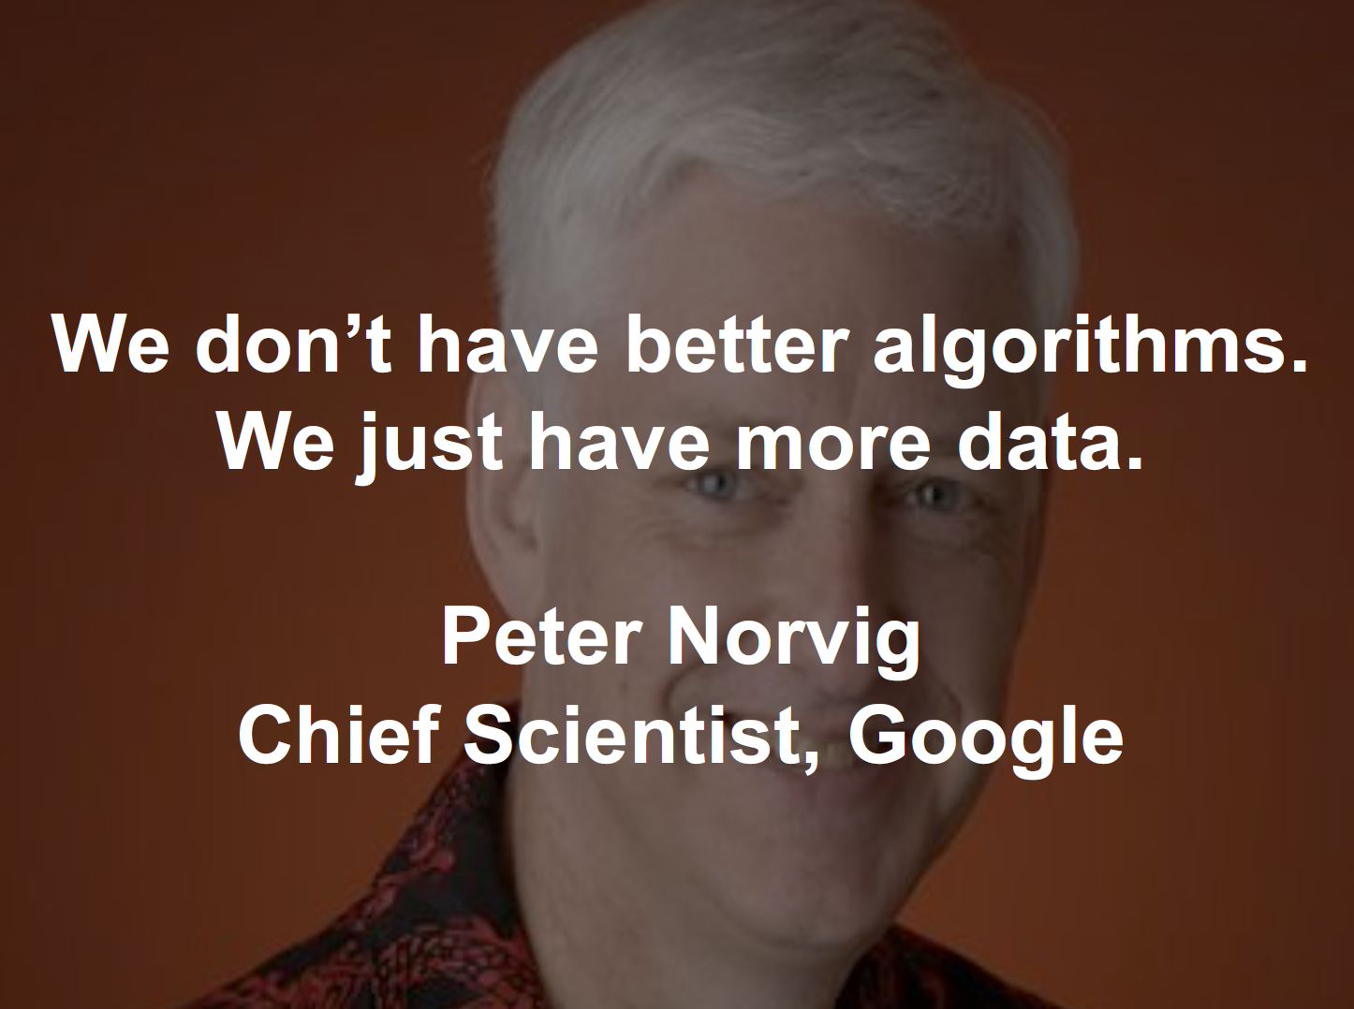

Slide 166
Crowdsourcing Requirements
The crowd and social media also represent potential sources of data-driven requirements
For example
  Dozens of emergency applications exist to support people during catastrophes
  Recent events (e.g., Fort McMurray fires, summer 2016) yet suggest their utility is limited.
Can we analyze social media information (e.g., Twitter feeds) to elucidate more appropriate requirements?
Nayebi, M.; Marbouti, M; Quapp, R; Maurer, F and Ruhe, G. “Crowdsourced Exploration of Mobile App Features: A Case Study of the Fort McMurray Wildfire”. In Proceedings of the 39th International Conference on Software Engineering (ICSE). ACM, 2017.

Slide 167
Sample Crowdsourced Requirements
Top 10 in-demand features based on the analysis of nearly 70,000 tweets related to the Fort McMurray fires
  Fire alarm notification
  Food and water requests and resource
  Emergency maintenance service
  Send emergency text messages
  Safety guidelines
  Fire and safeness warning
  Request ambulance at a tap
  Find nearest gas station
  Emergency zones maps
  Find a medical centre
How many of these were found in the dozens of emergency apps on the market?
  None!
Fort McMurray wildfire tweets show key info missing during disasters: U of C (Global News, Jan 2017)

Slide 168
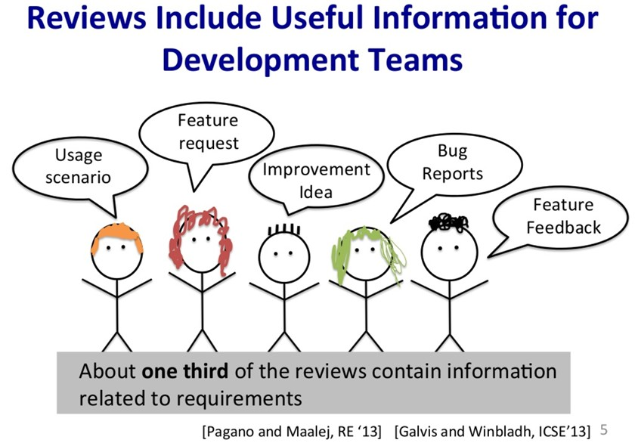
Online Reviews as Data Sources for Requirements

Slide 169
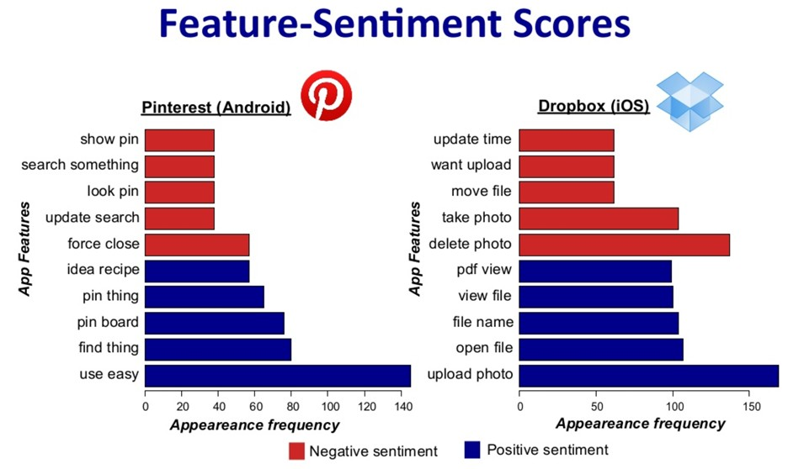
Sentiment Analysis for Good/Bad Features

Slide 170
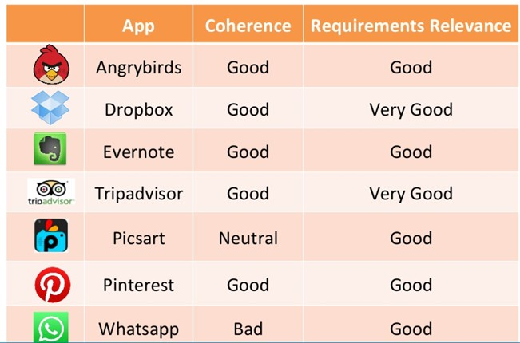
Relevance of Review Data to RE
Walid Maalej, Zijad Kurtanovic, Hadeer Nabil, Christoph Stanik: On the automatic classification of app reviews. Requir. Eng. 21(3): 311-331 (2016)
Emitza Guzman, Walid Maalej: How Do Users Like This Feature? A Fine Grained Sentiment Analysis of App Reviews. RE 2014: 153-162 (2014)
Workshops: Crowd Requirements Engineering (2 so far)

Slide 171
Elicitation Quiz
Name three important challenges of requirements elicitation
Name five types of stakeholders for the Candy Crush game
Why should we analyse existing systems?
What is to plan in an interview?
In a questionnaire, what question would you ask to find out to what extent SEG3101 has enough exercises?
What are the benefits/drawbacks of low-fidelity prototypes?
When are use cases more appropriate than user stories?
  What if many distributed stakeholders with divergent interests?
  http://www.astadia.com/blog/mis-using-user-stories-agile-projects/
What kind of quality requirements are misuse cases good at elicitating?
How does Candy Crush use usage data to discover and quantify requirements?

