Slide 1
Requirements Inception
SEG3101 (Fall 2018)
Daniel Amyot, University of Ottawa
Based on Powerpoint slides by Gunter Mussbacher
with material from:
Wiegers (Software Requirements), Leffingwell & Widrig (Managing Software Requirements), and U. Waterloo colleagues (J. Atlee, D. Berry, N. Day)

Slide 2
Table of Contents
Problem Analysis
Business Requirements
Steps for Problem Analysis
Vision and Scope Document
Project Viability
… Content covered in more detail in other courses, but overviewed here as a starting point.
The important thing is not to stop questioning. Curiosity has its own reason for existing.¹
[1] Albert Einstein (1879 - 1955)

Slide 3
Problem Analysis
Problem Analysis Business Requirements Agreement Root Causes Stakeholders Vision & Scope Constraints Document
Goal: gain a better understanding of the problem being solved before development begins
Identify root cause
Identify stakeholders and their needs (or problems)
Identify solution boundary
Uses business requirements obtained from stakeholders
Results in Product Vision and Project Scope

Slide 4
Business Requirements / Objectives (1)
Problem Analysis Business Requirements Agreement Root Causes Stakeholders Vision & Scope Constraints Document
Business Opportunity
Description of market opportunity, competing market, business problem being solved or improved, advantage of proposed solution...
Example: Exploit the poor security record of a competing product
Business Objective and Success Criteria
Important business benefits the product will provide in a quantitative and measurable way, how success will be measured, factors that have great impact on success...
Examples: Achieve positive cash flow on the product within 6 months; Get 50%+ of the market
Business Risks
Major risks associated with developing or not developing the product (marketplace competition, timing, user acceptance, available resources, implementation issues...)
Can be modeled with goals

Slide 5
Business Requirements (2)
Problem Analysis Business Requirements Agreement Root Causes Stakeholders Vision & Scope Constraints Document
Important for:
Ensuring that all project participants work for the same reasons
Getting stakeholders agreement on requirements
User and software requirements must align with the context and objective defined by business requirements
Requirements that do not help achieve business objectives should not be included

Slide 6
Problem Analysis – Understand Root Causes (1)
Problem Analysis Business Requirements Agreement Root Causes Stakeholders Vision & Scope Constraints Document
There is often a problem behind the problem
Root cause analysis consists of finding underlying causes that may not be immediately apparent
Determine recursively what factors contribute to the problem
Example: Our e­commerce site is not profitable
Why is it not profitable?
Poor site design?
Bad pricing?
Poor customer management after the sale?
In what proportions?

Slide 7
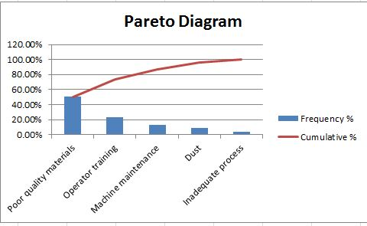
Problem Analysis – Understand Root Causes (2)
Problem Analysis Business Requirements Agreement Root Causes Stakeholders Vision & Scope Constraints Document
Address Root Causes
Root causes do not all have same impact
Some may not be worth fixing, at least for now
Estimate relative impact of root causes (e.g., with the help of a Pareto (bar) chart): 20% of causes → 80% of problems…
Create problem statement for root cause problem identified as worth solving (and with computer solution)
https://www.6sigma.us/training/create-pareto-chart-root-cause-analysis/

Slide 8
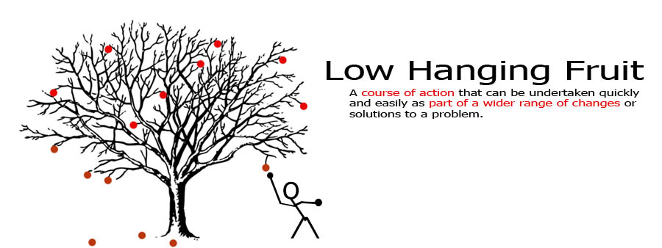
“Low Hanging Fruits”
Problem Analysis Business Requirements Agreement Root Causes Stakeholders Vision & Scope Constraints Document

Slide 9
Problem Analysis – Product Vision and Project Scope
Problem Analysis Business Requirements Agreement Root Causes Stakeholders Vision & Scope Constraints Document
Product Vision: describes what the product is about and what it could eventually become
Aligns all stakeholders in a common direction
Project Scope: identifies what portion of the ultimate long-term product vision the current project will address
Draws boundary between what is in and what is out
Product Vision
Project Scope for release 1.0
Project Scope for release 1.1
…..
Project Scope for release n

Slide 10
Vision Statement (1)
Problem Analysis Business Requirements Agreement Root Causes Stakeholders Vision & Scope Constraints Document
Vision Statement template for Products (according to Moore)
For [target customer]
Who [statement of the need or opportunity]
The [product name]
Is [a product category]
That [key benefit, compelling reason to buy or use]
Unlike [primary competitive alternative, current system, or current business process],
Our product [statement of primary differentiation and advantages of new product]

Slide 11
Vision Statement (2)
Problem Analysis Business Requirements Agreement Root Causes Stakeholders Vision & Scope Constraints Document
Example
For scientists who need to request containers of chemicals, the Chemical Tracking System is an information system that will provide a single point of access to the chemical stockroom and vendors. The system will store the location of every chemical container within the company, the quantity of material remaining in it and the complete history of each container's location and usage. This system will save the company 25% on chemical costs in the first year of use by allowing the company to fully exploit chemicals that are already available within the company, dispose of fewer partially used or expired containers and use a single standard chemical purchasing process. Unlike the current manual ordering processes, our product will generate all reports required to comply with government regulations that require the reporting of chemical usage, storage, and disposal.

Slide 12
Vision Statement (Enterprise Level) (3)
Problem Analysis Business Requirements Agreement Root Causes Stakeholders Vision & Scope Constraints Document
uOttawa Vision (2010)
We aspire to be, among universities, the essential reference on what Canada represents: a university that is an integral part of its community, open to the world, and distinguished by its search for excellence in research, its high-quality learning environment, its passion for knowledge and innovation, its leadership on language issues, and its openness to diversity. Every member of our institution will take part in our educational mission.

Slide 13
Vision Statement (Enterprise Level) (4)
Problem Analysis Business Requirements Agreement Root Causes Stakeholders Vision & Scope Constraints Document
uOttawa Vision (Today)
The University of Ottawa will offer an unparalleled university experience and, through outstanding teaching and research, play a vital role in defining the world of tomorrow. We will instil in each of our graduates an ethic of service, a culture of engagement and an awareness of shared responsibility that will prepare them for global citizenship.
http://www.uottawa.ca/about/sites/www.uottawa.ca.about/files/destination-2020-plan-strategique.pdf
Vision at The Ottawa Hospital
To provide each patient with the world-class care, exceptional service and compassion we would want for our loved ones.
http://www.ottawahospital.on.ca/en/about-us/our-vision/

Slide 14
Dynamic Vision, Scope and Requirements…
Problem Analysis Business Requirements Agreement Root Causes Stakeholders Vision & Scope Constraints Document
The product vision may apply to many projects
Views of the customer, of the enterprise
Evolves rather slowly (e.g., in years)
The product scope focuses on one project
Important to the project manager
More dynamic than the vision
Can be part of a requirements document
Requirements focus on what is needed in order for the product to meet business objectives
Many and rapid changes!

Slide 15
Project Viability – Scope
Problem Analysis Business Requirements Agreement Root Causes Stakeholders Vision & Scope Constraints Document
Scope: product's purpose and the system's boundaries
How much of the work will be done by the system-to-be-developed?
How much of the work will be done by interacting systems?
Information needed for cost and time estimates
Define more precisely the problem to solve
List all the things the system should have to do
Exclude as much as possible to reduce the complexity of the problem
Establish broader goals if the problem is too simple
Example: an automated system for university registration
Initial list of wide problems
Reduced scope
For other systems
Course Browser
Room Allocation
Course Browser
Room Allocation
Registration
Registration
Exam Schedule
Exam Schedule
Payment
Payment
Later stage

Slide 16
Vision and Scope Document
Problem Analysis Business Requirements Agreement Root Causes Stakeholders Vision & Scope Constraints Document
Business requirements
Vision of the solution
Including major features and dependencies
Scope and limitation
For initial and subsequent releases
Business context
Including priorities and operating environment
Risks!!!

Slide 17
In Summary…
Problem Analysis Business Requirements Agreement Root Causes Stakeholders Vision & Scope Constraints Document
“The idea is to do just enough investigation to form a rational, justifiable opinion of the overall purpose and feasibility of the potential new system, and decide if it is worthwhile to invest in deeper exploration”
[Craig Larman]

