Slide 1
Requirements Modelling with UML 2
SEG3101 (Fall 2018)
Daniel Amyot, University of Ottawa
Based on Powerpoint slides by Gunter Mussbacher
with material from:
B. Selic, Brugge & Dutoit, developpez.com,
S. Somé 2008, D. Amyot 2008-2018, et G.v. Bochmann 2010

Slide 2
Overview
Models and Analysis
UML for Requirements Engineering
UML Class Diagrams for Domain Models
UML State Diagrams for lifecycles

Slide 3
All models are false,
but some models are useful…
George Edward Pelham Box (1919-2013)

Slide 4
Models
According to Bran Selic, a model is a reduced representation (simplified, abstract) of (one aspect of) a system used to:
  Help understand complex problems and / or solutions
  Communicate information about the problem / solution
  Direct implementation (especially in software)
Qualities of a good model
  Abstract
  Understandable
  Accurate
  Predictive
  Inexpensive

Slide 5
Modeling Representations
Natural language (English)
  No special training required
  Ambiguous, verbose, vague, obscure ...
  No automation
Ad hoc notation
(bubbles and arrows)
  No special training required
  No syntax formally defined meaning not clear, ambiguous
  No automation
Semi-formal notation (URN, UML...)
  Syntax (graphics) well defined
  Partial common understanding, reasonably easy to learn
  Partial automation
  Meaning only defined informally
  Still a risk of ambiguities
Formal notation (Logic, SDL, Petri nets, FSM ...)
  Syntax & semantics defined
  Great automation (analysis and transformations)
  More difficult to learn & understand

Slide 6
Model Analysis
By construction
  We learn by questioning and describing the system
By inspection
  Execute/analyze the model in our minds
  Reliable?
By formal analysis
  Requires formal semantics (mathematical) and tools
  Reliable (in theory), but expensive (for certain modeling approaches)
By testing
  Execution, simulation, animation, test...
  Requires well-defined semantics and execution/simulation tools
  More reliable than inspection for certain aspects
  Possible to interact directly with the model (prototype)

Slide 7
UML and
Requirements Engineering

Slide 8
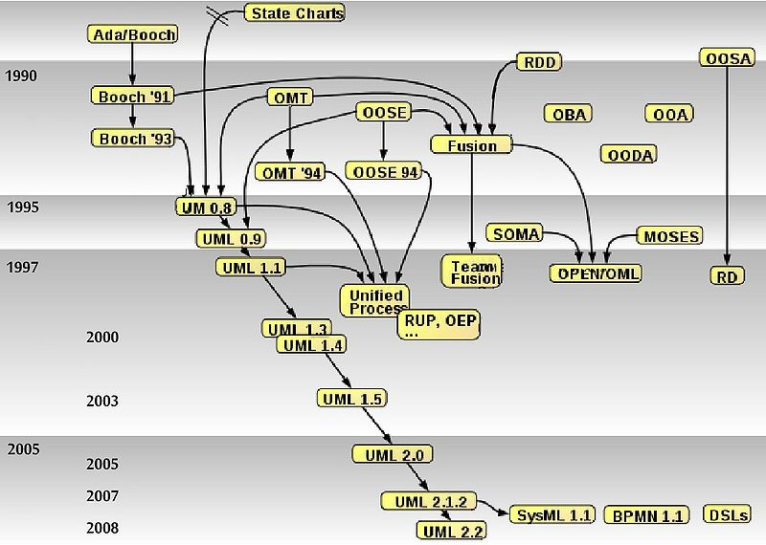

History of UML (http://www.omg.org/uml/)
Rumbaugh
Booch
Jacobson
http://www.omg.org/uml/
Official Version 2.5
(June 2015)
“Simplified”… only
794 pages!
Source: http://en.wikipedia.org/wiki/Unified_Modeling_Language

Slide 9
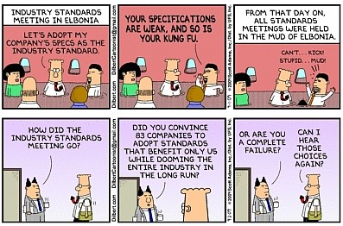
Dilbert on Standards

Slide 10
Thirteen Diagram Types in UML 2.x
According to UML Reference Manual
  Structural
    Class, object, composite structure, component, and use case diagrams
  Dynamic (that is, describing dynamic behavior)
    State machine, activity, sequence, communication, timing, and interaction overview diagrams
  Physical
    Deployment diagrams
  Model Management
    Package diagram

Slide 11
Most Relevant for Requirements Engineering
Use case diagram
  Use cases structuring
Activity diagram
  Workflow and process modeling
  Concepts much related to concepts of Use Case Maps
Sequence diagram
  Modeling of message exchange scenarios
Class diagram
  Domain modeling
State machine diagram
  Detailed behavioral specification (of objects, protocols, ports…)
  System behaviour (black box)
  Object/document lifecycles

Slide 12
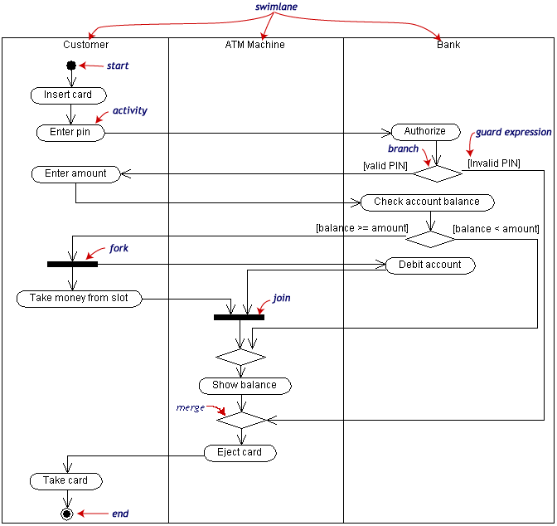
Basic Notational Elements of Activity Diagrams
Describe the dynamic behavior of a system as a flow of activities (workflow)
Flow
  Sequence
  Alternative
  Parallel
Note: in this diagram, the data flow objects are not shown. They may be shown as boxes on the control flow lines.

Slide 13
UCM or UML Activity Diagrams?
UCM and Activity Diagrams have many concepts in common
  Responsibility ↔ action, start/end points, alternatives, concurrency
  Stub / plug-in ↔ action / sub-activity diagram
  Association between elements and components / partition
Unique to Activity Diagrams
  Data flow modeling, with rich data
  Integration with UML (including class diagrams and OCL)
Unique to UCM
  Dynamic stubs with several plug-ins
  Plug-ins can continue in parallel with their parent model
  2D graphical layout of components
  Definitions of scenarios (integrated testing capabilities)
  Integration with GRL in URN

Slide 14
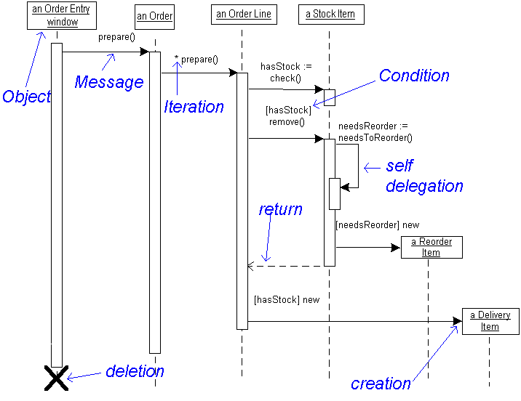
Basic Notational Elements of Sequence Diagrams
Describe the dynamic behavior as interactions between so-called “participants” (e.g. agents, actors, the system, system components). For each participant, there is a “lifeline”
http://fox.wikis.com/graphics/sequence.gif

Slide 15
Combined Fragments
Allow multiple sequences to be represented in compact form (may involve all participants or just a subset)
Combined fragment operators
  alt, for alternatives with conditions
  opt, for optional behavior
  loop(lower bound, upper bound), for loops
  par, for concurrent behavior
  critical, for critical sections
  break, to show a scenario will not be covered
  assert, required condition
  ignore/consider(list of messages), for filtering messages
  neg, for invalid or mis-use scenarios that must not occur
  strict or seq, for strict/weak sequencing
  ref, for referencing other sequence diagrams

Slide 16
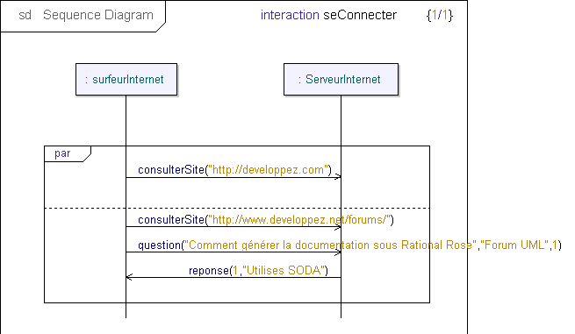
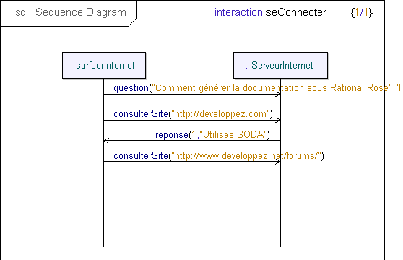
Concurrency Quiz
Is the interaction on the right a valid sequential trace that can be generated from the interaction with the par combined fragment on the left?
No! The sequences of the two operands may be interleaved but the ordering defined for each operand must be maintained.

Slide 17
Class Diagrams and Domain Models

Slide 18
From ER to Class Diagrams
Based on Entity-Relationship modeling
  Originally proposed by Peter Chen in 1976
Concepts:
  Entity/Class: represents a type of entity instances, defines the properties that hold for all such instances.
  Relationship/Association: represents relationship that hold between certain pairs of entities.
    The related entity types are also called roles.
    Multiplicity information indicate how many instances of the “other” side may be related to a given instance of “this” side.
  Attribute: An entity may have attributes. Each attribute is identified by a name and its (data/class) type

Slide 19
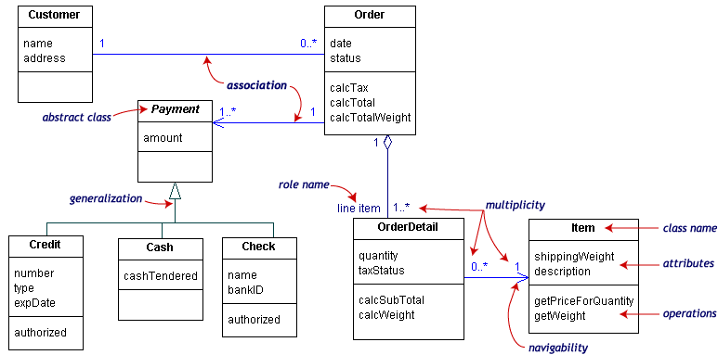
UML Class Diagrams

Slide 20
Class Diagrams for Domain Modeling
It is important to define
  The concepts that exist in a domain where requirements are being specified
    Provides the basic terminology/vocabulary
  The particular attributes of these concepts
  The relationships that exist between these concepts
    Generalization, aggregation, others more domain-specific…
Class diagrams are ideal to capture this information!
But a precise subset is useful here…

Slide 21
Class Diagrams for Precise Domain Modeling
No operations!
Attributes with types
  Use associations when types are other classes
Associations with precise multiplicities
  Beware of fixed numbers… and of 1..1 associations!
Names for association ends (roles) must be used instead of a simple association name
  Less confusing, especially for expressing constraints
Enumerations are also useful
Beware of generalization
  Yes, patterns are useful here too!
Supplement with constraints for precision wherever needed
  In natural language (using the names of classes, attributes, and association ends in the model) or in OCL (Object Constraint Language)

Slide 22
Exercise…
Design a simple domain model for a genealogy software application
  What are the relevant classes, attributes and associations?
  Do you see some constraints that are difficult to express with UML class diagrams?

Slide 23
Modularity Problems with Class Diagrams (Info)
Scattering: design
elements to support R1 in many components
Requirement1 (R1)
Requirement2 (R2)
ComponentA
R1 elements
Requirement3 (R3)
…
RequirementN (RN)
ComponentB
R1 elements
ComponentC
R1 elements
ComponentD
R1 elements
ComponentF
R1 elements
R2 elements
R3 elements
RN elements
Tangling: single
component has
elements for many
requirements
ComponentE

Slide 24
A Partial Solution – Aspects (info)
intertype
declaration
Aspect
ClassA
R1 elements
F.R1
R1 elements
Triggered
behavior
(code)
ClassG
R1 elements
R1 elements
advice
ClassC
R1 elements
Predicate
R1 elements
ClassB
R1 elements
R1 elements
pointcut
ClassF
R1 elements
R2 elements
R3 elements
RN elements
(identifies joinpoints
where advice is executed)
R1 elements
Terminology based on AspectJ: www.eclipse.org/aspectj

Slide 25
State Machine Diagrams

Slide 26
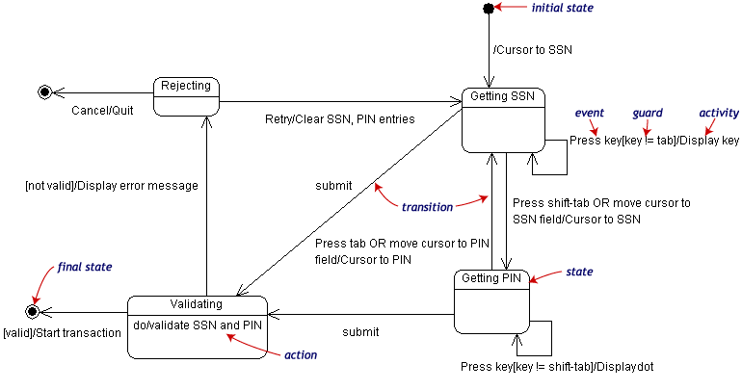
Basic Notational Elements of State Machine Diagrams
Describe the dynamic behavior of an individual object (with states and transitions)

Slide 27
Types of State Machines
UML allows both types to be mixed
on
on
Lamp On
Lamp On
print(”on”)
on/print(”on”)
on
off
off
off
off
Lamp
Off
Lamp
Off
Mealy Automaton
Moore Automaton

Slide 28
Variables (“Extended” States)
on
Lamp On
ctr : Integer
on/ctr := ctr + 1
off
Lamp Off
off

Slide 29
Modeling Behavior
In general, state machines are suitable for describing reactive systems based or events
Not appropriate to describe continuous systems (e.g., spacecraft trajectory control, stock market predictions)
threshold
time

Slide 30
UML State Machine Diagrams – Summary
Composite State
State
Initial
Pseudostate
top
Trigger
Ready
Transition
stop
/ctr := 0
Done
Final State
Action
stop

Slide 31
Entry and Exit Actions
LampOn
e2
entry/lamp.on();
exit/lamp.off();
e1

Slide 32
Action Ordering
Output actions: transition prefix
Input actions: transition postfix
LampOn
LampOff
off/printf(“to off”);
entry/lamp.on();
entry/lamp.off();
exit/printf(“exiting”);
exit/printf(“exiting”);
Resulting action sequence:
printf(“exiting”);
printf(“to off”);
lamp.off();
off/printf(“needless”);
printf(“exiting”);
printf(“needless”);
lamp.off();

Slide 33
State Activity (Do)
Creates a concurrent process that will execute until
  The action terminates, or
  We leave the state via an exit transition
“do” activity
Error
entry/printf(“error!”)
do/alarm.ring()

Slide 34
Guards (Conditions)
Conditional execution of transitions
Guards must not have side effects
bid [value < 100] /reject
Selling
bid [value >= 200] /sell
Happy
bid [(value >= 100) & (value < 200)] /sell
Unhappy

Slide 35
Hierarchical State Diagrams
Composed states, to manage complexity
LampOff
LampFlashing
flash/
entry/lamp.off()
FlashOn
off/
entry/lamp.on()
1sec/
1sec/
on/
on/
FlashOff
on/
LampOn
entry/lamp.off()
entry/lamp.on()

Slide 36
Group Transitions
Default transition to
Initial pseudostate
LampOff
LampFlashing
entry/lamp.off()
flash/
FlashOn
off/
entry/lamp.on()
1sec/
1sec/
on/
FlashOff
on/
LampOn
entry/lamp.off()
entry/lamp.on()
Group transition

Slide 37
Completion Transition
Triggered by a completion event
  Automatically generated when an embedded state machine terminates
Completion transition
(without trigger)
Committing
Phase1
CommitDone
Phase2

Slide 38
Triggering Rules
Many transitions can share the same triggering event
  When leaving, the most deeply embedded one takes precedence
  The event disappears whether it triggers a transition or not
LampFlashing
FlashOn
on/
off/
on/
FlashOff

Slide 39
Action Ordering – Composite States
S1
exit/exS1
S2
entry/enS2
/initS2
S11
exit/exS11
E/actE
S21
entry/enS21
Action sequence on transition E:
exS11 ⇨ exS1 ⇨ actE ⇨ enS2 ⇨ initS2 ⇨ enS21

Slide 40
Exercise I – Describe this Behavior
What should be added to this state machine to more fully describe the dialing behavior?

Slide 41
Orthogonal Regions
Combine many concurrent perspectives – interactions across regions typically done via shared variables
age
financialStatus
Child
Poor
Adult
age
financialStatus
Child
Rich
Retiree
Poor
Adult
Retiree
Rich

Slide 42
Semantics of Orthogonal Regions
All mutually orthogonal regions detect the same events and respond simultaneously (possibly interleaved)
legalStatus
financialStatus
LawAbiding
Poor
robBank/
robBank/
Outlaw
Rich

Slide 43
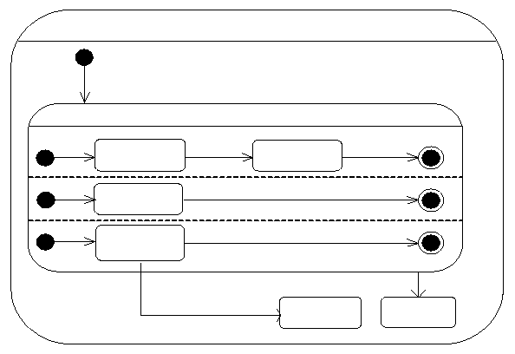
Exercise II – Describe this Behaviour
CourseAttempt
Studying
Lab1
lab done
Lab2
lab done
Term Project
project done
Final Test
pass
fail
Failed
Passed

Slide 44
Exercise III
In requirements engineering, state machines are quite popular for describing the lifecycle of documents and other artefacts.
  Simpler subset of the notation needed
  States, transitions with events [and conditions]
    Fewer actions than for conventional behaviour descriptions
  Hierarchical states and orthogonal regions used only if they simplify the model
  Simple but still VERY useful!
Using a UML state machine diagram, describe the lifecycle of:
  A software bug in a bug management system such as Bugzilla or Jira.
  An prerequisite exemption request for a course at the University of Ottawa.

Slide 45
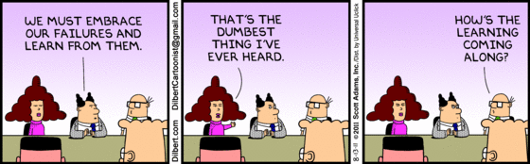
Conclusion…

Slide 46
Quiz!
Is formal logic always better than natural language?
Why do we need domain models in requirements engineering?
Why must class diagrams be sometimes supplemented by constraints?
Why are Hierarchical State Diagrams useful?
Why spend time documenting lifecycles of documents and objects?

