Slide 1
User Requirements Notation (URN)
Part 1: Goal-oriented Requirement Language (GRL)
SEG3101 (Fall 2018)
Daniel Amyot, University of Ottawa
Based on material from:
Mussbacher and Amyot 2009-2018

Slide 2
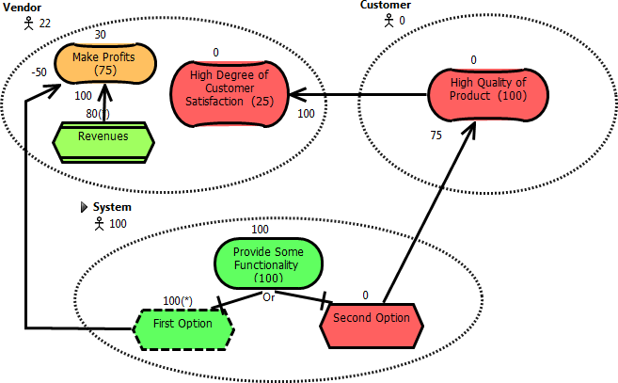
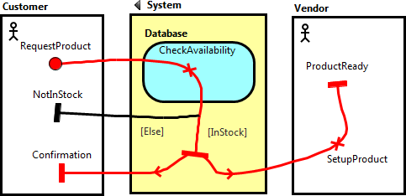
Bird’s Eye View of URN
GRL
intentional elements + actors +
links+ indicators + strategies
URN Links
UCM
responsibilities + causality + components + scenarios

Slide 3
Table of Contents
Introduction to the User Requirements Notation (URN)
Goals and Rationales
Goal-oriented Requirement Language (GRL)
  GRL Basics
  Evaluations
  Examples
  Tools
  Indicators
All models are false, but some models are useful.¹
[1] George Edward Pelham Box (1919-)

Slide 4
URN Overview (1)
User Requirements Notation jUCMNav Goals and Rationale GRL Basics Evaluations Examples Tools Indicators
URN is a semi-formal, lightweight graphical language for modeling and analyzing requirements in the form of goals and scenarios and the links between them
Combines two existing notations
  Goal-oriented Requirement Language (GRL)
  (based on i* & NFR Framework)
  Use Case Maps (UCMs)
Support for the elicitation, analysis,
specification, and validation of requirements
Allows systems, software, and requirements engineers to discover and specify requirements for a proposed system or an evolving system, and analyse such requirements for correctness and completeness
Commuter
Minimize time lost
by commute
Minimize cost
for commute
50
50
60
40
Work during
commute
-40
Minimize
travel time
Minimize
infrastructure cost
Share
ongoing cost
80
45
-30
80
80
80
-90
-20
20
-20
60
Take public
transport
-10
Take private
transport
Regular
Bus
80
OR
OR
Express
Bus
Take
own car
Hitch a
ride
Regular
Bus
Express
Bus
Take
own car
Hitch a
ride
home
Commuting
secure
home
transport
elevator
transport
Car
ready
to
leave
home
commute
take
elevator
drive car
in
cubicle
X
stay
home
Secure Home
transport
Hitch a Ride
hitch a ride in car
elevator
Take Elevator
home
arm system
lock door
X
in
out1
X
call
elevator
select
floor
out2
use alternative
alarm system
X
X
stay
home
X
Regular Bus
commuter
Arm System
deal with
work email
take
stairs
home
transport
X
elevator
arrived
X
not armed
take #95
take #96
alarm system
X
X
[quit]
take #97
accept
code
armed
X
check
code
[matched]
X
X
[not
matched]
Express Bus
commuter
deal with
work email
transport
X
take #100
X
URN: www.usecasemaps.org/urn jUCMNav: www.softwareengineering.ca/jucmnav Virtual Library: www.usecasemaps.org/pub

Slide 5
URN Overview (2)
User Requirements Notation jUCMNav Goals and Rationale GRL Basics Evaluations Examples Tools Indicators
URN models can be used to specify and analyze various types of reactive systems, business processes, and telecommunications standards
jUCMNav
  URN editor & analysis tool
  Eclipse plug-in
  Open source project

Slide 6
URN Overview (3)
User Requirements Notation jUCMNav Goals and Rationale GRL Basics Evaluations Examples Tools Indicators
vision
GRL
Model business goals, stakeholders’ priorities, alternative solutions, rationale, and decisions
called strategies, compared with GRL evaluation mechanism
traceability with URN links
extensible
with
metadata
with UCM traversal mechanism based on UCM scenario definitions
UCM
Model & test use cases; investigate high level architecture; transform to more detailed models
more detailed models
A GRL / UCM model visually communicates business objectives and constraints / high-level functional requirements to all stakeholders

Slide 7
ITU-T Z.151: URN – Language Definition
User Requirements Notation jUCMNav Goals and Rationale GRL Basics Evaluations Examples Tools Indicators
URN is the first and currently only standard which explicitly addresses goals (non-functional requirements with GRL) in addition to scenarios (functional requirements with UCMs) in a graphical way in one unified language
  International Telecommunication Union (ITU-T Z.150 series)
  UN: 193 countries + member companies
  ITU-T Z.150 (02/03, revised 02/11):
  User Requirements Notation (URN) - Language requirements and framework
  ITU-T Z.151 (11/08, corrigendum 2011, revised 2012):
  User requirements notation (URN) - Language definition
    Metamodel, abstract/concrete syntaxes, semantics…
  2018 version submitted, with textual syntax for UCM/GRL
ITU-T Z.150: http://www.itu.int/rec/T-REC-Z.150/en ITU-T Z.151: http://www.itu.int/rec/T-REC-Z.151/en

Slide 8
ITU-T Languages
User Requirements Notation jUCMNav Goals and Rationale GRL Basics Evaluations Examples Tools Indicators
SDL: Specification and Description Language
  For defining and executing complete reactive systems
MSC: Message Sequence Charts
  For defining message-oriented scenarios
ASN.1: Abstract Syntax Notation One
  For defining data types/packets
TTCN-3: Testing and Test Control Notation
  For defining test cases and test environments
URN: User Requirements Notation
  Goal-oriented Requirement Language (GRL)
  Use Case Map notation (UCM)
  For defining abstract goals, scenarios, and requirements
UML 2.x profiles for some of these languages (e.g., SDL)…

Slide 9
Goals and Rationale

Slide 10
What is a Rationale?
User Requirements Notation jUCMNav Goals and Rationale GRL Basics Evaluations Examples Tools Indicators
Rationale is the reasoning that leads to the system
Rationales include
  Issues that were addressed
  Alternatives that were considered
  Decisions that were made to resolve the issues
  Criteria that were used to guide decisions
  Debate developers went through to reach a decision
[Bruegge and Dutoit, chapter 12]
Source: Bruegge and Dutoit, chapter 12

Slide 11
Uses of Rationales in Software Engineering
User Requirements Notation jUCMNav Goals and Rationale GRL Basics Evaluations Examples Tools Indicators
Improve design support
  Avoid duplicate evaluation of poor alternatives
  Make consistent and explicit trade-offs
Improve documentation support
  Makes it easier for non developers (e.g., managers, lawyers, technical writers) to review the design
Improve maintenance support
  Provide maintainers with design context
Improve learning
  New staff can learn the design by replaying the decisions that produced it

Slide 12
ATM Example (Table)
User Requirements Notation jUCMNav Goals and Rationale GRL Basics Evaluations Examples Tools Indicators
Question: Alternative Authentication Mechanisms?
References: Service: Authenticate
Decision: Smart Card + PIN
Criteria 1:
ATM Unit Cost
Criteria 2:
Privacy
Option 1: Account number
+
–
Option 2: Fingerprint reader
–
+
Option 3: Smart Card + PIN
+
+
Qualitative version

Slide 13
ATM Example (Table)
User Requirements Notation jUCMNav Goals and Rationale GRL Basics Evaluations Examples Tools Indicators
Question: Alternative Authentication Mechanisms?
References: Service: Authenticate
Decision: Smart Card + PIN
Criteria 1:
ATM Unit Cost
Criteria 2:
Privacy
Option 1: Account number
1
20
Option 2: Fingerprint reader
4
30
Option 3: Smart Card + PIN
2
40
Quantitative version
Questions: Relationships between criteria? Scalability?
Stakeholders?... Can we do better than a simple table?

Slide 14
What Is a Goal?
User Requirements Notation jUCMNav Goals and Rationale GRL Basics Evaluations Examples Tools Indicators
Goal: high level objective of the business, organization or system
  A requirement specifies how a goal should be accomplished by a proposed system
Operationalization: the process of defining a goal with enough detail so that its sub-goals have an operational definition.
Decomposition: the process of subdividing a set of goals into a logical sub-grouping so that system requirements can be more easily understood, defined and specified.
Obstacles: behaviours or other goals that prevent or block the achievement of a given goal.
  Abstracting and identifying goal obstacles allows one to consider the possible ways for goals to fail and anticipate exception cases.
Source: A. Antón

Slide 15
Roles of Goals in RE [van Lamsveerde, 2009]
User Requirements Notation jUCMNav Goals and Rationale GRL Basics Evaluations Examples Tools Indicators
Goal refinement provides a natural mechanism for structuring complex specifications at different levels of concern.
Goals provide the rationale for requirements.
Goals drive the identification of requirements to support them.
Goals provide a richer structure for satisfaction arguments.
Goals provide a basis for showing the alignment of the system-to-be with the organization’s strategic objectives.
Goals provide a precise criterion for requirements completeness.
Goals provide a precise criterion for requirements relevance.
Goals provide a natural way of structuring the requirements domain.
Goals provide anchors for risk analysis.
Goals provide the roots for managing conflicts among requirements.
Goals provide a criterion for delimiting the scope of the system.
Goals support the analysis of dependencies among agents.
Goals provide a basis for reasoning about alternative options.
Goals support traceability management.
Goals provide essential information for evolution support.

Slide 16
Goal-oriented Requirement Language (GRL)

Slide 17
GRL Overview (1)
User Requirements Notation jUCMNav Goals and Rationale GRL Basics Evaluations Examples Tools Indicators
The Goal-oriented Requirement Language (GRL)
  Graphical notation (textual syntax under standardization)
  Connects requirements to business objectives
  Allows reasoning about (non-functional) requirements
  Is based on i* (concepts / syntax) and the NFR Framework (evaluation mechanism)
  Indicators, strategies, and extension mechanisms
GRL models the “why” aspect
  Model goals and other intentional concepts
  Little or no operational details
Supports goal and trade-off analysis and evaluations
  Which actors will be happy about these decisions?
Nothing comparable in UML, SysML or BPMN…

Slide 18
GRL Overview (2)
User Requirements Notation jUCMNav Goals and Rationale GRL Basics Evaluations Examples Tools Indicators
GRL is used to …
  Visually describe business goals, objectives, stakeholders’ priorities, alternative solutions, rationale, and decisions
  Decompose high-level goals into alternative solutions called tasks (this process is called operationalization)
  Model positive & negative influences of goals and tasks on each other
  Capture dependencies between actors (i.e., stakeholders)
  Reason about alternatives and trade-offs

Slide 19
GRL Notation (1)
User Requirements Notation jUCMNav Goals and Rationale GRL Basics Evaluations Examples Tools Indicators
GRL Example: Tiny Online Business
Resource
Business
Owner
Online Shopper
Increase
Sales
Payment
Offer Online
Shopping
+
+
Dependency
Contribution
Have System
Security
Actor
Softgoal
Minimize Cost of
Terminal
+
+
.
Correlation
_
Have Security
of Terminal
Have Security
of Host
+
.
+
.
+
Decomposition
Access
Authorization
Encryption
Biometrics is no
regular, off-the-shelf
technology
Ensure
Authentication
AND
OR
Task
Belief
Provide
Identification
Use
Fingerprint
Use
Password
Use
Cardkey
Goal

Slide 20
GRL Notation (2)
User Requirements Notation jUCMNav Goals and Rationale GRL Basics Evaluations Examples Tools Indicators
Intentional elements
  Softgoal, goal, task ,resource, belief
Achievement of softgoal is qualifiable but not measurable; it is quantifiable for goals
  Softgoal …often non-functional
  Goal … often functional
Task is a proposed solution that achieves a goal or satisfies (satisfices) a softgoal
Belief captures rationale

Slide 21
GRL Notation (3)
User Requirements Notation jUCMNav Goals and Rationale GRL Basics Evaluations Examples Tools Indicators
Contribution and Correlation Links
  Contribution describes desired impact,
  correlation shows side effects
  Qualitative or quantitative contribution types
  are used for these links
Decomposition Link
  Defines what an intentional element needs to
  be satisfied
    AND
    OR
    XOR
Dependency Link
  An actor (the depender) depends on another actor (the dependee) for something (the dependum), e.g. the business owner depends on the online shopper for payment (the dependum is optional)
GRL Contributions Types:
(qualitative)
Break
Make
Some-
Some+
Hurt
Help
?
Unknown

Slide 22
GRL Notation (4)
User Requirements Notation jUCMNav Goals and Rationale GRL Basics Evaluations Examples Tools Indicators
GRL graphs can be allocated to actors
Dependencies can be defined between actors
together with
intermediate
resources or
other
elements
Provides a strategic view
Note: this is an i* model and therefore the syntax is slightly different

Slide 23
Why GRL?
User Requirements Notation jUCMNav Goals and Rationale GRL Basics Evaluations Examples Tools Indicators
Goals become an important driver for requirements elaboration – yet, stakeholders goals and objectives are complex and will conflict…
GRL expresses and clarifies tentative, ill-defined, and ambiguous requirements
  Supports argumentation, negotiation, conflict detection & resolution, and in general decisions
  Captures decision rationale and criteria (documentation!)
GRL identifies alternative requirements and alternative system boundaries
GRL provides clear traceability from strategic objectives to technical requirements
GRL allows reuse of stable higher-level goals when the system evolves

Slide 24
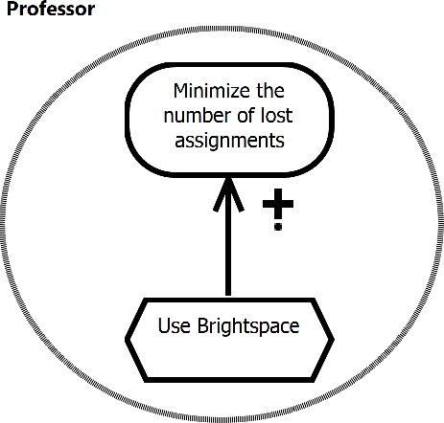
User Stories and Goal models
User Requirements Notation jUCMNav Goals and Rationale GRL Basics Evaluations Examples Tools Indicators
Pattern: As an [Actor] I want to [Task] in order to [Contribution] achieve [Goal]
This user story identifies the task of an actor, a contribution level, and a contribution from the task to a goal (inside or outside the actor)
As a professor, I want to use Brightspace in order to help minimize the number of lost assignments.

Slide 25



GRL – Strategy Execution (Strategy 1)
User Requirements Notation jUCMNav Goals and Rationale GRL Basics Evaluations Examples Tools Indicators
GRL Example: Tiny Online Business
Business
Owner
42
25
Business
Owner
*
*
Increase
Sales
Online Shopper
100
100
33
Increase
Sales
Online Shopper
Payment
Payment
Offer Online
Shopping
+
Offer Online
Shopping
high
+
44
high
System
Security
Importance
System
Security
medium
75
Cost of
Terminal
Cost of
Terminal
+
25
+
.
*
100
Security
of Host
Security of
Terminal
Security
of Host
_
Security of
Terminal
+
.
+
.
+
-75
*
100
Access
Authorization
Access
Authorization
Encryption
Biometrics is no
regular, off-the-shelf
technology
100
Encryption
Authentication
Authentication
AND
OR
*
*
-75
Initial
Satisfaction
Level
0
Identification
0
100
Identification
Fingerprint
Fingerprint
Password
Password
Cardkey
Cardkey

Slide 26
GRL – Strategies and Evaluation Mechanism (1)
User Requirements Notation jUCMNav Goals and Rationale GRL Basics Evaluations Examples Tools Indicators
GRL allows a particular configuration of intentional elements to be defined in a strategy (i.e., one possible solution)
  Captures the initial, user-defined satisfaction levels for these elements separately from the GRL graphs
  Strategies can be compared with each other for trade-off analyses
In order to analyze the goal model and compare solutions with each other, jUCMNav’s customizable evaluation mechanism executes the strategies
  Propagating satisfaction levels to the other elements and to actors shows impact of proposed solution on high level goals for each stakeholder
  Propagation starts at user-defined satisfaction levels of intentional elements (usually bottom-up)

Slide 27
GRL – Strategies and Evaluation Mechanism (2)
User Requirements Notation jUCMNav Goals and Rationale GRL Basics Evaluations Examples Tools Indicators
Evaluations of GRL graphs show the impact of qualitative decisions on high level softgoals
Evaluation mechanism takes into consideration
  Initial satisfaction levels of children (intentional elements)
  Links, types of these links, and contribution/decomposition types
  Importance defined for intentional elements
More complete than simple pros/cons tables or criteria evaluation matrices
See Chapter 11.1 and Appendix II of the Z.151 standard
  Standard provides minimum requirements

Slide 28


GRL – Qualitative or Quantitative Approach
User Requirements Notation jUCMNav Goals and Rationale GRL Basics Evaluations Examples Tools Indicators
GRL Satisfaction Levels:
(qualitative)
Qualitative Approach
  Contribution types: from Make to Break
  Importance: High, Medium, Low, or None
  Qualitative satisfaction levels
Quantitative Approach
  Contribution types: [-100, 100]
  Importance: [0, 100]
  Quantitative satisfaction levels: [-100, 100]
Hybrid Approach is also possible
  Qualitative contribution types
  Quantitative importance
  Quantitative satisfaction levels
Satisfied
Weakly
Satisfied
Unknown
Weakly
Denied
Denied
Conflict
None

Slide 29
GRL – Strategy Execution (Strategy 3)
User Requirements Notation jUCMNav Goals and Rationale GRL Basics Evaluations Examples Tools Indicators
GRL Example: Tiny Online Business
Business
Owner
52
51
Business
Owner
*
*
Increase
Sales
Online Shopper
100
100
68
Increase
Sales
Online Shopper
Payment
Payment
Offer Online
Shopping
+
Offer Online
Shopping
high
+
90
high
System
Security
System
Security
medium
0
Cost of
Terminal
Cost of
Terminal
+
+
.
*
100
100
Security
of Host
Security of
Terminal
Security
of Host
_
Security of
Terminal
+
.
+
.
+
0
*
100
Access
Authorization
Access
Authorization
Encryption
Biometrics is no
regular, off-the-shelf
technology
Encryption
Authentication
Authentication
AND
OR
0
0
0
0
Identification
Identification
Fingerprint
Fingerprint
Password
Password
Cardkey
Cardkey

Slide 30
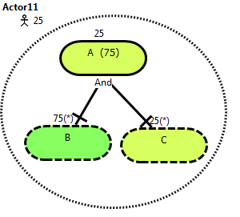
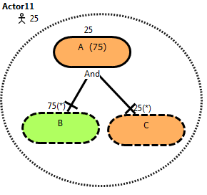
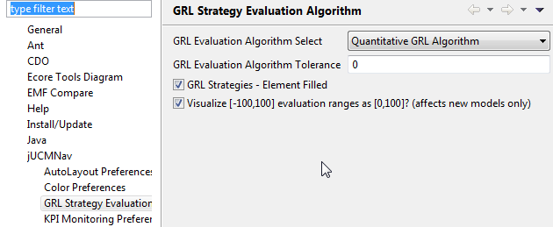
User Requirements Notation jUCMNav Goals and Rationale GRL Basics Evaluations Examples Tools Indicators
More Intuitive [0..100] GRL Satisfaction Scale
Right-click on URNspec (in the Outline view) to switch between [0..100] and [-100..100]. The menu for quantitative values will change too.
New visualization option with [0..100] for evaluations
Suddenly, 25 is no longer good (orange)!
Applies to new models.
A [0..100] satisfaction scale instead of a [-100..100] scale in GRL is more intuitive to
some types of stakeholders (especially in combination with negative contributions…)

Slide 31
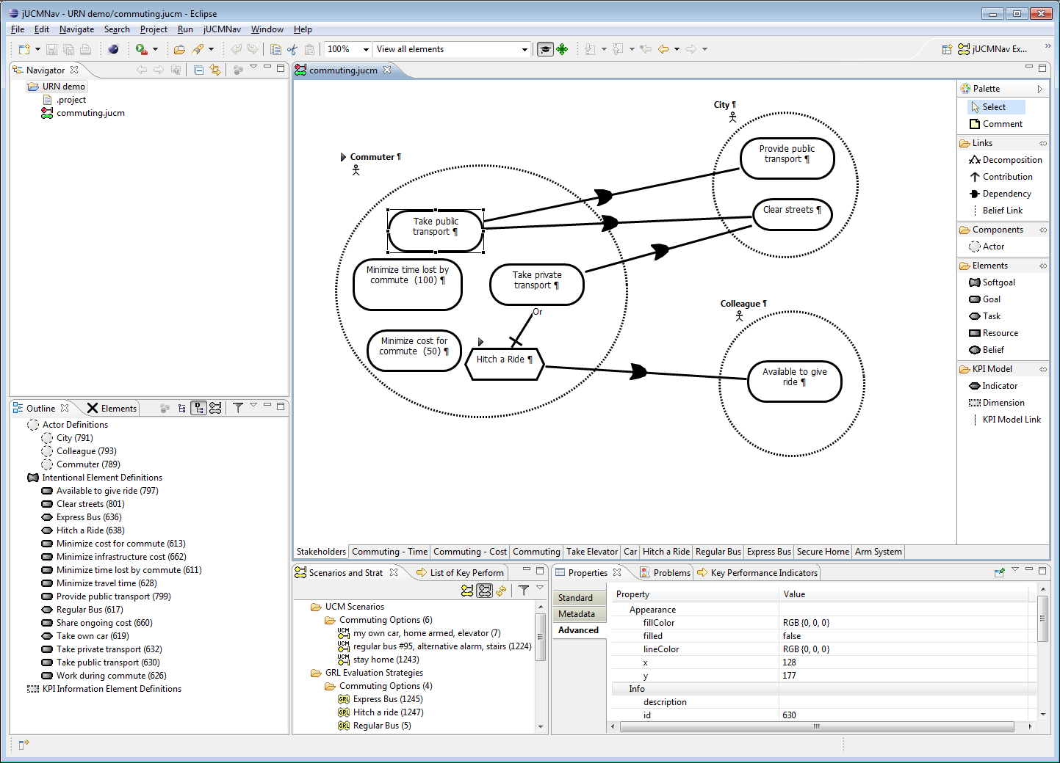
jUCMNav 7 Tool, for Eclipse
User Requirements Notation jUCMNav Goals and Rationale GRL Basics Evaluations Examples Tools Indicators
Menu
Perspectives
Toolbar
Editor
Projects & Files
Views
Palette
Analysis
Details of Model Element
Model Elements in File

Slide 32
URN Abstract Metamodel
User Requirements Notation jUCMNav Goals and Rationale GRL Basics Evaluations Examples Tools Indicators

Slide 33
GRL Abstract Metamodel
User Requirements Notation jUCMNav Goals and Rationale GRL Basics Evaluations Examples Tools Indicators

Slide 34
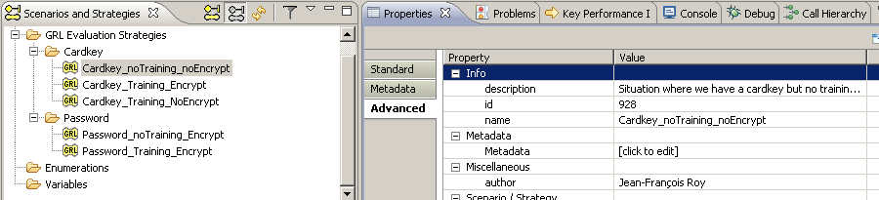
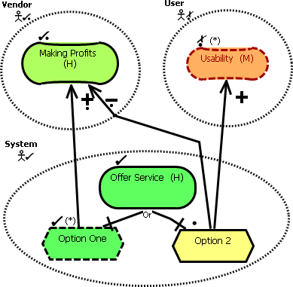
Strategies in jUCMNav
User Requirements Notation jUCMNav Goals and Rationale GRL Basics Evaluations Examples Tools Indicators
A star (*) indicates an initial value part of
a given strategy (element also shown in
dashed lines).
All the others are evaluated through
a propagation algorithm. Dashed red lines
are overridden values (could be computed)

Slide 35
GRL Strategies Abstract Metamodel
User Requirements Notation jUCMNav Goals and Rationale GRL Basics Evaluations Examples Tools Indicators
Notes:
- Advantage is that user could compare different strategies and their impact on the model

Slide 36
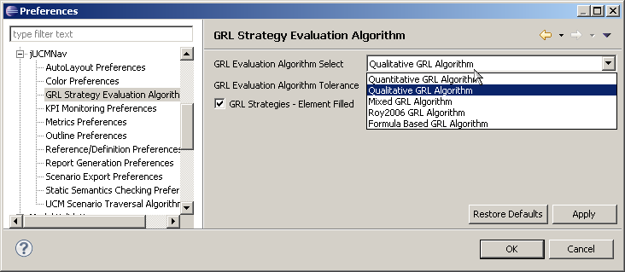
Propagation Algorithms in jUCMNav
User Requirements Notation jUCMNav Goals and Rationale GRL Basics Evaluations Examples Tools Indicators
jUCMNav supports 7 propagation algorithms
  1 Quantitative, 1 Qualitative
  1 Quantitative/Qualitative hybrid
  Experimental support for indicator propagation
  Experimental support for conditions (legal compliance)
  Experimental support for constraint-based
  Experimental support for feature-based
Most support the automatic resolution of conflicts
Most use links in this
order:
  Decompositions
  Contributions
  Dependencies

Slide 37
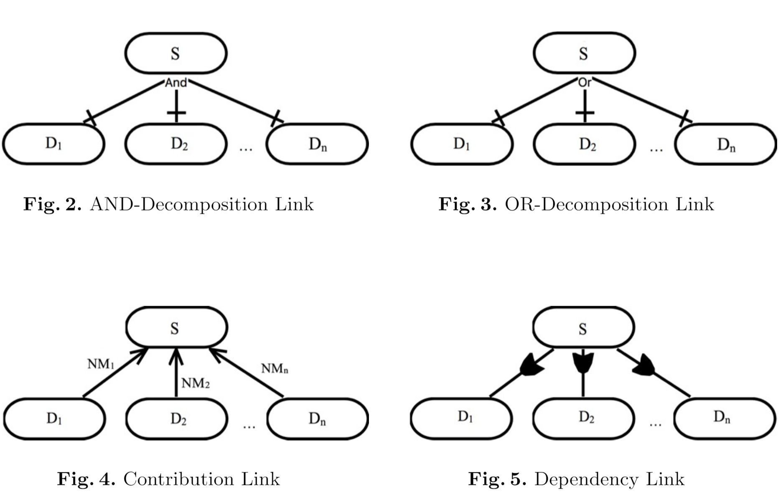
Quantitative Propagation (1)
User Requirements Notation jUCMNav Goals and Rationale GRL Basics Evaluations Examples Tools Indicators

Slide 38
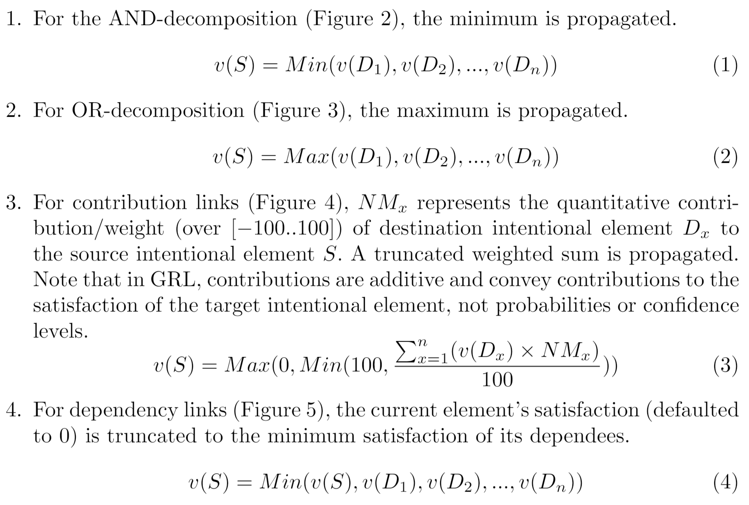
Quantitative Propagation (2): Arithmetic Rules
User Requirements Notation jUCMNav Goals and Rationale GRL Basics Evaluations Examples Tools Indicators

Slide 39
Quantitative Propagation (3): Examples
User Requirements Notation jUCMNav Goals and Rationale GRL Basics Evaluations Examples Tools Indicators
Minimum for AND, maximum for OR/IOR
Contributions are additives, but they are also normalized

Slide 40
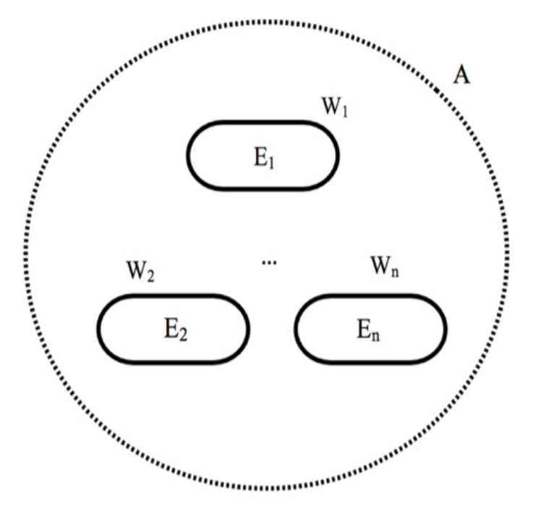
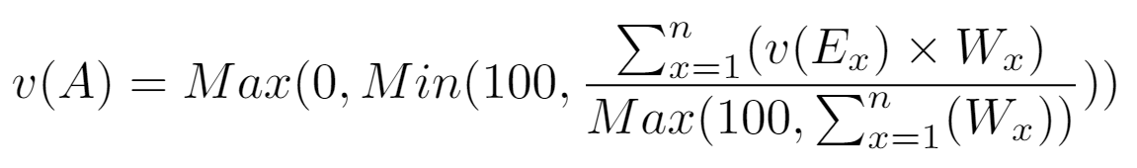
Quantitative Propagation (3): Actor Evaluation
User Requirements Notation jUCMNav Goals and Rationale GRL Basics Evaluations Examples Tools Indicators
Evaluations deal with negotiations between stakeholders
Actor evaluations help analyzing and comparing the satisfaction levels of each actor based on the selected strategy
Computed from importance attribute and (Wx) satisfaction levels of intentional element references bound to actors
Notes:
Criticality and priority is high, medium or low

Slide 41
Quantitative Propagation (5): Examples
User Requirements Notation jUCMNav Goals and Rationale GRL Basics Evaluations Examples Tools Indicators
An element cannot be
more satisfied than
another it depends on.
Actor satisfaction (A) helps understand trade-offs between strategies at that level.
Computed from importance attribute and (Wx) satisfaction levels of intentional element inside the actor
Telecom
100
Provider
Low
(44)
Cost (29)
25
100
Low
Reliability
-
Weight
(100)
75
High
Perf
(60)

Slide 42
Qualitative Propagation: AND/OR Decomposition
User Requirements Notation jUCMNav Goals and Rationale GRL Basics Evaluations Examples Tools Indicators

Slide 43
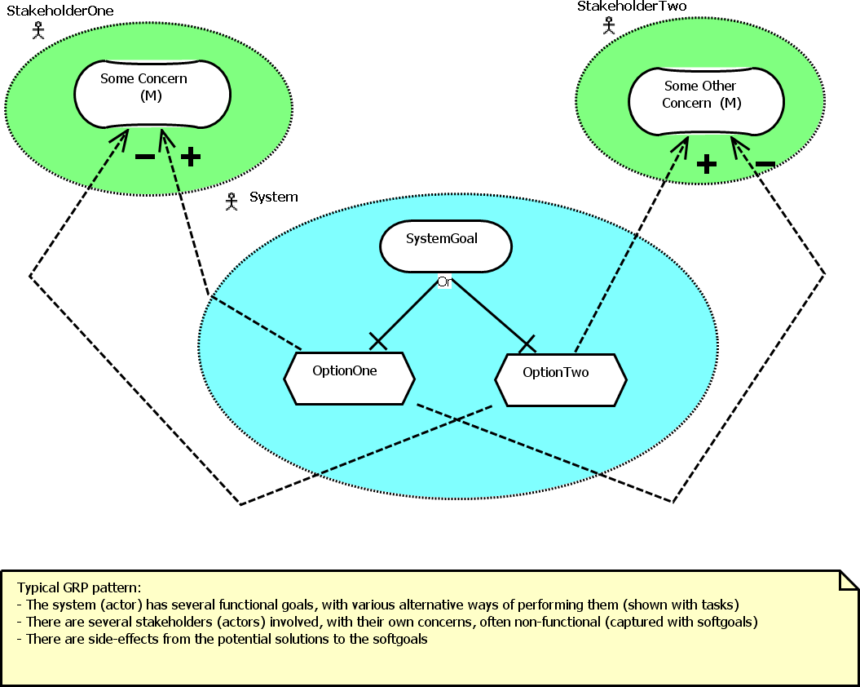
Recurring Pattern in GRL
User Requirements Notation jUCMNav Goals and Rationale GRL Basics Evaluations Examples Tools Indicators

Slide 44
GRL Example I – Context
User Requirements Notation jUCMNav Goals and Rationale GRL Basics Evaluations Examples Tools Indicators
New service for wireless network
  Where to put the service logic?
  Where to put the service data?

Slide 45
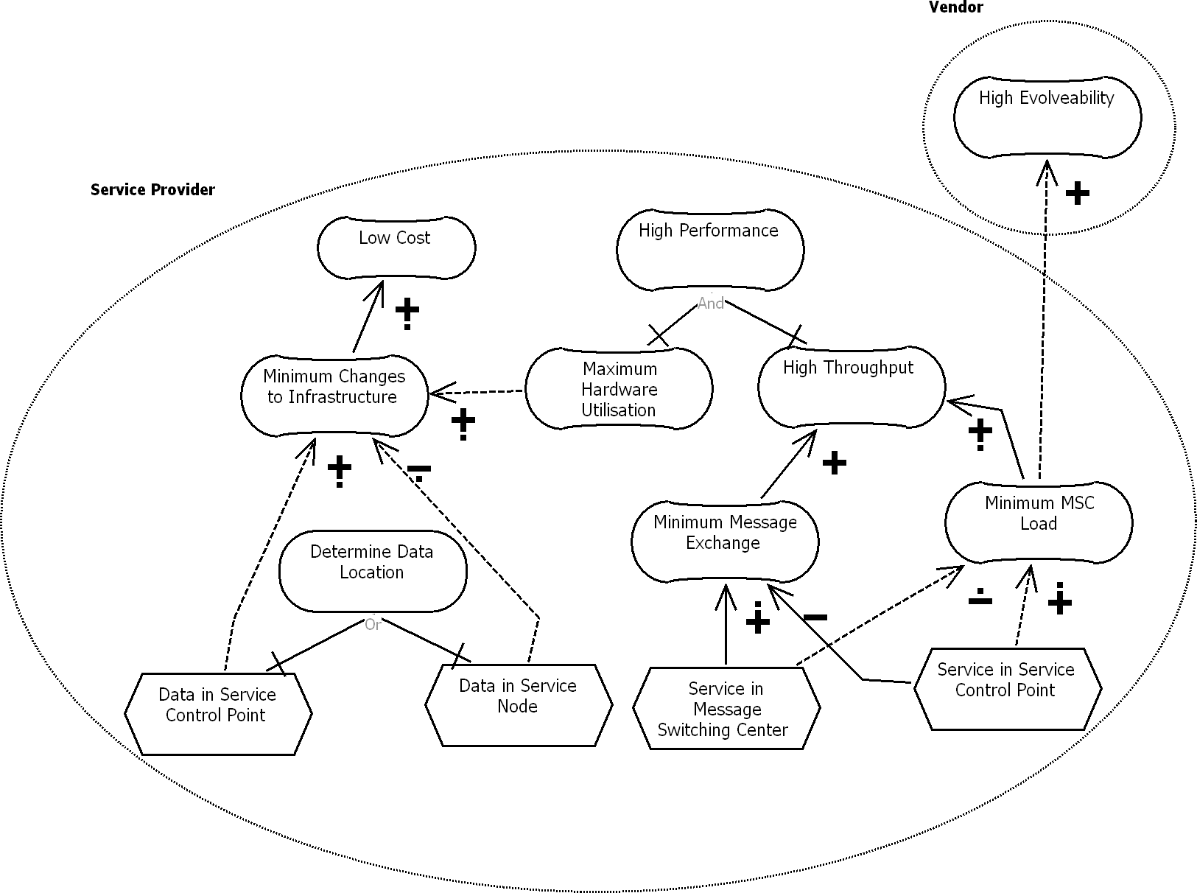
GRL Example I – Intentional Elements and Actors
User Requirements Notation jUCMNav Goals and Rationale GRL Basics Evaluations Examples Tools Indicators

Slide 46
GRL Example I – Links
User Requirements Notation jUCMNav Goals and Rationale GRL Basics Evaluations Examples Tools Indicators

Slide 47
GRL Example I – Contribution Types
User Requirements Notation jUCMNav Goals and Rationale GRL Basics Evaluations Examples Tools Indicators
Qualitative
or
quantitative

Slide 48
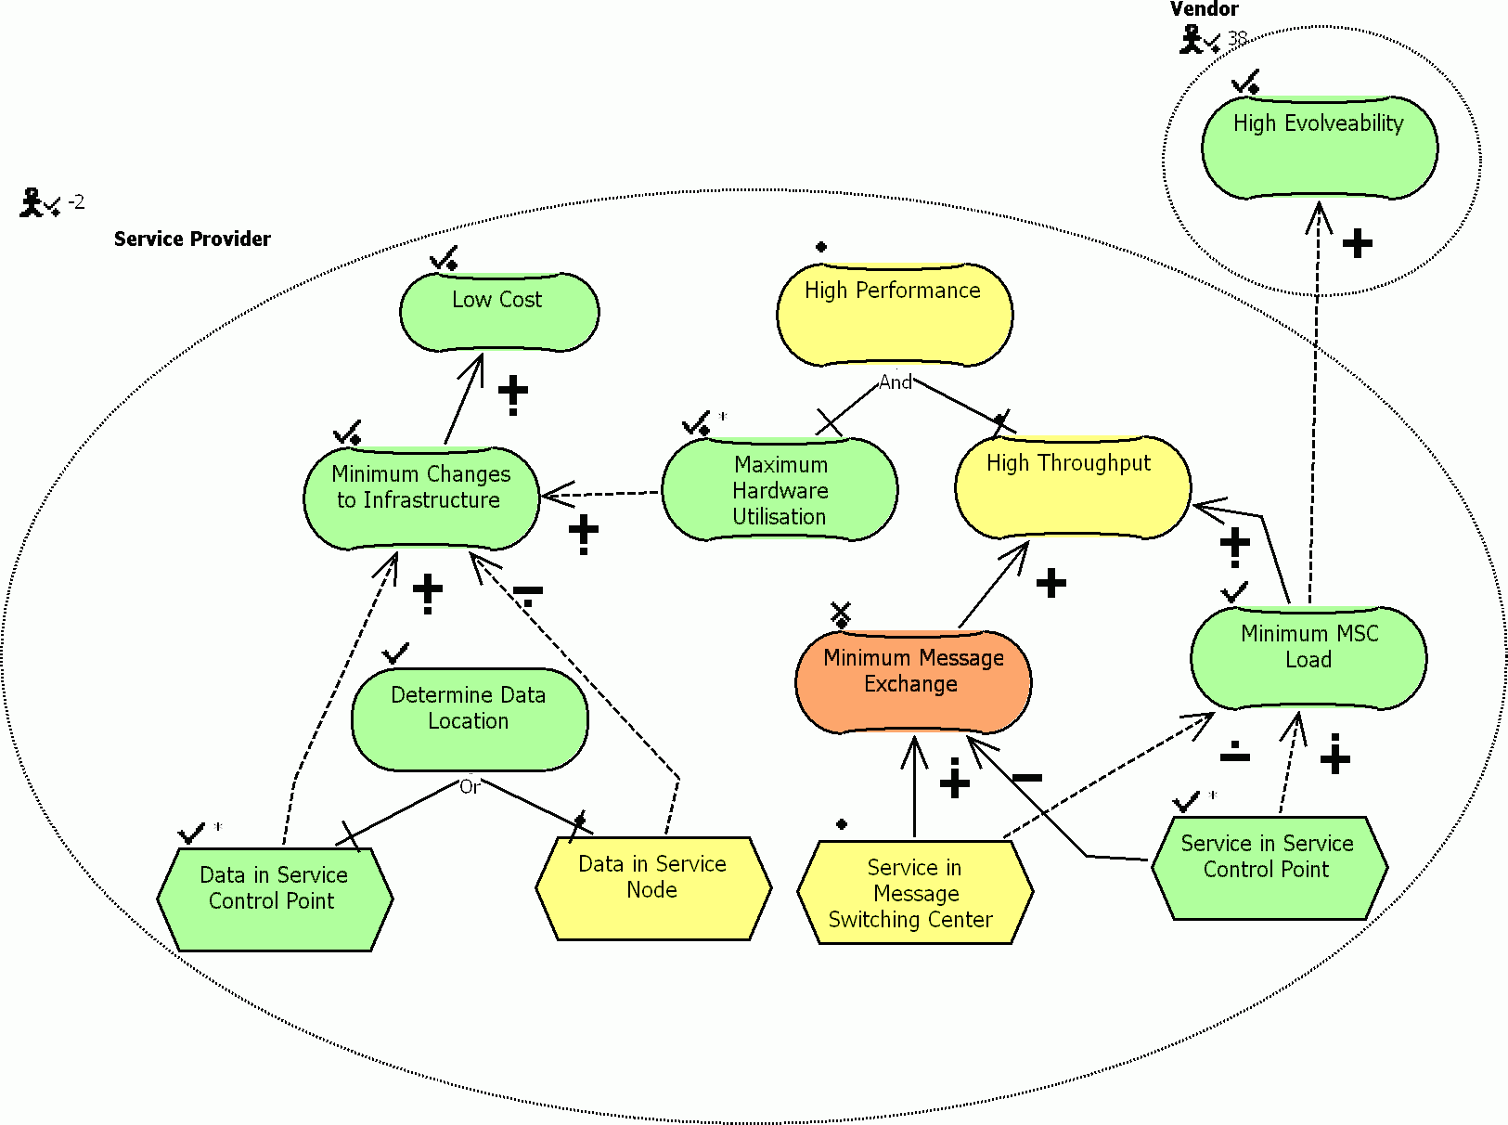
GRL Example I – Qualitative Model Evaluation
User Requirements Notation jUCMNav Goals and Rationale GRL Basics Evaluations Examples Tools Indicators

Slide 49
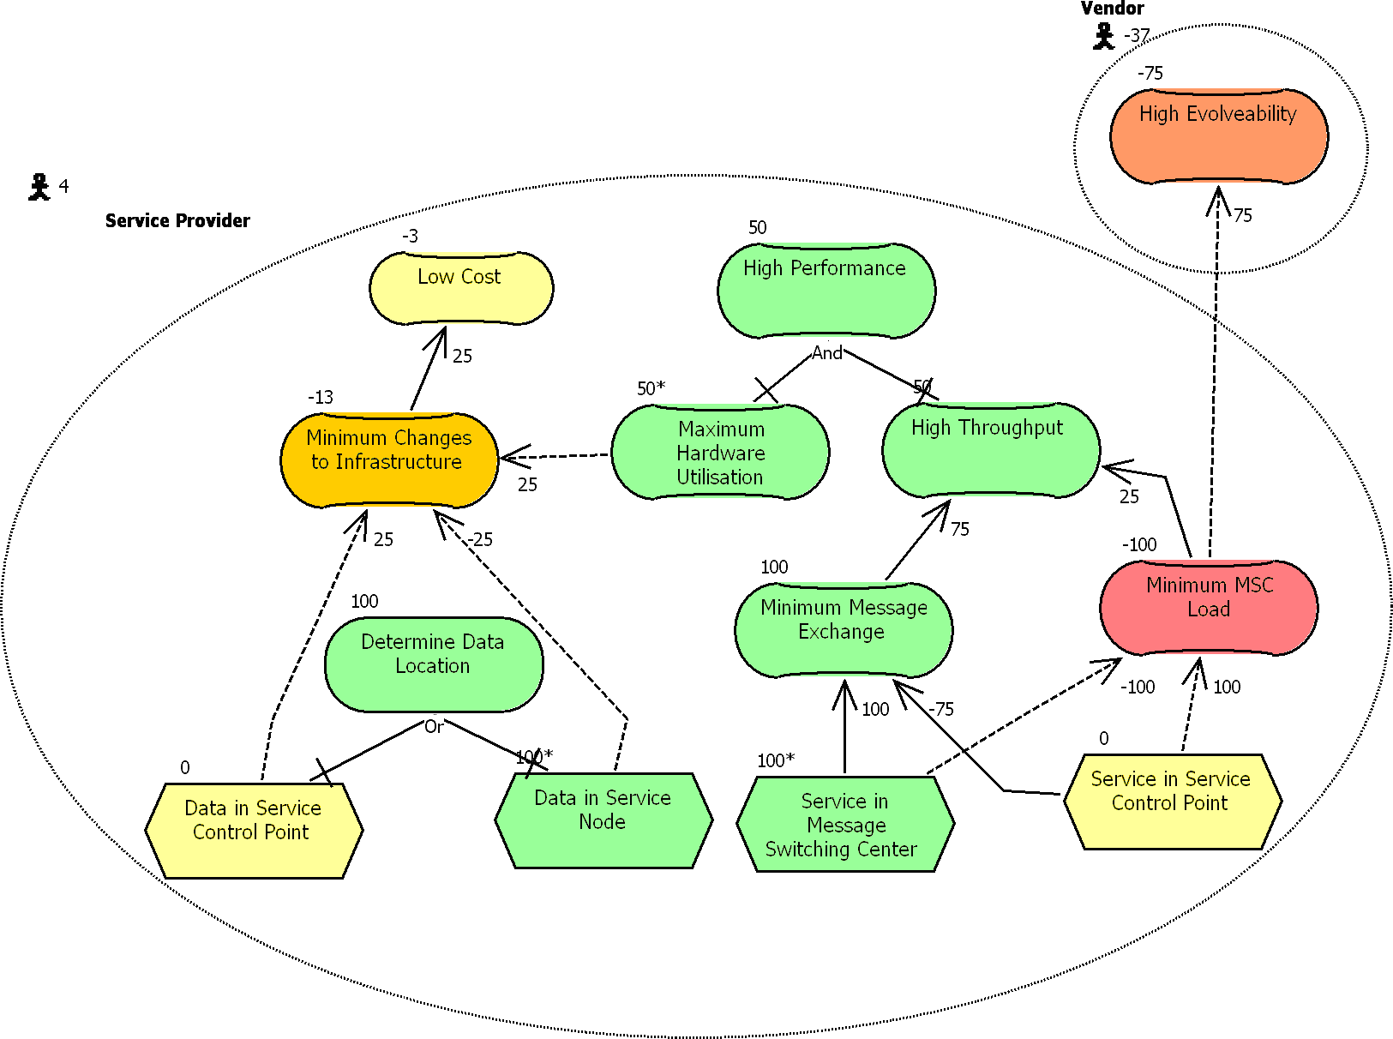
GRL Example I – Quantitative Model Evaluation
User Requirements Notation jUCMNav Goals and Rationale GRL Basics Evaluations Examples Tools Indicators

Slide 50
GRL Example II – Context
User Requirements Notation jUCMNav Goals and Rationale GRL Basics Evaluations Examples Tools Indicators
GRL model that addresses privacy protection in a hospital environment
  Researchers want access to patient data but the Health Information Custodian (HIC – i.e., the hospital) needs to protect patient privacy, as required by law (PHIPA in Ontario).
  The process of accessing databases must ensure privacy. As required by law, a Research Ethics Board (REB) is usually involved in assessing privacy risks for the research protocol proposed by a researcher.
  DB administrators also want to ensure that DB users are accountable for their acts.

Slide 51
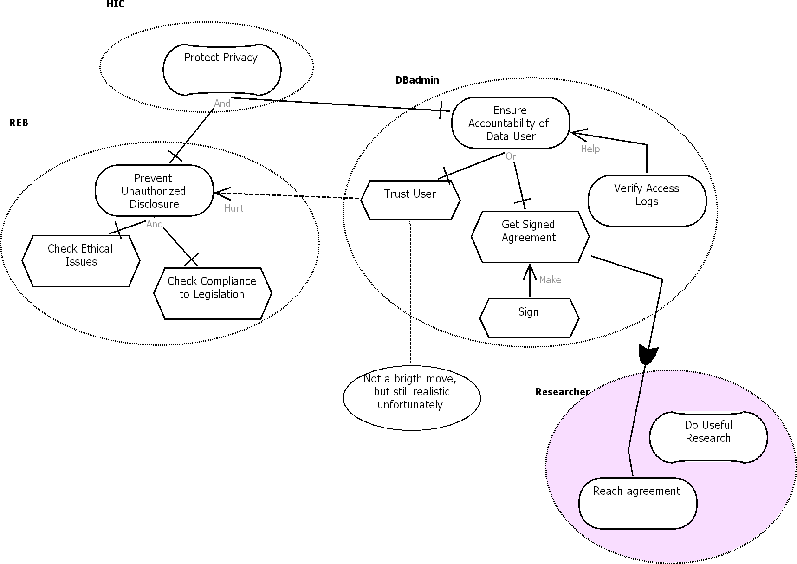
GRL Example II – GRL Model
User Requirements Notation jUCMNav Goals and Rationale GRL Basics Evaluations Examples Tools Indicators

Slide 52
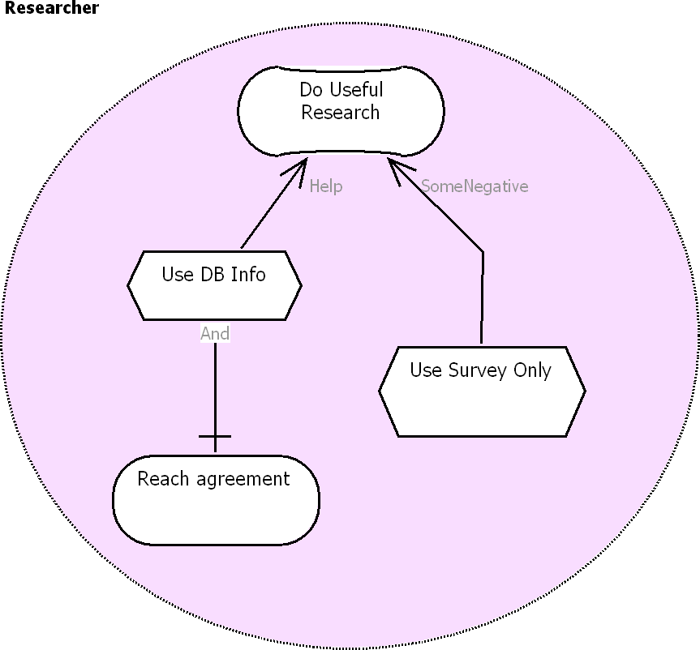
GRL Example II – One GRL Model, Many Diagrams
User Requirements Notation jUCMNav Goals and Rationale GRL Basics Evaluations Examples Tools Indicators

Slide 53
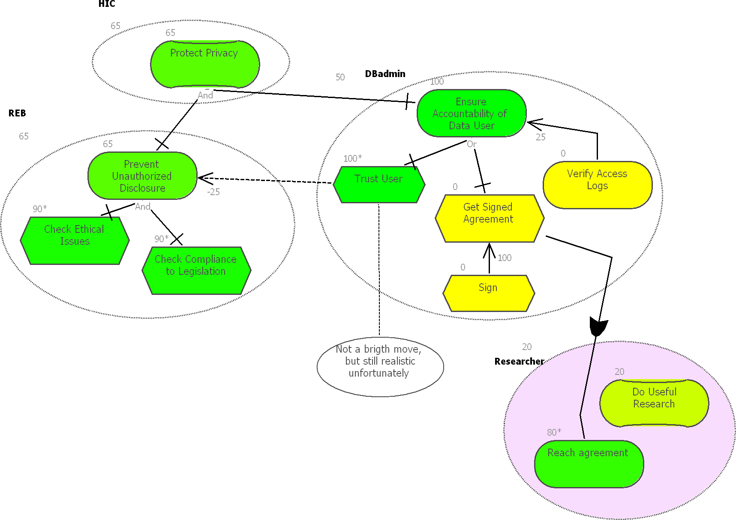
GRL Example II – Quantitative Model Evaluation
User Requirements Notation jUCMNav Goals and Rationale GRL Basics Evaluations Examples Tools Indicators
[-100, 100] scale

Slide 54
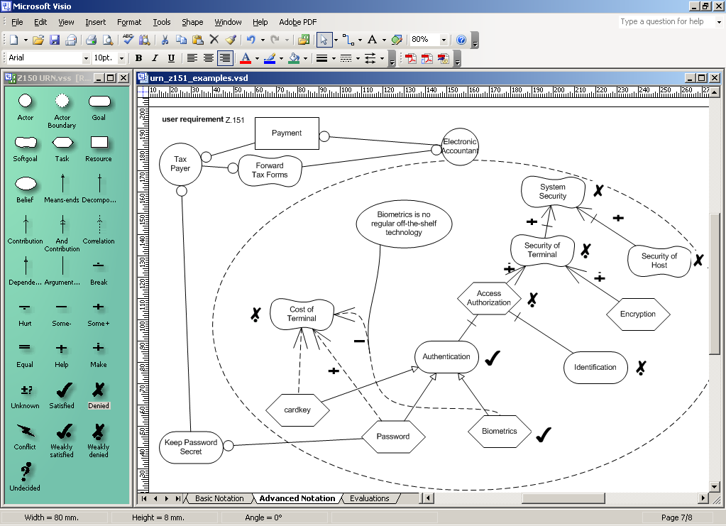
Tool Support – SanDriLa (Plug-in for Visio)
User Requirements Notation jUCMNav Goals and Rationale GRL Basics Evaluations Examples Tools Indicators

Slide 55
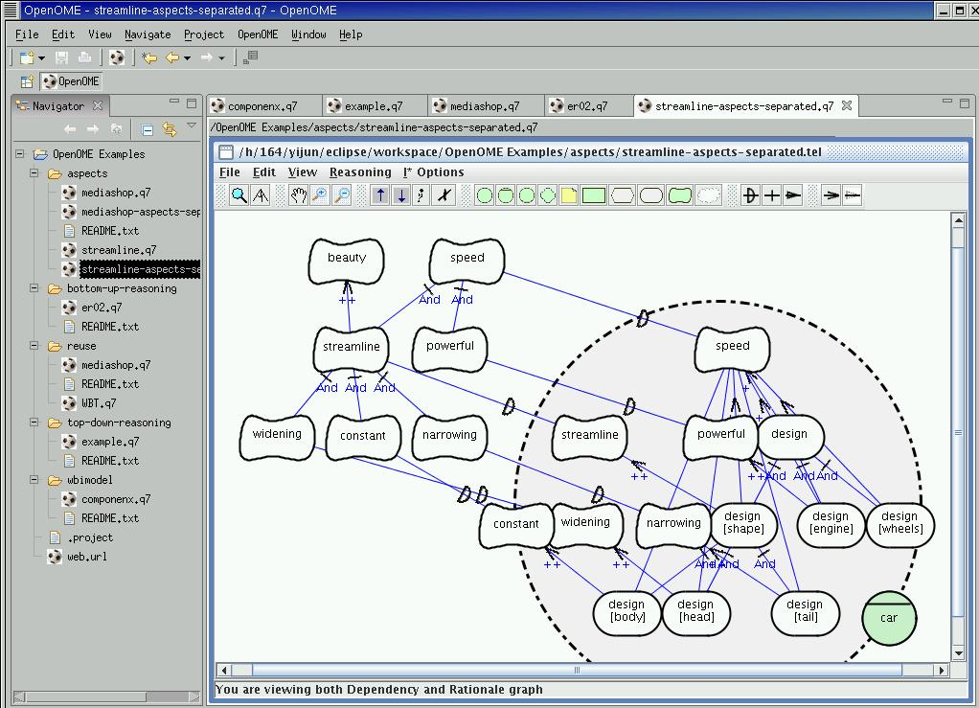
Tool – OpenOME, with Eclipse Plug-in
User Requirements Notation jUCMNav Goals and Rationale GRL Basics Evaluations Examples Tools Indicators
http://www.cs.toronto.edu/km/openome/

Slide 56
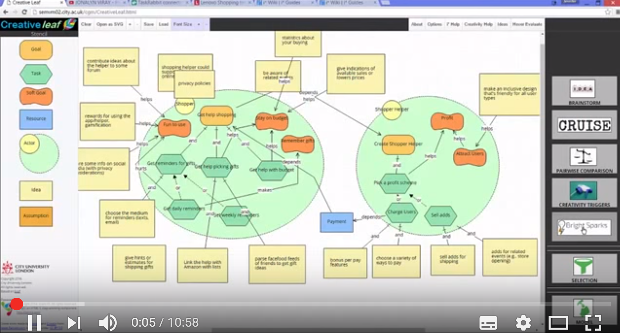
Web Tool – Creative Leaf
User Requirements Notation jUCMNav Goals and Rationale GRL Basics Evaluations Examples Tools Indicators
Online: http://semvm02.city.ac.uk/cgm/
Videos: https://www.youtube.com/channel/UCjU8aqp-93qP8DnbDKXQpMQ

Slide 57
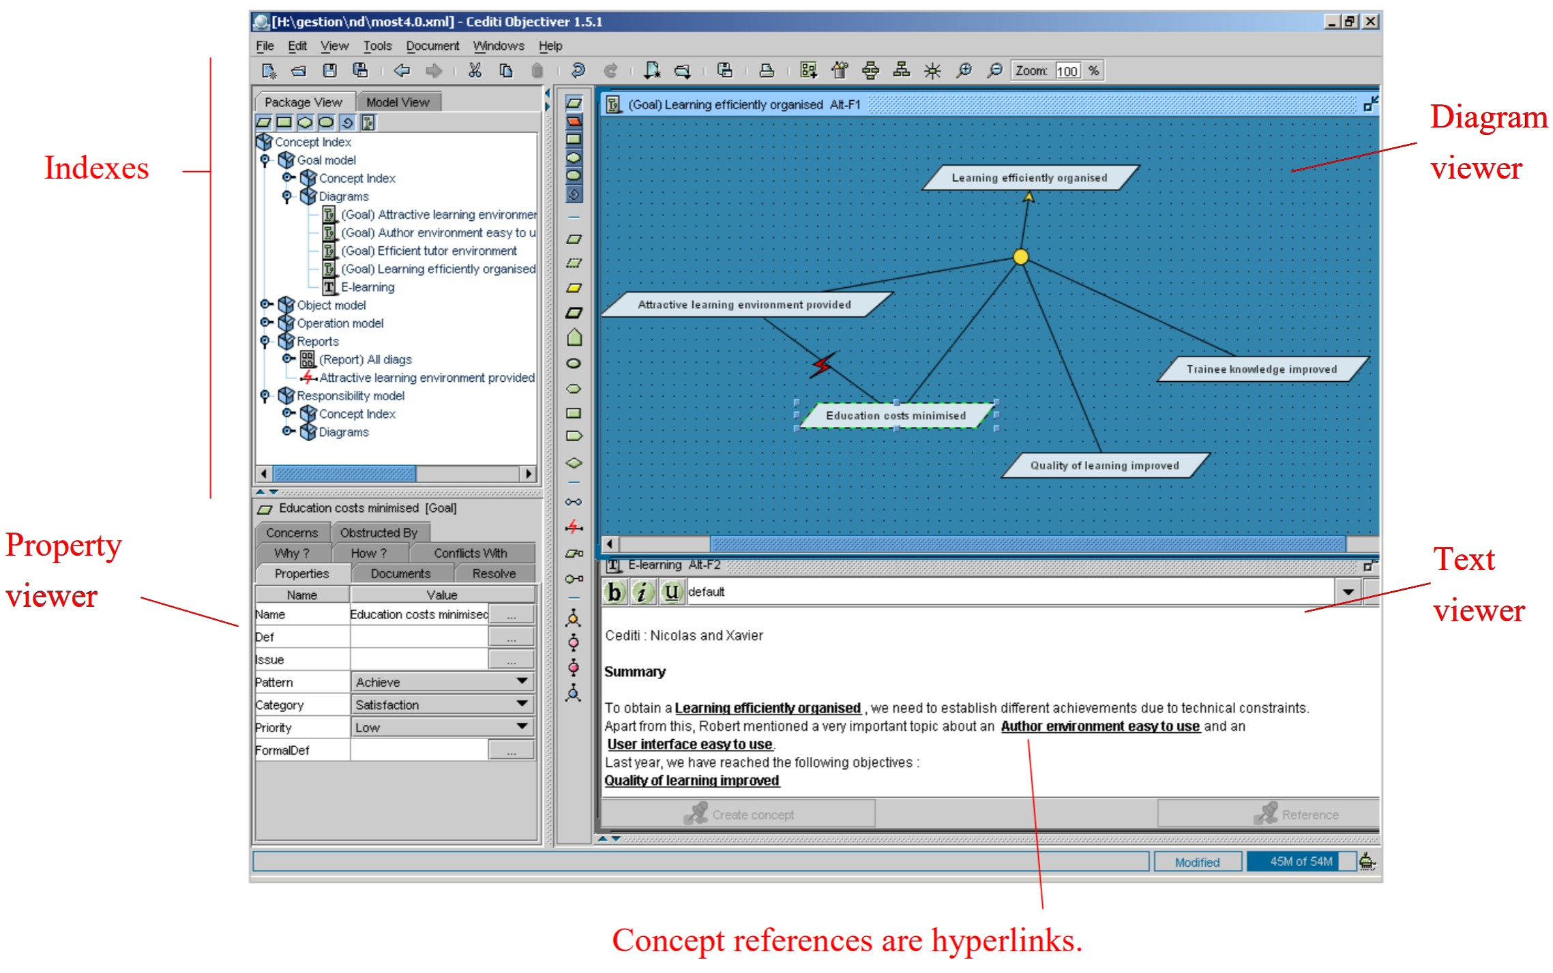
Commercial Tool: Objectiver (for KAOS)
User Requirements Notation jUCMNav Goals and Rationale GRL Basics Evaluations Examples Tools Indicators
http://www.objectiver.com/

Slide 58
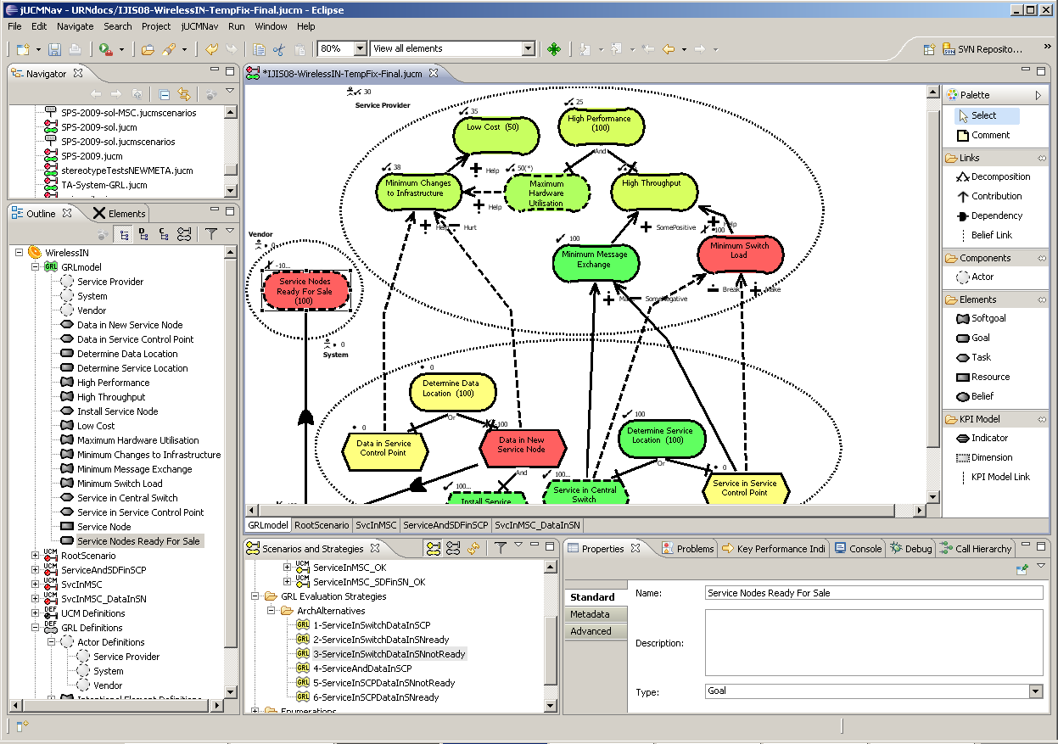
jUCMNav (Eclipse Plug-in)
User Requirements Notation jUCMNav Goals and Rationale GRL Basics Evaluations Examples Tools Indicators
Features for GRL
  7 GRL evaluation algorithms, with color highlight
  One model, multiple diagrams
  References to actors and intentional elements
    Drag&drop from outline or via properties
  Auto-layout
  Catalogues
    For exporting/importing/reusing
    common models
  Export graphics (.bmp, .gif, .jpg)
  Export strategy evaluations (.csv)
  URN links (for integration with
  UCMs)
  Export to DOORS
Toolbar
Navigator view
Editor
Outline
view
Palette
Scenarios and Strategies view
Properties
view

Slide 59
Inclusion of Measures in Goal Models
User Requirements Notation jUCMNav Goals and Rationale GRL Basics Evaluations Examples Tools Indicators
Average Work
Time (in min)
59
GRL includes a notion of goal satisfaction, with qualitative and quantitative ([-100..100], and now [0..100]) scales.
However, there is often a need to better relate observations about the real world to the goal model, with domain-specific units such as:
  Currencies (e.g., revenues in $)
  Durations (e.g., waiting time in a hospital, in hours)
  Counts (e.g., number of new students admitted in SEG)
GRL supports this kind of information, and integrates it in the rest of the goal model
  Key Performance Indicator (KPI)
KPIs help measure goals and NFRs with quantifiable metrics
GRL KPIs can also be fed from external sources of information, hence turning the GRL model into a monitoring engine (e.g., a dashboard).

Slide 60
GRL Key Performance Indicators
User Requirements Notation jUCMNav Goals and Rationale GRL Basics Evaluations Examples Tools Indicators
60
In GRL, a KPI is defined as an intentional element, but with additional characteristics
  Attributes (for a given GRL strategy)
    An evaluation value (observed, or simulated in a what-if strategy)
    A target value (the KPI is fully satisfied if the evaluation value reaches it)
    A worst-case value (the KPI is fully denied if the evaluation value reaches it)
    A threshold value (the KPI is neutral if the evaluation value equals it)
    A unit (e.g., $)
  Associations (for a given GRL model)
    Can be part of contributions or decompositions

Slide 61
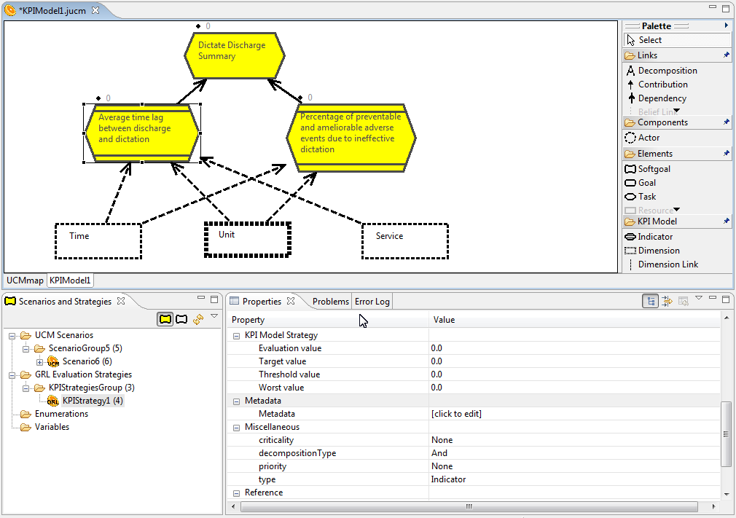
Sub-process
Performance Model
Link
KPI
Information Element
(Dimension)
KPI Value sets
Strategies
61

Slide 62
User Requirements Notation jUCMNav Goals and Rationale GRL Basics Evaluations Examples Tools Indicators
Indicators: From Current to Satisfaction Value
$1300
Principals
???
???
Staffing cost
Increased profits
50
Attribute | Value | GRL Satisfaction
Target | $1000 | 100
Threshold | $1500 | 0
Worst-case | $2500 | -100
Current | $1300 | ???
62

Slide 63
User Requirements Notation jUCMNav Goals and Rationale GRL Basics Evaluations Examples Tools Indicators
Indicators: From Current to Satisfaction Value
$1300
Principals
40(*)
20
Staffing cost
Increased profits
50
Attribute | Value | GRL Satisfaction
Target | $1000 | 100
Threshold | $1500 | 0
Worst-case | $2500 | -100
Current | $1300 | 40
63

Slide 64
From KPIs to GRL Satisfaction Levels
User Requirements Notation jUCMNav Goals and Rationale GRL Basics Evaluations Examples Tools Indicators
Note: Linear interpolation is currently being used to compute the satisfaction,
which is a function of the evaluation, target, threshold, and worst values.
64

Slide 65
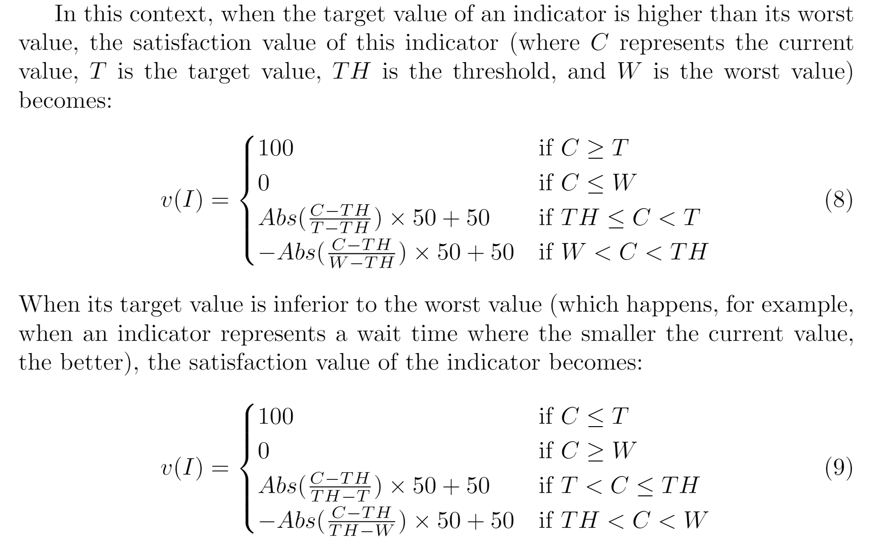
GRL Indicator Conversion for a [0..100] Scale
User Requirements Notation jUCMNav Goals and Rationale GRL Basics Evaluations Examples Tools Indicators

Slide 66
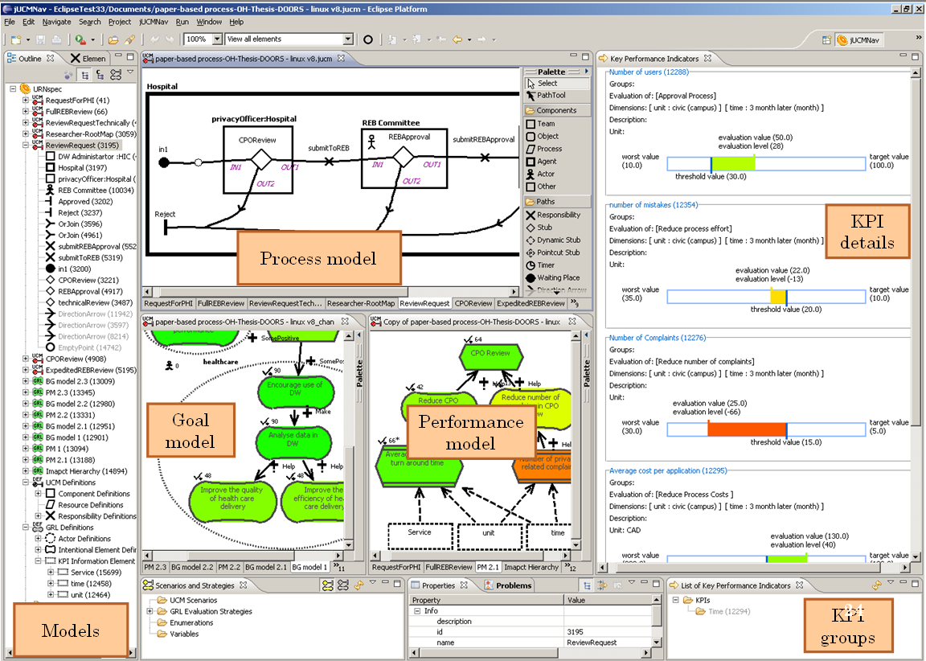
jUCMNav Extensions for KPI and Monitoring
Business Process Compliance with URN p. 66

Slide 67
KPIs: Commuting Example (from G. Mussbacher)
User Requirements Notation jUCMNav Goals and Rationale GRL Basics Evaluations Examples Tools Indicators
Example: Commuting
Commuter
Minimize time lost
by commute
Minimize cost
for commute
40
50
50
60
Work during
commute
Minimize
travel time
Minimize
infrastructure cost
Share
ongoing cost
-10
100
80
100
45
-40
-30
100
80
100
Average Travel
Time (in min)
Commuting
Monthly Infrastructure
Cost (in $)
Average Work
Time (in min)
OR
Take public
transport
Take private
transport
Average
Ongoing Cost
(in $)
OR
OR
Key Performance
Indicator (KPI)
Regular
Bus
Express
Bus
Take
own car
Hitch a
ride

Slide 68
From Real World Values to Model Values
User Requirements Notation jUCMNav Goals and Rationale GRL Basics Evaluations Examples Tools Indicators
Real World
Value
Model Value (Satisfaction Value)
Regular
Bus
Express
Bus
Take
own car
Hitch a
ride
Average Work
Time (in min)
49
29.75
4.5
4.5
Target Value (60)
Threshold Value (5)
Worst Value (0)
→
→
→
→
80
45
-10
-10
Average Travel
Time (in min)
56
52
24
24
Target Value (20)
Threshold Value (40)
Worst Value (80)
→
→
→
→
-40
-30
80
80
Monthly Infrastructure
Cost (in $)
10
10
455
140
Target Value (0)
Threshold Value (50)
Worst Value (500)
→
→
→
→
80
80
-90
-20
Average
Ongoing Cost
(in $)
68
76
120
92
→
→
→
→
Target Value (60)
Threshold Value (100)
Worst Value (200)
80
60
-20
20

Slide 69
Strategy Execution with KPIs (1/2)
User Requirements Notation jUCMNav Goals and Rationale GRL Basics Evaluations Examples Tools Indicators
Strategy “Regular Bus”:
Regular Bus = 100
Example: Commuting
40
Commuter
Commuter
20
80
Minimize time lost
by commute
Minimize time lost
by commute
Minimize time lost
by commute (100)
Minimize cost
for commute (50)
Minimize cost
for commute
Minimize cost
for commute
40
50
50
60
80
-40
80
80
Work during
commute
Work during
commute
Minimize
travel time
Minimize
travel time
Minimize
infrastructure cost
Minimize
infrastructure cost
Share
ongoing cost
Share
ongoing cost
100
100
-40*
100
100
100
Commuting
80*
Average Travel
Time (in min)
Commuting
Average Travel
Time (in min)
Average Travel
Time (in min)
Monthly Infrastructure
Cost (in $)
Monthly Infrastructure
Cost (in $)
80*
Monthly Infrastructure
Cost (in $)
Average Work
Time (in min)
OR
80*
Average Work
Time (in min)
Average Work
Time (in min)
100
0
Average
Ongoing Cost
(in $)
Average
Ongoing Cost
(in $)
Take public
transport
Average
Ongoing Cost
(in $)
Take public
transport
Take private
transport
Take private
transport
KPI “Regular Bus”:
Av. Work Time = 49→80
Av. Travel Time = 56→-40
Mo. Infrast. Cost = 10→80
Av. Ongoing Cost = 68→80
OR
OR
100*
0
0
0
Regular
Bus
Regular
Bus
Regular
Bus
Express
Bus
Express
Bus
Take
own car
Take
own car
Hitch a
ride
Hitch a
ride

Slide 70
Strategy Execution with KPIs (2/2)
User Requirements Notation jUCMNav Goals and Rationale GRL Basics Evaluations Examples Tools Indicators
Strategy “Hitch a ride”:
Hitch a ride = 100
Example: Commuting
22
Commuter
Commuter
35
-4
Minimize time lost
by commute
Minimize time lost
by commute
Minimize time lost
by commute (100)
Minimize cost
for commute (50)
Minimize cost
for commute
Minimize cost
for commute
40
50
50
60
-10
80
-20
20
Work during
commute
Work during
commute
Minimize
travel time
Minimize
travel time
Minimize
infrastructure cost
Minimize
infrastructure cost
Share
ongoing cost
Share
ongoing cost
100
100
80*
100
100
100
Commuting
-20*
Average Travel
Time (in min)
Commuting
Average Travel
Time (in min)
Average Travel
Time (in min)
Monthly Infrastructure
Cost (in $)
Monthly Infrastructure
Cost (in $)
-10*
Monthly Infrastructure
Cost (in $)
Average Work
Time (in min)
OR
20*
Average Work
Time (in min)
Average Work
Time (in min)
0
100
Average
Ongoing Cost
(in $)
Average
Ongoing Cost
(in $)
Take public
transport
Average
Ongoing Cost
(in $)
Take public
transport
Take private
transport
Take private
transport
KPI “Hitch a ride”:
Av. Work Time = 4.5→-10
Av. Travel Time = 24→80
Mo. Infrast. Cost = 140→-20
Av. Ongoing Cost = 92→20
OR
OR
0
0
0
100*
Regular
Bus
Regular
Bus
Express
Bus
Express
Bus
Take
own car
Take
own car
Hitch a
ride
Hitch a
ride
Hitch a
ride

Slide 71
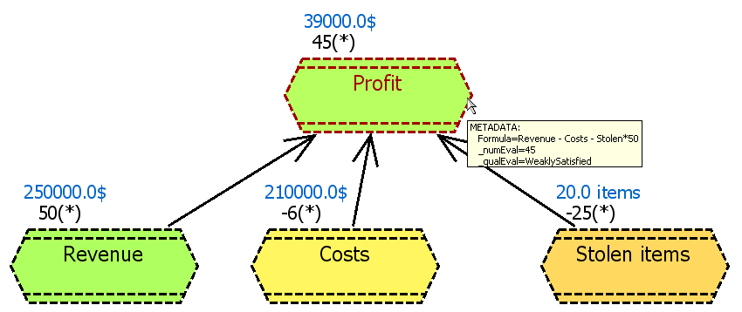
KPI Aggregation
User Requirements Notation jUCMNav Goals and Rationale GRL Basics Evaluations Examples Tools Indicators
In jUCMNav, KPI values can also be computed (aggregated) from other KPIs,
in a way similar to Excel.
Formula-based GRL evaluation algorithm
p. 71

Slide 72
Other Goal-Oriented Languages
NFR Framework (Mylopoulos et al., Toronto)
  Qualitative analysis with propagation
i* Framework (Yu et al., Toronto)
  Modelling of organizations and of actor dependencies
KAOS – Keep All Objectives Satisfied (van Lamsweerde et al., Louvain & Oregon)
  Obstacle analysis, temporal logic, and model verification
GBRAM – Goal-Based Requirements Analysis Method (Antón et al., Atlanta)
Tropos (Fuxman, Giorgini, Mylopoulos et al., Trento & Toronto)
  For multi-agent systems, security; Formal Tropos: temporal logic and model verification
SMILE – Structural Modeling, Inference, and Learning Engine and GeNie (Druzdzel et al.)
  Decision support, probabilistic approaches, Bayesian networks
BIM – Business Intelligence Model (Mylopoulos, Amyot et al., Toronto & Ottawa)
  Goals, situations and indicators
GRL is the first to be standardized
Overview: http://www.cs.utoronto.ca/~alexei/pub/Lapouchnian-Depth.pdf
Tools: http://istarwiki.org (i* Wiki)
iStar 2.0: https://sites.google.com/site/istarlanguage/home

Slide 73
Industrial Applications?
Yu, E., Amyot, D., Mussbacher, G., Franch, X., Castro, J.: Practical Applications of i* in Industry: The State of the Art. Mini-tutorial, 21th IEEE International Requirements Engineering Conference (RE 2013), Rio de Janeiro, Brazil, July 18, 2013. IEEE CS, 366-367
Alistair Mavin, Philip Wilkinson, Sabine Teufl, Henning Femmer, Jonas Eckhardt, Jakob Mund: Does Goal-Oriented Requirements Engineering Achieve Its Goal? 25th IEEE International Requirements Engineering Conference (RE 2017), Lisbon, Portugal, September 2017. IEEE CS, 174-183
  Discusses gaps between research and practice

Slide 74
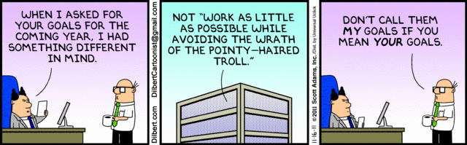
Dilbert on Goals

Slide 75
Concrete GRL Metamodel (for Diagrams)

Slide 76
Appendix: GRL Notation
Goal
Softgoal
Task
Resource
Denied
Weakly
Denied
Weakly
Satisfied
Satisfied
+
Belief
Conflict
Unknown
None
Exceeds
Indicator
Actor with Boundary
Collapsed
Actor
(c) GRL Satisfaction Levels
(a) GRL Elements
Make
Help
Some Positive
Unknown
Contribution
Dependency
Decomposition
Correlation
Means-End
Some Negative
Break
Hurt
(b) GRL Links
(d) GRL Contributions Types

Slide 77
Quiz!
Why are rationales important?
How can GRL models be superior to the use of tabular comparisons?
Is GRL better at answering “why” questions or “when” questions?
How can we define an obstacle in GRL?
What is a GRL strategy?
What is the difference between a quantitative evaluation and a qualitative one?
What are the three types of weight one can set in a GRL model?
If an evaluated GRL model returns 48 as an evaluation of an actor, is this good or bad?
Why are indicators important?
Are 100-contributions and AND-decomposition similar?

