Slide 1
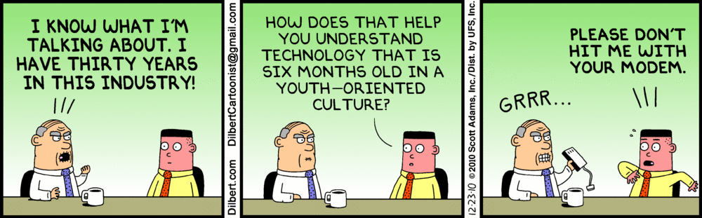
Requirements Negotiation and Triage/Prioritization
SEG3101 (Fall 2018)
http://dilbert.com/
Daniel Amyot, University of Ottawa
Based on PowerPoint slides by Gunter Mussbacher (2010-2017)
with material from:
K.E. Wiegers, D. Leffingwell & D. Widrig, I.K. Bray, B. Selic, B. Regnell
Volere, IBM, D. Damian, S. Somé 2008, D. Amyot 2008-2017

Slide 2
Requirements Negotiation (1)
Requirements Negotiation Triage and Prioritization Pairwise Comparison and AHP Tools
Possible conflicts to be resolved among stakeholders
  Conflicts related to subjects, interests, values, relationships, structure…
  Between supplier and customers about costs, benefits, risks
  Power struggle within customer organization
  Conflicts with other projects about resources (availability but also control)
  Conflicting goals, features, requirements
  Conflicting beliefs, cultures
  Misuse cases
  ...
In practice, causes are frequently intermixed.

Slide 3
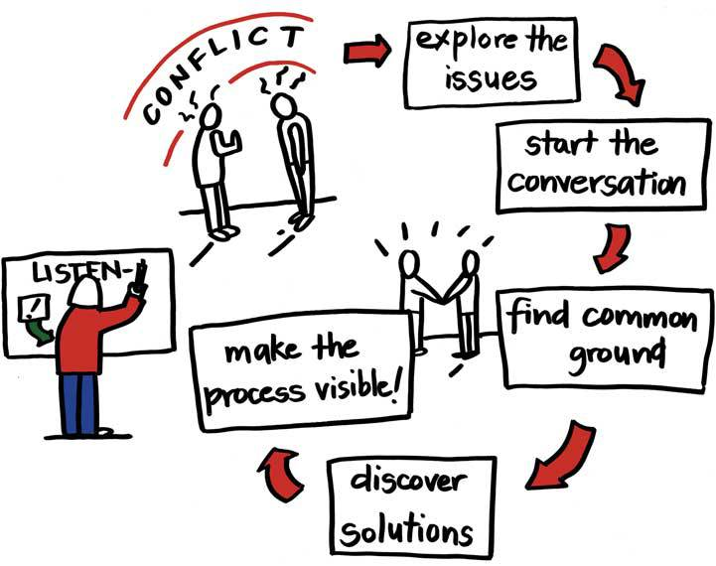
Requirements Negotiation (1)
Requirements Negotiation Triage and Prioritization Pairwise Comparison and AHP Tools
Potential resolution strategies:
  Agreement
  Compromise
  Voting
  Definition of variants
  Overruling
  Mediation
  Arbitration
  Goal analysis (think GRL!)
  Game (head or tail!)
Conflict resolution hence often involves negotiation
  Negotiating a coherent set of requirements is not easy
  But it is one task of the requirements analyst
  Difficult to satisfy everyone, to achieve all goals, make good decisions!

Slide 4
Requirements Negotiation (3)
Requirements Negotiation Triage and Prioritization Pairwise Comparison and AHP Tool
First, detect when requirements are inconsistent
Then, convince all stakeholders to understand each other’s essential point of view
  Have each party explain what they believe the other party wants and why
Reach an agreement on a coherent set of requirements that meets the needs of as many stakeholders as possible
  Analyze each party’s goals, find solutions that do not conflict but ideally support everybody’s goals
Finally, document resolution
  Stakeholders, alternatives considered, decision... Rationales and GRL!

Slide 5
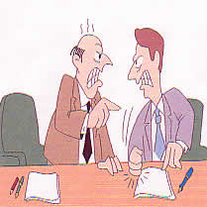
Let Schedule Drive Requirements (Not the Reverse)
Requirements Negotiation Triage and Prioritization Pairwise Comparison and AHP Tool
“It Will Take Us 9 Months”
“Okay, Here Are Our Requirements By When Can You Build Them?”
“Sorry, They Must Be Completed in 6 Months”
Typical Scenario
NOW WHAT?
Source: Davis, A.: “Just Enough Requirements Management”, Dorset House, 2005; “The art of requirements triage”, IEEE Computer, 03/2003

Slide 6

Let Schedule Drive Requirements (Better Scenario)
Requirements Negotiation Triage and Prioritization Pairwise Comparison and AHP Tool
“Let’s see. If we build reqts 1 through 9 and 12, we’ll be able to do them in 3 months”
“Okay, we’re going to build in a series of 3 month increments. Here are all the requirements.”
“But we really need reqt 17 in that first release.”
“Okay. How about if we add reqt 17 and drop reqt 12?”
Source: Davis, A.: “Just Enough Requirements Management”, Dorset House, 2005; “The art of requirements triage”, IEEE Computer, 03/2003

Slide 7
Let Schedule Drive Requirements (Better Scenario)
Requirements Negotiation Triage and Prioritization Pairwise Comparison and AHP Tool
“Well if we drop requirements 3 and 4, we could do it.”
“Hmmm. I really liked reqt 12. Can we drop reqt 3 instead?.”
“Okay”
“Okay. How about if we add reqt 17 and drop reqt 12?”
Teamwork!!!
Source: Davis, A.: “Just Enough Requirements Management”, Dorset House, 2005; “The art of requirements triage”, IEEE Computer, 03/2003

Slide 8
Difficulties (1)
Requirements Negotiation Triage and Prioritization Pairwise Comparison and AHP Tool
There are too many requirements!
From many different sources
Resources are limited (budget, time…)
Establishing priorities is important, but
  Which requirements are important, and to whom?
  How to prioritize them? On what basis? What to minimize/maximize?
  In which iteration should the requirement be considered?
Developers may not know the business value of some requirements, and clients may not know the implementation complexity of some requirements

Slide 9
Difficulties (2)
Requirements Negotiation Triage and Prioritization Pairwise Comparison and AHP Tool
Different stakeholders have different (and often conflicting) goals and different priorities
Some stakeholders’ decisions carry more weight than others
Companies often lack systematic data, metrics, and technologies to support the prioritization process
  Often done manually, informally, on an ad-hoc basis
  Difficult to establish and communicate
Attitude!
  "No need for priorities, we can do everything in the specification!“
    Yes, but when and at what cost?
  Suddenly, when the deadline is fast approaching, some requirements are put aside in order to deliver something on time...

Slide 10
Requirements Prioritization and Triage
Requirements Negotiation Triage and Prioritization Pairwise Comparison and AHP Tool
Requirements prioritization is also referred to as triage
Need to decide which requirements really matter or on those that need to be implemented in the current release
Need for compromise, negotiation, priorities
Prioritization is needed because there will almost always be the need for trade-offs (e.g., required functionality vs. time and resources)
Must help:
  Make acceptable tradeoffs among goals of value, cost, time-to-market
  Allocate resources based on importance of requirements to the project as a whole (project planning)
  Determine when a requirements should become part of the product
  Offer the right product!

Slide 11
80-20 Rule
Requirements Negotiation Triage and Prioritization Pairwise Comparison and AHP Tool
20% of functionalities provide 80% of revenues
  Think of MS Word…
The remaining 80% of functionalities offer a lower return on investment while adding delays, development costs, maintenance costs...
How to find the most useful and beneficial 20% of functionalities?

Slide 12
Which Sector Should We Focus On?
Requirements Negotiation Triage and Prioritization Pairwise Comparison and AHP Tool
A lot!
R11
R10
R6
R9
R13
R7
Value
R3
R15
R8
R14
R1
R2
R12
R4
R5
To avoid!
R16
0
Cost
A lot!

Slide 13
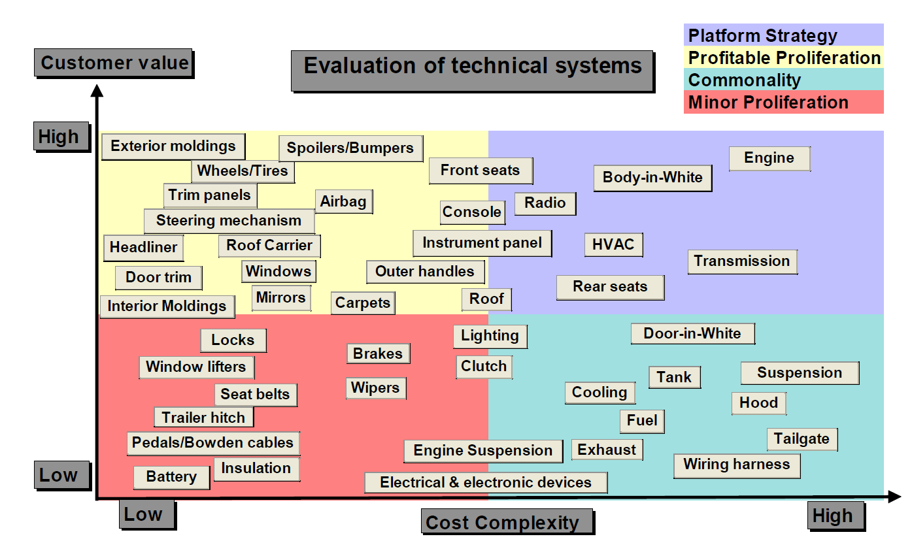
Example: Volvo Car Corporation
Requirements Negotiation Triage and Prioritization Pairwise Comparison and AHP Tool
https://gupea.ub.gu.se/bitstream/2077/1789/1/stenbeck_svensson_0304.28.pdf

Slide 14
Requirements Triage Process
Requirements Negotiation Triage and Prioritization Pairwise Comparison and AHP Tool
Must be simple and fast, for industry adoption
Must yield accurate and reliable results
Must consider issues such as
  The value of requirements to stakeholder (maximize)
  The cost of implementation (minimize)
  Time to market (to minimize)
Important to agree on requirements granularity
  E.g., use cases, features, detailed functional requirements

Slide 15
1st Technique – Prioritization Scales
Requirements Negotiation Triage and Prioritization Pairwise Comparison and AHP Tool
Determine criteria, granularity, scale dimensions
Frequently used:
  Urgency
    High (mission critical requirement; required for next release)
    Medium (supports necessary system operations; required eventually but could wait until a later release if necessary)
    Low (a functional or quality enhancement; would be nice to have someday if resources permit)
  Importance
    Essential (product unacceptable unless these requirements are satisfied)
    Conditional (would enhance the product, but the product is acceptable if absent)
    Optional (functions that may or may not be worthwhile)

Slide 16
Prioritization Based on Cost and Value
Requirements Negotiation Triage and Prioritization Pairwise Comparison and AHP Tool
Calculate return on investment by
  Assessing the value of each requirement
  Assessing the cost of each requirement
  Calculating the cost-value trade-offs
Difficulties:
  Hard to calculate absolute value/cost
  Relative value/cost figures are easier to obtain
  Interdependent requirements difficult to treat individually
  Inconsistencies or conflicts in priorities assigned by individual stakeholders

Slide 17
2nd Technique – Wiegers’ Prioritization
Requirements Negotiation Triage and Prioritization Pairwise Comparison and AHP Tool
Semi-quantitative analytical approach to requirements prioritization based on value, cost, and risk
Inspired from Quality Function Deployment (QFD)
Relies on estimation of relative priorities of requirements
  Dimensions
    Relative benefit (for having requirement)
    Relative penalty to stakeholder (if requirement is not included)
    Relative cost (to implement requirement)
    Relative risk (technical and other risks)
  Each dimension is given a value on a scale (e.g., 0..9)
  Dimensions have relative weights
Formula used to derive overall priority
  priority = (value%) / ((cost% * cost weight) + (risk% * risk weight))
Still limited by ability to properly estimate
  Requires adaptation and calibration

Slide 18
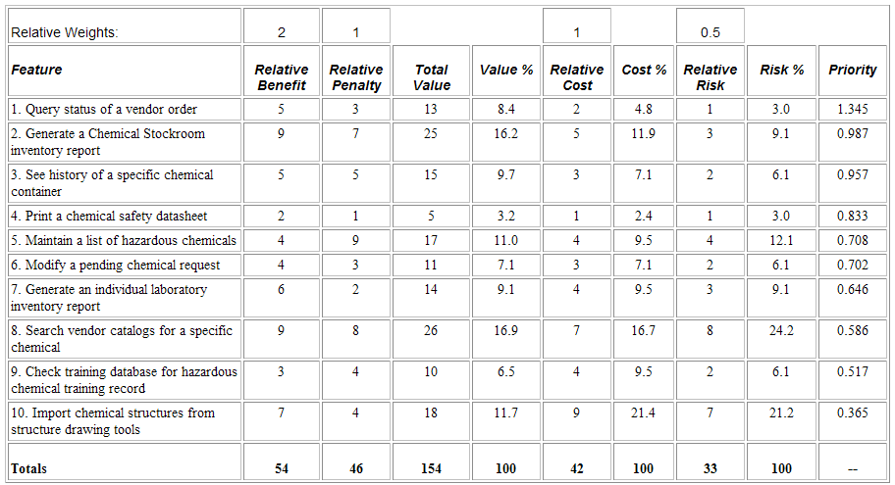
Wiegers’ Prioritization Example
Requirements Negotiation Triage and Prioritization Pairwise Comparison and AHP Tool
Chemical tracking system
Source: Wiegers, Karl E., First Things First: Prioritizing Requirements, http://www.processimpact.com/articles/prioritizing.html

Slide 19
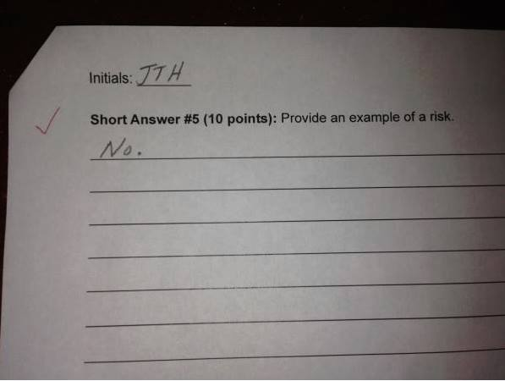
Risk Example…
Requirements Negotiation Triage and Prioritization Pairwise Comparison and AHP Tool

Slide 20

Risk
Requirements Negotiation Triage and Prioritization Pairwise Comparison and AHP Tool
ISO 31000:2009
No longer “chance or probability of loss”
→ now a risk refers to positive or negative possibilities
Identify, characterize uncertainty (threats / opportunities)
Assess susceptibility of critical assets to specific
threats / opportunities
Determine risks (i.e., potential damage|gain x
probability of occurrence)
Identify ways to reduce negative risks (mitigation)
Prioritize risk reduction measures based on a
strategy
Product or process-related risks
risk = the effect of
uncertainty on objectives

Slide 21
Another Example – Volere Prioritisation
Requirements Negotiation Triage and Prioritization Pairwise Comparison and AHP Tool
Editable Excel document
Source: Volere Prioritisation Analysis, http://www.volere.co.uk/prioritisationdownload.htm

Slide 22
Other Criteria to Consider
Requirements Negotiation Triage and Prioritization Pairwise Comparison and AHP Tool
Costs/benefits approach is good but sometimes insufficient
The following criteria are not all applicable to all projects, but they should be considered:
  Cost of implementation (how much does it cost to develop?)
  Value to customer (how much does the customer want it?)
  Time to implement (how much time does it take to deliver?)
  Ease of implementation at technical level
  Ease of implementation at the organizational level (business process)
  Value to company (how much will the business benefit?)
  Obligation to some external authority (laws, standards, patents…)
  …

Slide 23
3rd Technique: Kano Surveys
Requirements Negotiation Triage and Prioritization Pairwise Comparison and AHP Tool
The Kano Model is a method for grouping requirements based on customer perception, in order to select the requirements that deliver the greatest customer satisfaction.
Basic: requirements that the customer takes for granted
Performance: requirements that the customer specifically asked for
Excitement: requirements that the customer does not request or expect
Indifferent: requirements that the customer does not care about
Reverse: “requirements” that the customer hates

Slide 24
Questions and Answers in Kano Surveys
Requirements Negotiation Triage and Prioritization Pairwise Comparison and AHP Tool
Ask customers what their reaction would be if the requirement were included in the product (i.e., functional question)
Ask customers what their reaction would be if the requirement were NOT included in the product (i.e., disfunctional question)
The possible answers (for each) are
  I like it
  I expect it
  I am neutral
  I can tolerate it
  I dislike it

Slide 25
Conclusions from Kano Survey
Requirements Negotiation Triage and Prioritization Pairwise Comparison and AHP Tool
Customer Survey Responses |  | Disfunctional Question Answer
 |  | Like | Expect | Neutral | Tolerate | Dislike
Functional Question Answer | Like | Questionable | Excitement | Excitement | Excitement | Performance
 | Expect | Reverse | Questionable | Indifferent | Indifferent | Basic
 | Neutral | Reverse | Indifferent | Indifferent | Indifferent | Basic
 | Tolerate | Reverse | Indifferent | Indifferent | Questionable | Basic
 | Dislike | Reverse | Reverse | Reverse | Reverse | Questionable
Basic > Performance > Excitement > Indifferent > Reverse

Slide 26
4th Technique – Analytic Hierarchy Process (AHP)
Requirements Negotiation Triage and Prioritization Pairwise Comparison and AHP Tool
Developed by Karlsson and Ryan (1997) based on work by Saaty (early 1970)
  see also http://en.wikipedia.org/wiki/Analytic_Hierarchy_Process
Use cost-value diagrams to analyze and discuss candidate requirements
Useful for requirements triage and release planning (but also applicable in many other situations where complex decisions are to be made)

Slide 27
Analytic Hierarchy Process – Steps
Requirements Negotiation Triage and Prioritization Pairwise Comparison and AHP Tool
Requirements engineers check individual requirements for ambiguities, completeness…
Apply AHP’s pairwise comparison to estimate the relative value of candidate requirements
Experienced software engineers use AHP’s pairwise comparison to estimate the cost of candidate requirements
Plot these values on a cost-value diagram
Stakeholders use this diagram for analysis and to make trade-offs
http://www.youtube.com/watch?v=18GWVtVAAzs

Slide 28
Pairwise Comparisons
Requirements Negotiation Triage and Prioritization Pairwise Comparison and AHP Tool
Finding scores and weights is difficult and subjective
Potential solution: pairwise comparison
  Which requirements (A or B) is more important:
  A << < = > >> B
Benefits
  Indicates what is important to the client
  Identifies requirements of high value and low cost (priority!)
  Identifies requirements of low value and high cost (likely to be removed)
  Has already been used to assist numerous corporate and government decision makers
    Choosing a telecommunication system, formulating a drug policy, choosing a product marketing strategy

Slide 29
Analytic Hierarchy Process – Example (1)
Requirements Negotiation Triage and Prioritization Pairwise Comparison and AHP Tool

Slide 30
Analytic Hierarchy Process – Example (2)
Requirements Negotiation Triage and Prioritization Pairwise Comparison and AHP Tool
Cost-value diagram

Slide 31
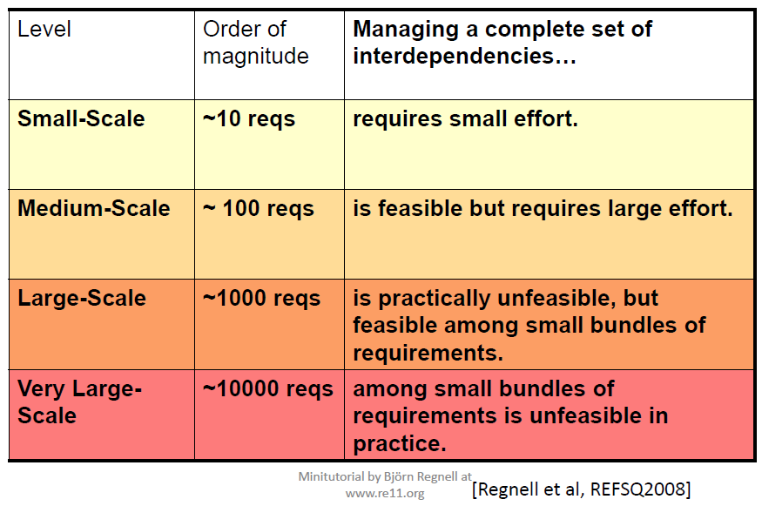
Challenge: Complexity Management!
Requirements Negotiation Triage and Prioritization Pairwise Comparison and AHP Tool

Slide 32
Pairwise Comparisons: Problems and Solutions (2)
Requirements Negotiation Triage and Prioritization Pairwise Comparison and AHP Tool
Large number of pairs – pairwise comparison can be tedious
  Solved using transitivity and other tricks!
  Mathematical optimization of the number of pairs to be considered (no need to cover all)
    If A>>B and B>>C, do we have to ask about A compared to C?
  Partial sampling (according to time/budget) can help
Many dependencies between requirements
  Can actually be used to further reduce the # of pairs
  E.g., group many requirements as features, use cases, services…
Complexity handled by grouping requirements per feature
  Fewer pairs to check; if we go from 100 requirements to compare to 10 services to compare, is this much faster?
Complexity handled by targeting questions per stakeholder
  Not all stakeholders are interested in all requirements!

Slide 33
Analytic Hierarchy Process – Stakeholders (1)
Requirements Negotiation Triage and Prioritization Pairwise Comparison and AHP Tool
Each client is unique!
Each stakeholder group may have a different weight
  Process uses a weighting criteria to consider each individual stakeholder group
Example (stakeholders M1 to M10 are different markets)
  Revenue last release
  Profit last release
  Number of sold licenses last release
  Predictions of the above criteria for the coming release
  Number of contracts lost to competitors
  Number of potential customer with nil licenses to date
  Size of total market segment
  Growth potential

Slide 34
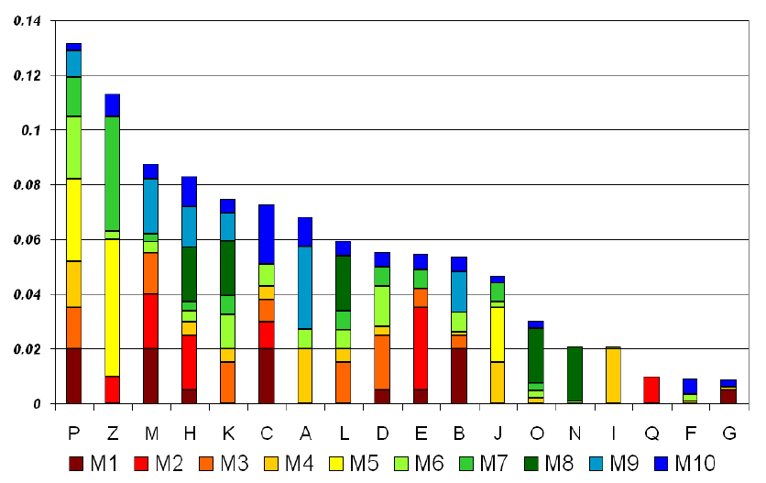
Analytic Hierarchy Process – Stakeholders (2)
Requirements Negotiation Triage and Prioritization Pairwise Comparison and AHP Tool
Before adjustment based on stakeholders importance
Source: Damian, 2005

Slide 35
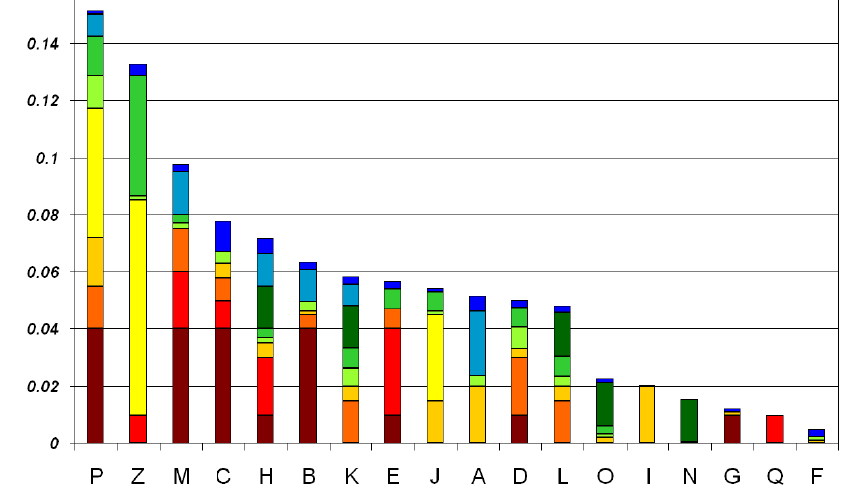
Analytic Hierarchy Process – Stakeholders (3)
Requirements Negotiation Triage and Prioritization Pairwise Comparison and AHP Tool
After adjustment based on stakeholders importance
Priorities different than before (used to be P Z M H K…)
Source: Damian, 2005

Slide 36
Example of Commercial Tool
Requirements Negotiation Triage and Prioritization Pairwise Comparison and AHP Tool
TeamBLUE Focal Point
  Decision support, portfolio management
  Pairwise comparisons of features
    Creation and validation of web questionnaires
  Dynamic algorithm for reducing the number of pairs, according to the responses
  Detection of inconsistency between the answers
  Priorities
    For different markets
  Represented in various different ways
  Integration with DOORS
  https://teamblue.unicomsi.com/products/focal-point/
  http://www.youtube.com/watch?v=V7IChf577is

Slide 37
Example of a Local Prioritization Tool
Requirements Negotiation Triage and Prioritization Pairwise Comparison and AHP Tool
Web-based survey, in two phases
  Requirements/Feature importance, scored between 1 and 10
  Imposed (or suggested) distribution curve: ask the participant to « move » requirements/features towards a higher/lower priority rank
Report per requirement/feature type, by user type, etc.
Online demo

Slide 38
References
Volere Prioritisation Analysis
  http://www.volere.co.uk/prioritisationdownload.htm
Wiegers, Karl E., First Things First: Prioritizing Requirements.
  http://www.processimpact.com/articles/prioritizing.html
Davis, A. The art of requirements triage, IEEE Computer, March 2003
Karlsson, J. and Ryan, K. A cost-value approach for prioritizing requirements, IEEE Software, Sept/Oct 1997
Regnell, B. et al., An industrial case study on distributed prioritization in market-driven requirements engineering for packaged software, Requirements Engineering 6, 51-62

Slide 39
Quiz!
Name 4 general requirements V&V techniques
When do we redo an inspection according to Fagan? Why?
Why are checklists evolving?
Name 4 conflict resolution approaches
Is it easy to determine the costs and the value of a requirement?
What is the main difficulty of an approach that uses relative priorities (on a scale of 1 to 10)?
What is the main difficulty of a pairwise comparison approach, and how can we manage it?
What approach would you take to prioritize ethical requirements for an upcoming autonomous vehicle?
  Minimize number of deaths; save children over adults; save adults over children; save women over men; save passengers over external people; save lawful people over unlawful people; …

Slide 40
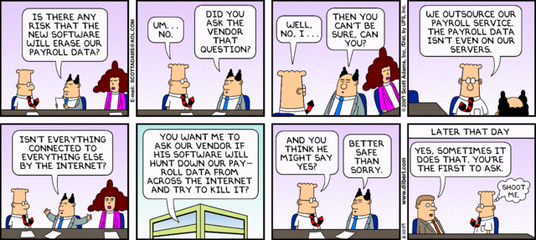
Dilbert and Verification

