Slide 1
Requirements Verification and Validation
SEG3101 (Fall 2018)
Daniel Amyot, University of Ottawa
Based on PowerPoint slides by Gunter Mussbacher
with material from:
G. Kotonya and I. Sommerville, P. Heymans, K.E. Wiegers, B. Selic,
S. Somé 2008, D. Amyot 2008-2017, G.v. Bochmann 2010, and Mussbcher 2017

Slide 2
Dilbert and Validation

Slide 3
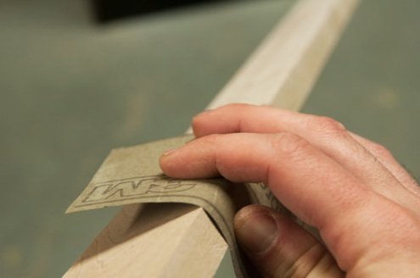
Requirements Verification vs. Validation
Introduction Simple Checks Prototyping Functional Test Design Formal V&V Reviews and Inspections
Requirements verification:
“Are we building the product right?”
Requirements validation:
“Are we building the right product?”

Slide 4
Requirements Verification and Validation
Introduction Simple Checks Prototyping Functional Test Design Formal V&V Reviews and Inspections
Requirements Verification
Check that product is being built right
Ensures that each step followed in the process of building the software is well done
Checks consistency of the software requirements specification artefacts and other software development products (design, implementation, ...) against the specification
Requirements Validation
Check that the right product is being built
Ensures that the software being developed (or changed) will satisfy its stakeholders’ real needs
Checks the software requirements specification against stakeholders goals and requirements
Both need to be performed at every stage during the (requirements) process

Slide 5
Requirements V&V vs. Requirements Analysis
Introduction Simple Checks Prototyping Functional Test Design Formal V&V Reviews and Inspections
Both have several activities in common
Reading requirements, problem analysis, meetings and discussions...
But inputs are different!
Analysis works with raw, incomplete requirements as elicited from the system stakeholders
Develop a software requirements specification document
Emphasis on "we have the right requirements"
Requirements V&V works with a software requirements specification and with negotiated and agreed (and presumably complete) domain requirements
Check that this these specifications are accurate
Emphasis on "we have the right requirements well done"

Slide 6
Various Requirements V&V Techniques
Introduction Simple Checks Prototyping Functional Test Design Formal V&V Reviews and Inspections
Simple checks
Prototyping
Functional test design
Formal V&V
Reviews and inspections
The software is done. We are just trying to get it to work…

Slide 7
Simple Checks
Introduction Simple Checks Prototyping Functional Test Design Formal V&V Reviews and Inspections
Various checks can be done using traceability techniques
Given the requirements document, verify that all elicitation notes are covered adequately
Often involves developing traceability matrices
Tracing between different levels of requirements
Checking goals against tasks, features, requirements…
Completeness and consistency checks
Verify that the requirements are well written (according to the criteria already discussed)

Slide 8
Prototyping
Introduction Simple Checks Prototyping Functional Test Design Formal V&V Reviews and Inspections
Excellent for validation by users and customers
More accessible than a long, linear specification
Demonstrates the requirements and helps stakeholders discover problems
Comes in all different shapes and sizes
From paper prototype of a computerized system to formal executable models/specifications
Important to choose scenarios or use cases for elicitation session
Good coverage, not just “playing around”

Slide 9
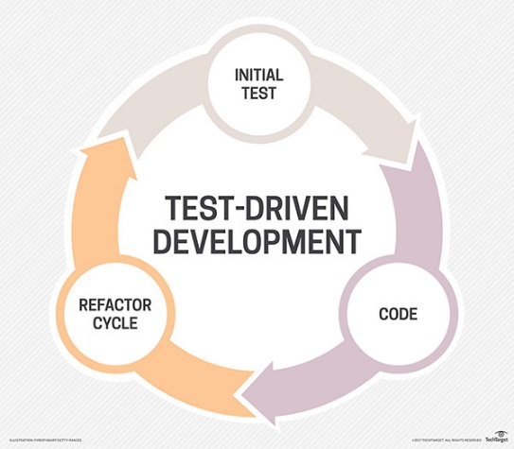
Functional Test Design
Introduction Simple Checks Prototyping Functional Test Design Formal V&V Reviews and Inspections
Functional tests at the system level must be developed sooner or later...
Tests can (and should) be derived from the requirements specification
Designing these tests may reveal errors in the specification (even before designing and building the system)!
Missing or ambiguous information in the requirements description may make it difficult to formulate tests
Some software development processes (e.g., agile methods) begin with tests before programming
Test-Driven Development (TDD) http://en.wikipedia.org/wiki/Test-driven_development

Slide 10
Formal V&V
Introduction Simple Checks Prototyping Functional Test Design Formal V&V Reviews and Inspections
Available V&V techniques vary from one modeling paradigms to another and also depend on the available tools
FSM, profiled UML, Petri nets, Z, etc.
The following functions may be provided through tools
Simulation – random or interactive
Testing – predetermined traces have to be accepted (or rejected)
Completeness checking – only according to certain syntax rules, templates
Consistency checking : given model M, show that M does not imply a contradiction and does not have any other undesirable general property (e.g. deadlock possibility, unhandled execption/message)
Refinement checking : given two models M and M’, show that the properties of M imply the properties of M’.
Model checking : given a model M and some properties P, show that any system implementation satisfying M will have the properties P.
Theorem proving: prove (through induction or other approach) the correctness and validity of theorems against a model, for all situations.

Slide 11
Formal V&V
Introduction Simple Checks Prototyping Functional Test Design Formal V&V Reviews and Inspections
Available V&V techniques vary from one modeling paradigms to another and also depend on the available tools
FSM, profiled UML, Petri nets, Z, etc.
The following may be provided for FSMs through tools
Simulation – random or interactive
Testing – predetermined traces have to be accepted (or rejected)
Completeness checking – only according to certain syntax rules, templates
Consistency checking : given model M, show that M does not imply a contradiction and does not have any other undesirable general property (e.g. deadlock possibility, unhandled execption/message)
Refinement checking : given two models M and M’, show that the properties of M imply the properties of M’.
Model checking : given a model M and some properties P, show that any system implementation satisfying M will have the properties P.
Theorem proving: prove (through induction or other approach) the correctness and validity of theorems against a model, for all situations.

Slide 12
Reviews and Inspections (1)
Introduction Simple Checks Prototyping Functional Test Design Formal V&V Reviews and Inspections
A group of people read and analyze requirements, look for potential problems, meet to discuss the problems, and agree on a list of action items needed to address these problems
A widely used requirements validation technique
Lots of evidence of effectiveness of the technique
Can be expensive
Careful planning and preparation
Pre-review checking
Need appropriate checklists (must be developed if necessary and maintained)

Slide 13
Reviews and Inspections (2)
Introduction Simple Checks Prototyping Functional Test Design Formal V&V Reviews and Inspections
A group of people read and analyze requirements, look for potential problems, meet to discuss the problems, and agree on a list of action items needed to address these problems
Different types of reviews with varying degrees of formality
Reading and approval (sign-off)
Encourages the reader to be more careful (and responsible!)
Walkthroughs
Can be led by author/expert to educate others on his/her work
Active reviews
Author asks reviewer questions which can only be answered with the help of the document to be reviewed
Formal inspections
Structured and detailed review, defined roles, preparation, etc
E.g., Fagan Inspection

Slide 14
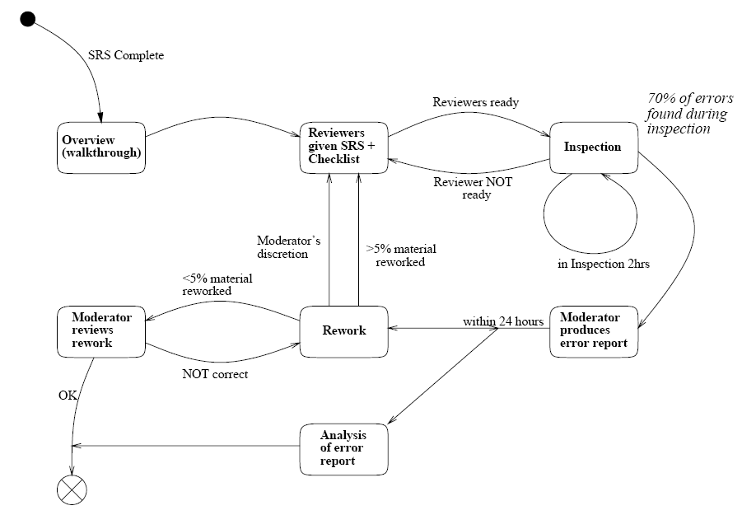
Fagan Inspection (1)
Introduction Simple Checks Prototyping Functional Test Design Formal V&V Reviews and Inspections
Formal and structured inspection process
Note: the boss is not involved in the process!

Slide 15
Fagan Inspection (2)
Introduction Simple Checks Prototyping Functional Test Design Formal V&V Reviews and Inspections
Characterized by rules on who should participate, how many reviewers should participate, and what roles they should play
Not more than 2 hours at a time, to keep participants focused
3 to 5 reviewers
Author serves as the presenter of the document
Metrics are collected
Important: the author’s supervisor does not participate in the inspection and does not have access to data
This is not an employee evaluation
Moderator is responsible for initiating the inspection, leading the meeting, and ensuring issues found are fixed
All reviewers need to prepare themselves using checklists
Issues are recorded in special forms

Slide 16
Fagan Inspection (3)
Introduction Simple Checks Prototyping Functional Test Design Formal V&V Reviews and Inspections
The inspection meeting is like a brainstorming session to identify (potential) problems
Re-inspection if > 5% of the document change
Some variants are less tolerant... too easy to introduce new errors when correcting the previous ones!
Do:
Critique the artifact
Keep review session to less than two hours
Plan time for reviews
Prioritize reviews of important issues
Keep things light
Don’t:
Attack the person
Go on for too long without adequate breaks
Skip reviews!
Use sarcasm or exaggeration
Involve the “boss”; this is not an employee evaluation

Slide 17
Review – Typical Problem Categorization
Introduction Simple Checks Prototyping Functional Test Design Formal V&V Reviews and Inspections
Requirements clarification
The requirement may be badly expressed or may have accidentally omitted information which has been collected during requirements elicitation
Missing information
Some information is missing from the requirements document
Requirements conflict
There is a significant conflict between requirements
The stakeholders involved must negotiate to resolve the conflict
Unrealistic requirement
The requirement does not appear to be implementable with the technology available or given other constraints on the system
Stakeholders must be consulted to decide how to make the requirement more realistic

Slide 18
Requirements Review Checklists
Introduction Simple Checks Prototyping Functional Test Design Formal V&V Reviews and Inspections
Essential tool for an effective review process
List common problem areas and guide reviewers
May include questions on several quality aspects of the document: comprehensibility, redundancy, completeness, ambiguity, consistency, organization, standards compliance, traceability ...
There are general checklists and checklists for particular modeling and specification languages
Checklists are supposed to be developed and maintained
See example on course website
Simple: http://site.uottawa.ca/~damyot/seg3101/notes/Inspection_checklist_Wiegers.pdf
Complex (NASA)
A few others in the private section of the Web site

Slide 19
Comments on Reviews and Inspections
Introduction Simple Checks Prototyping Functional Test Design Formal V&V Reviews and Inspections
Advantages
Effective (even after considering cost)
Allow finding sources of errors (not only symptoms)
Requirements authors are more attentive when they know their work will be closely reviewed
Encourage them to conform to standards
Familiarize large groups with the requirements (buy-in)
Diffusion of knowledge
Risks
Reviews can be dull and draining (need to be limited in time)
Time consuming and expensive (but usually cheaper than the alternative)
Personality problems
Office politics…

